Slide 1
Derelict Crab Trap Removal Program in the Pontchartrain Basin
Adam Songy
Coastal Scientist
Project Manager- Derelict Crab Trap Program

Slide 2
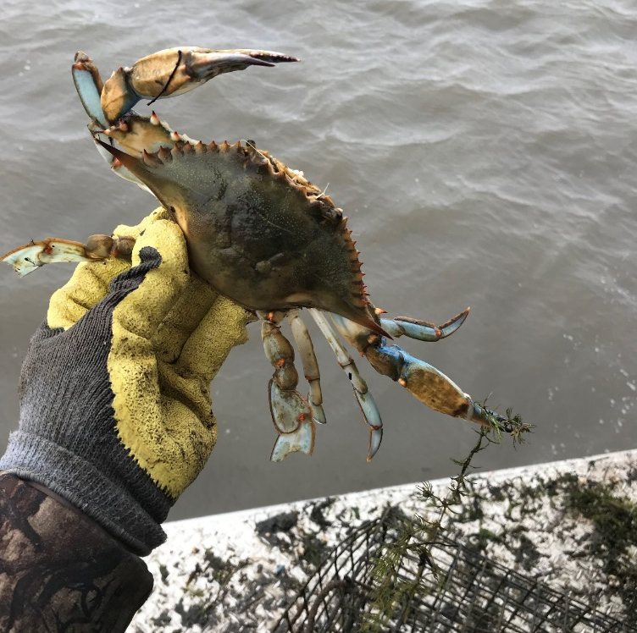
Introduction- Commercial Crab Fishery
The commercial crab fishery in Louisiana is an important fishery that primarily targets adult blue crabs (Callinectes sapidus).
Yielding an annual average of 18,600,000 kg (41,000,000 pounds) in 2013- 2016, the Louisiana blue crab fishery is frequently both the largest blue crab fishery and domestic blue crab supplier in the United States. (https://www.st.nmfs.noaa.gov/commercial-fisheries/commercial- landings/index)

Slide 3
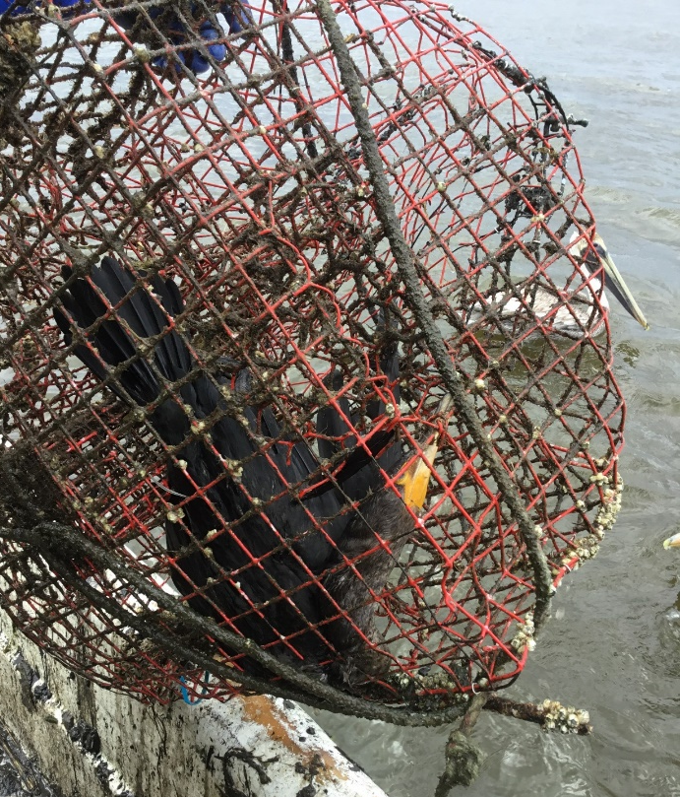
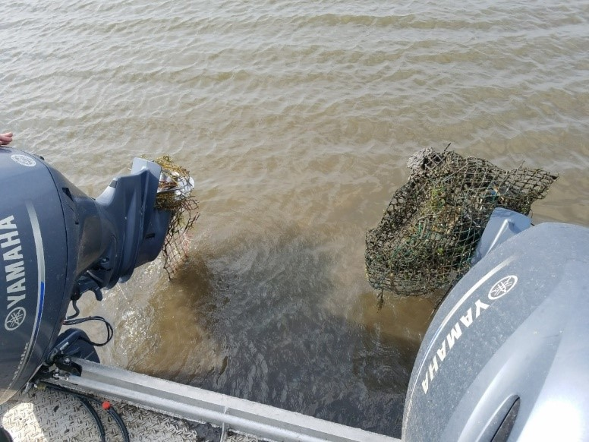
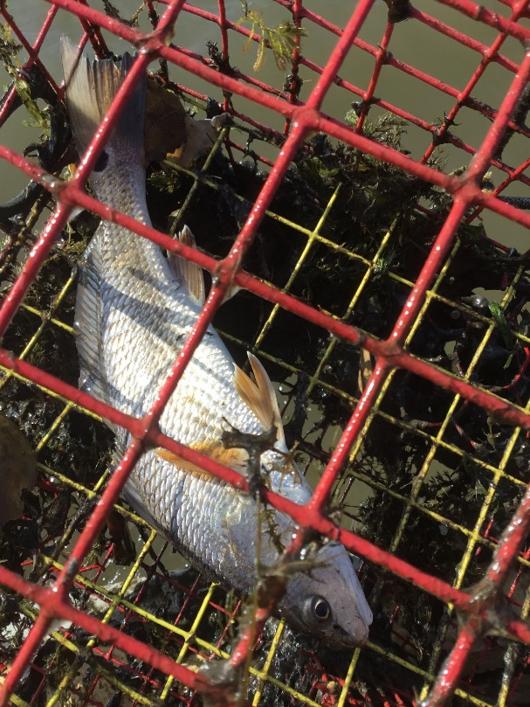
Introduction- Marine Debris
Marine debris in coastal oceans is a worldwide concern, particularly in light of increasing population and economic development.
Derelict fishing gear (DFG) is a harmful form of marine debris with negative effects. Once lost or abandoned, DFG impacts both target and non- target species and creates navigational hazards.

Slide 4
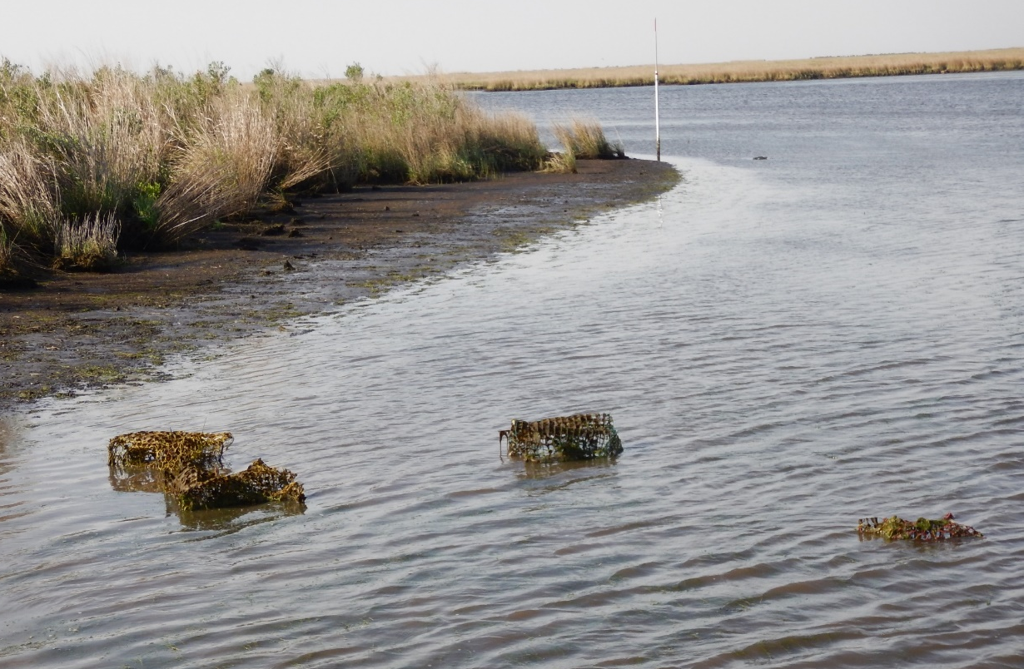
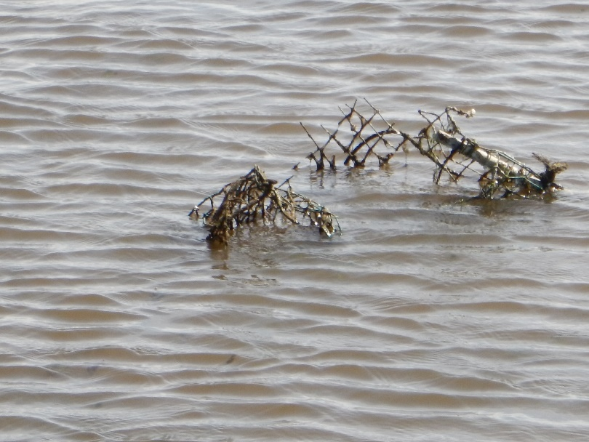
Introduction- Derelict Crab Traps
In Louisiana, derelict crab traps are a major form of marine debris, where they “ghost fish” for target and non-target species.
A lack of knowledge of the number of traps in the water, combined with the fact that crab traps are vinyl-coated (slowing degradation) make them an important and under-addressed issue for the Louisiana blue crab fishery.

Slide 5
# of Derelict Traps- Coastal Louisiana
In Louisiana, commercial crabbers can fish with an unlimited number of crab traps, and the number of traps they use is not reported, making estimates of both the number of derelict traps in Louisiana and the Pontchartrain Basin as well as their impact difficult.
As a result, the number of derelict traps in coastal Louisiana is unknown.
One estimate for the Gulf of Mexico is more than 600,000 traps, with an additional 250,000 becoming derelict every year.
Blue Crab Derelict Traps and Trap Removal Programs- Vincent Guillory et. al 2001
This same study found that Louisiana had the highest estimated loss rate (up to 100%) and number of traps per commercial license holder (250-270) among Gulf of Mexico states.

Slide 6
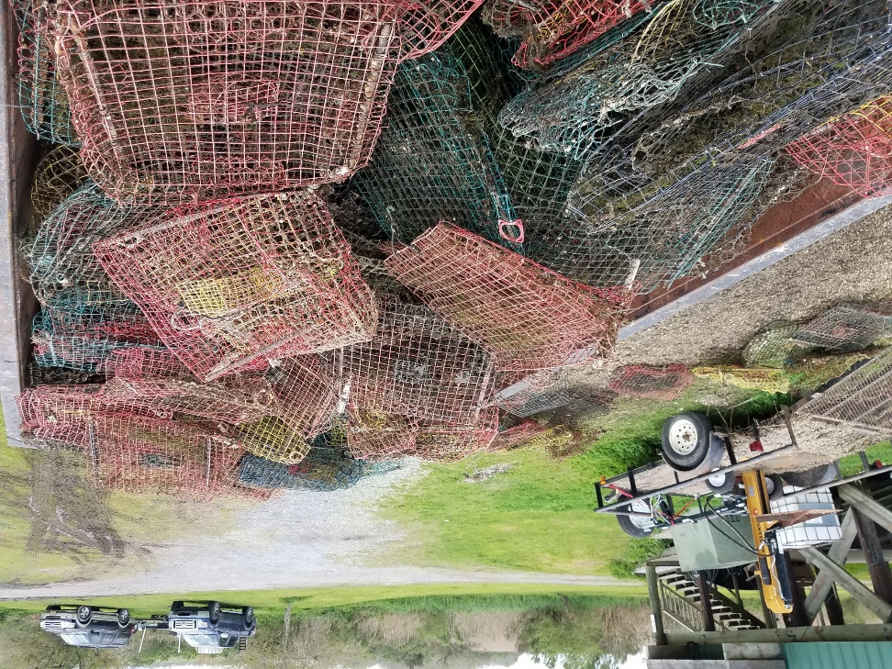
# of Derelict Traps- Coastal Louisiana
In 2017 1,458 commercial crabbers reported landings in Louisiana (pers. comm., Peyton Cagle, LDWF).
Applying the conservative Gulf-wide loss rate estimate (25%) (Guillory et al., 2001) and most recent average number of traps per license holder (460) (pers. comm., Payton Cagle, LDWF, 2017) to the number of license holders reporting landings, potentially167,670 crab traps become derelict every year in coastal Louisiana.
115 derelict traps/active license.

Slide 7
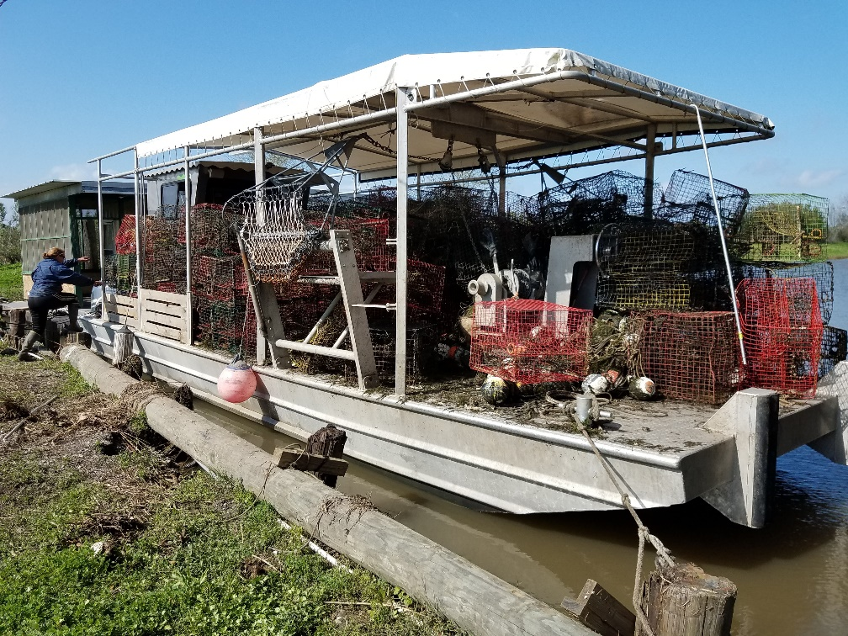
Derelict Traps and Environmental Impacts
Derelict crab traps are crab traps that have become discarded, lost, or abandoned in the marine environment.
Derelict crab traps cause a variety of problems for the coast and fisheries, as follows:

Slide 8
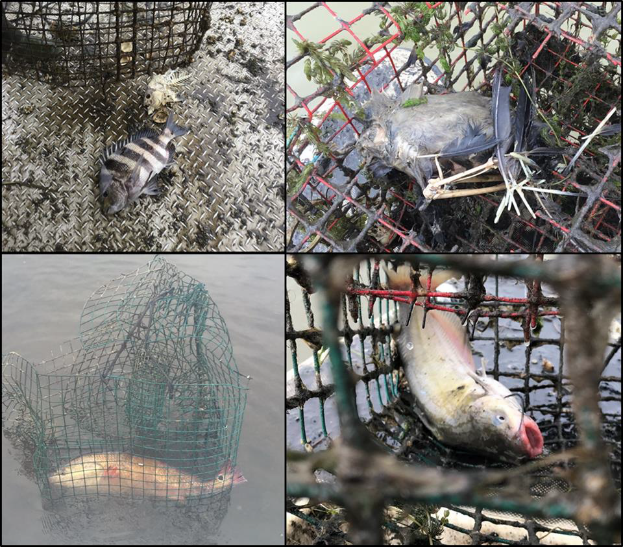
1. They continue to catch fish and crabs, and because they are not maintained the trapped organisms may eventually die in the traps, essentially rebating the trap, and attract new organisms, i.e. ghost fishing.
Organisms trapped in derelict crab traps. Clockwise from top left is a live and dead sheepshead (Archosargus probatocephalus), unknown bird remains, a channel catfish (IIctalurus punctatus), and a redfish (Sciaenops ocellatus). The photo of the redfish is courtesy of Dave Best

Slide 9
2. Float lines are a navigational hazard (especially on older gear which is less visible due to algae or barnacle growth).
3. They are a hazard to boat props for recreational fishers in shallow water, especially with severed float line.
4. They impact commercial shrimp fishing by disrupting work, damaging nets, and reducing catch. This impact is a long-term effect because highly degraded traps remain a hazard to nets, becoming more “Velcro-like” and more hazardous to nets over time.
5. They increase the cost to crabbers of maintaining catch levels due to the competition of derelict traps.

Slide 10
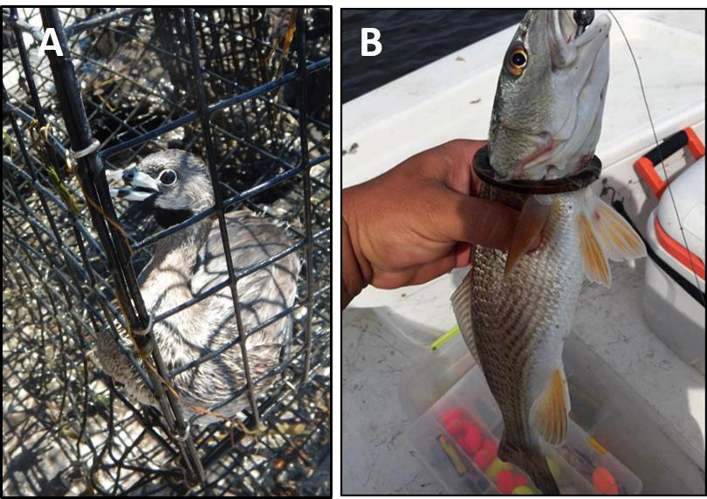
6. When washed ashore, they trap birds, raccoons and other marsh animals
7. Even once disintegrated, derelict crab trap components (such as escape rings) can entrap or entangle fish and birds
A: A Pied-billed Grebe released from a derelict crab trap in Delacroix, 2018.
B: Redfish stuck in an escape ring (component of a crab trap).

Slide 11
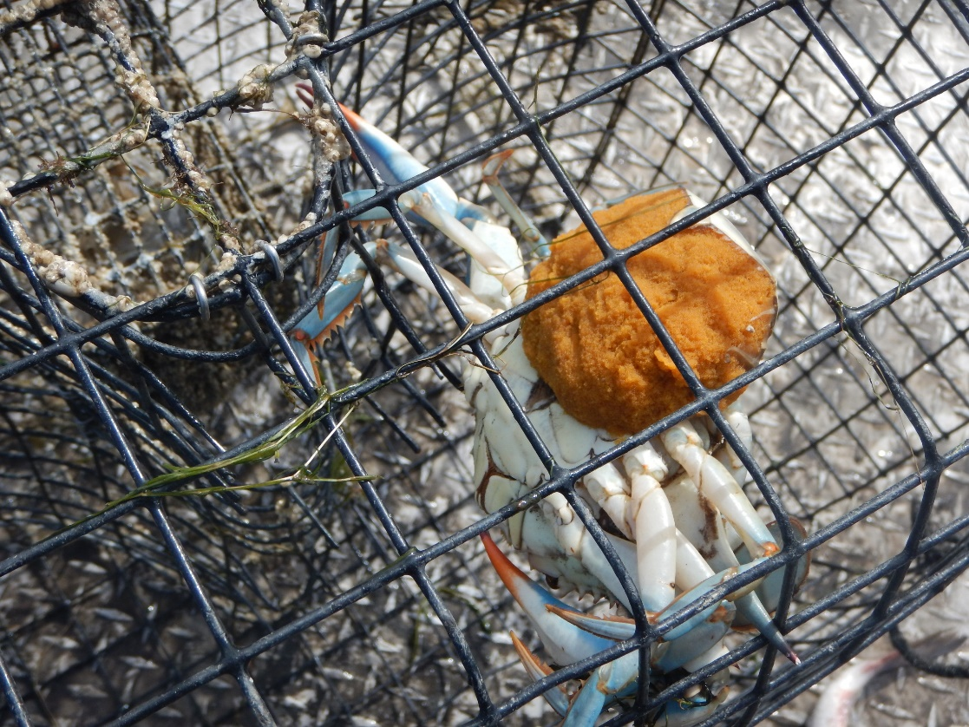
Ghost Fishing
A major effect of derelict traps is “ghost fishing” or continued capture of crabs and fish without fishers’ maintenance or baiting of traps.
Ghost fishing can be a long-term problem because crab traps may take up to nine years to degrade to the point where they no longer ghost fish.
Ghost Fishing in the Southeast Alaska Commercial Dungeness Crab Fishery- Maselko et al., 2013

Slide 12
Ghost Fishing
Guillory (1993) found that an average of 25.8 crabs die per trap per year in a study in Terrebonne Parish, Louisiana.
Ghost fishing by blue crab traps- Guillory, V. (1993).
In 2012 alone it was estimated that 12 million crabs (~10% of the commercial catch reported in 2012) were lost due to crab traps that became derelict.
Ghost fishing activity in derelict blue crab traps in Louisiana- Anderson & Alford, 2014

Slide 13
Ghost Fishing
Though the bait in crab traps may only last a few days, un-baited crab traps can still effectively trap blue crabs.
A crab trap can become re-baited by attracting fish that get trapped and die in the derelict trap.
Many fish, such as sheepshead and catfish, forage on organisms such as blue crabs, bivalves, and barnacles that adhere to the traps.
While foraging on these organisms, a sheepshead or catfish may become trapped and eventually die in the crab trap, thus rebaiting the trap repeatedly.
Many different species of fish, birds, and mammals have been observed dead in crab traps; sheepshead was identified as the most common in a yearlong study within coastal Louisiana (Guillory, 1993).

Slide 14
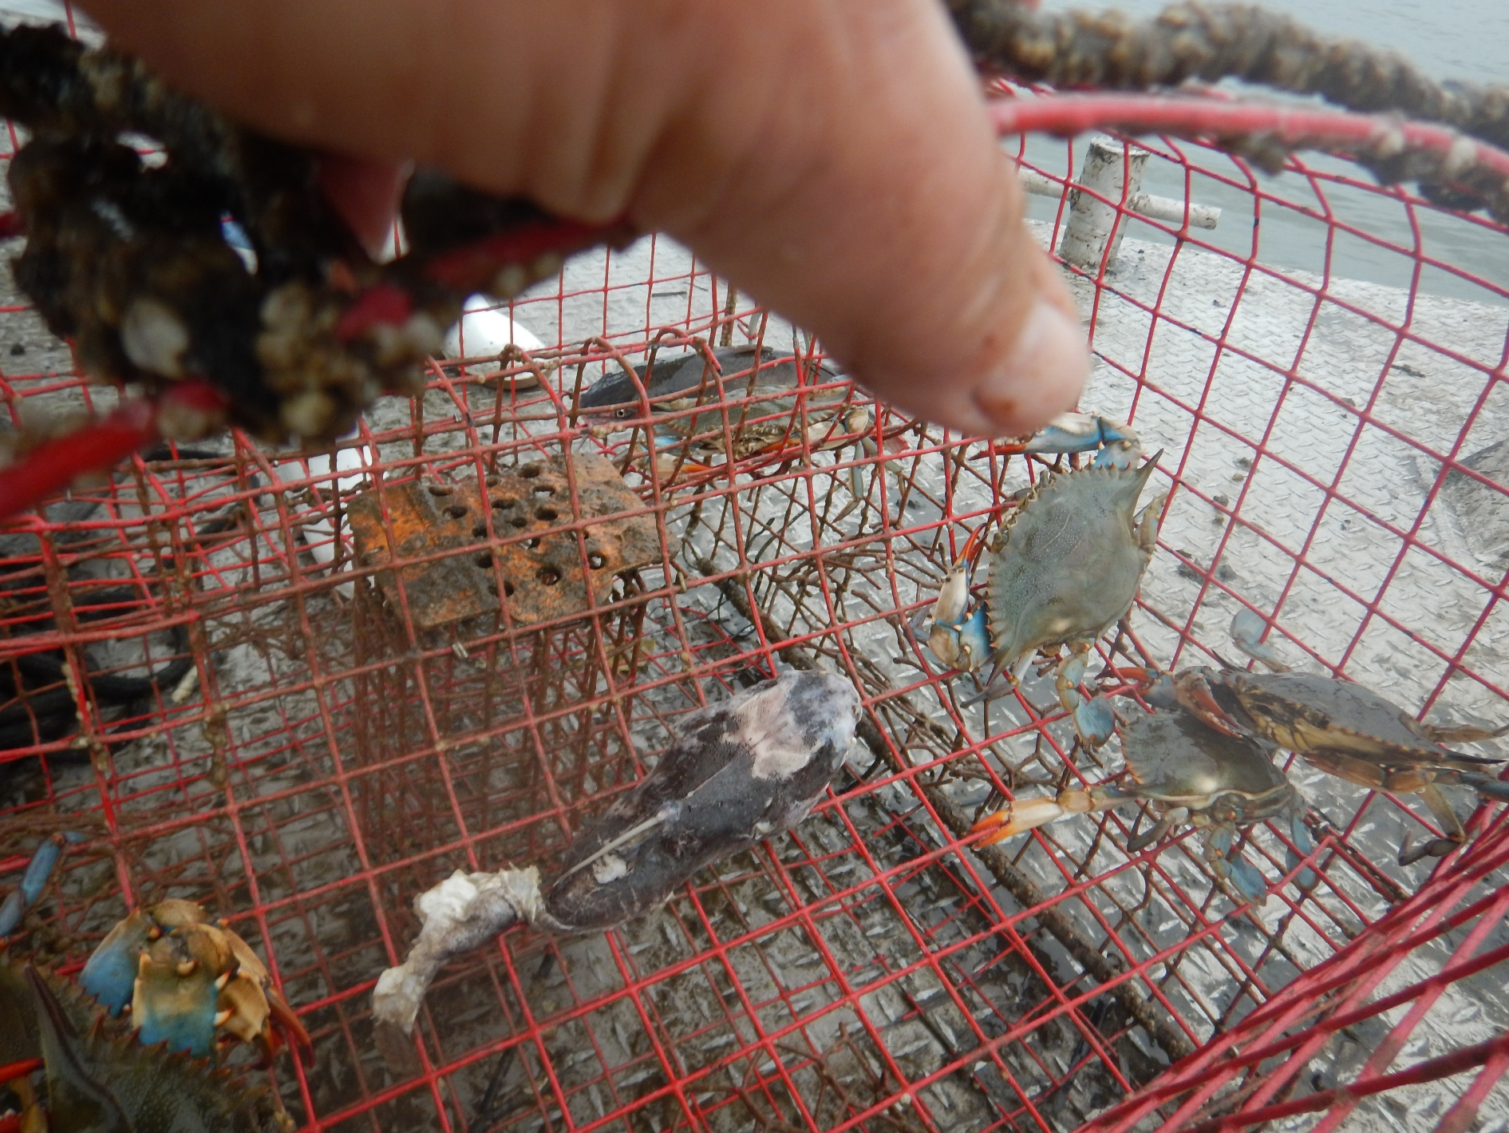

Slide 15
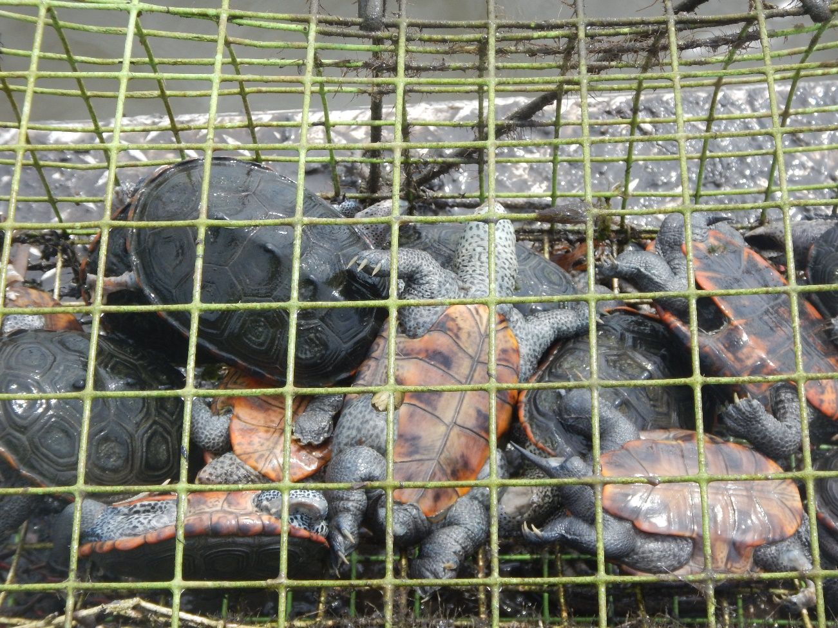

Slide 17
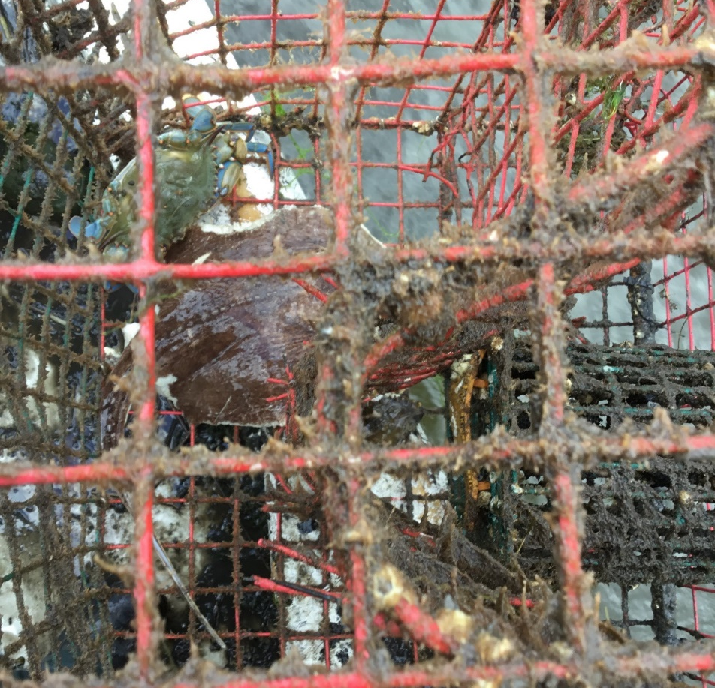
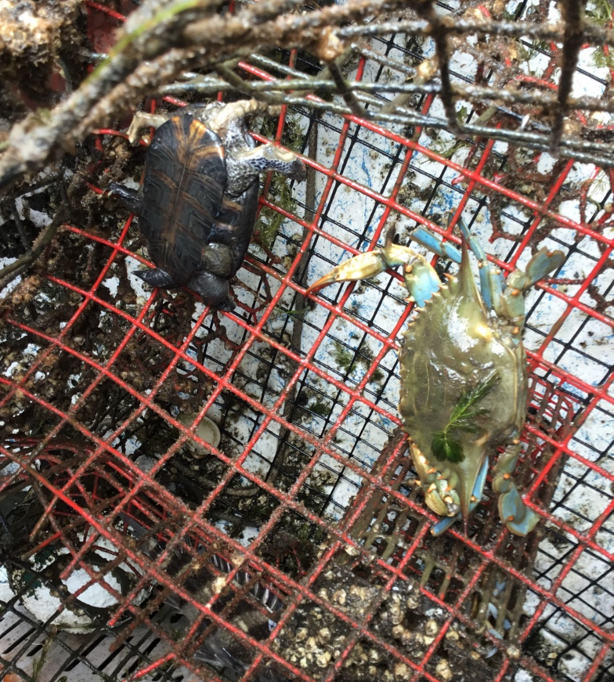
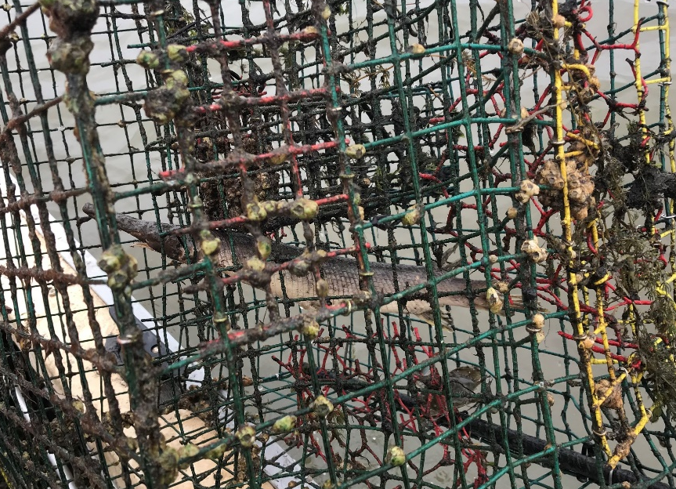

Slide 18
Ghost Fishing
LPBF has observed 28 species of bycatch during our derelict crab trap removals, including fish, reptiles, and birds .
Species Observed as Bycatch in Derelict Crab Traps
Common | Occasional | Rare
Sheepshead | Striped Mullet | Largemouth Bass
Redear Sunfish | Blue Catfish | Goby
Bluegill | Flathead Catfish | Sea Robin
Oyster Toadfish | Channel Catfish | Pinfish
Redspotted Sunfish | Gar | Eel
 | Black Drum | Flounder
 | Red drum | Spotted Seatrout
 | Stone Crab | Stingray
 | Mud Crab | Striped Bass
 | Diamondback Terrapin Turtles | Otter
 |  | Cormorant
 |  | Grebe
 |  | Red-winged blackbird

Slide 19
Derelict Crab Trap Rodeo (DCTR)
The Derelict Crab Trap Rodeo (DCTR) program was initiated in 2004 by the Louisiana Department of Wildlife and Fisheries (LDWF) to remove derelict traps and to reduce their environmental and economic impacts.
The LWFC dictates a closure area for derelict crab trap removal within Louisiana state water bottoms. Typically a closure lasts up to 16 days in February and March.
All traps inside of closure area are deemed derelict.
During these closures LDWF personnel as well as organizations or volunteers with the approval of LDWF are allowed to retrieve, crush, and dispose of derelict traps.

Slide 20
Derelict Trap Removal in the Pontchartrain Basin: 2019

Slide 22
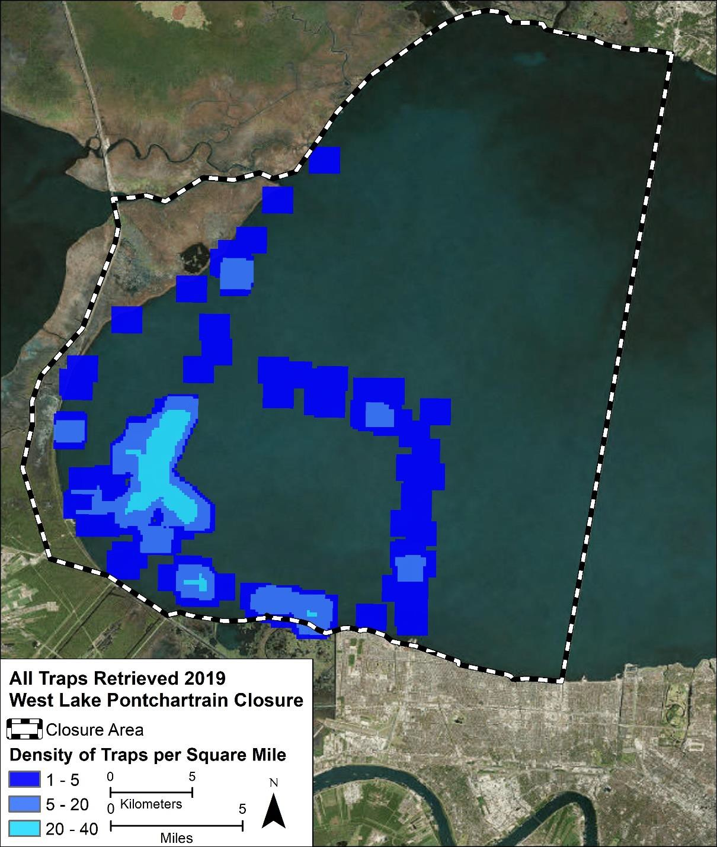
After 5 working days LPBF had removed a total of 401 derelict crab traps.
Efforts by LDWF resulted in the removal of 235 traps, resulting in a total of 636 derelict crab traps removed.
Density of crab traps removed by LPBF within the West Lake Pontchartrain closure area. (Areas in light blue = 30—41 traps per sq. mile).

Slide 23
Notes:
February 15th through February 28th- 14 Day Closure
Spanned northeast of the Mississippi River to Bayou Terre Aux Boeuf and covered a 238 square mile area.

Slide 24
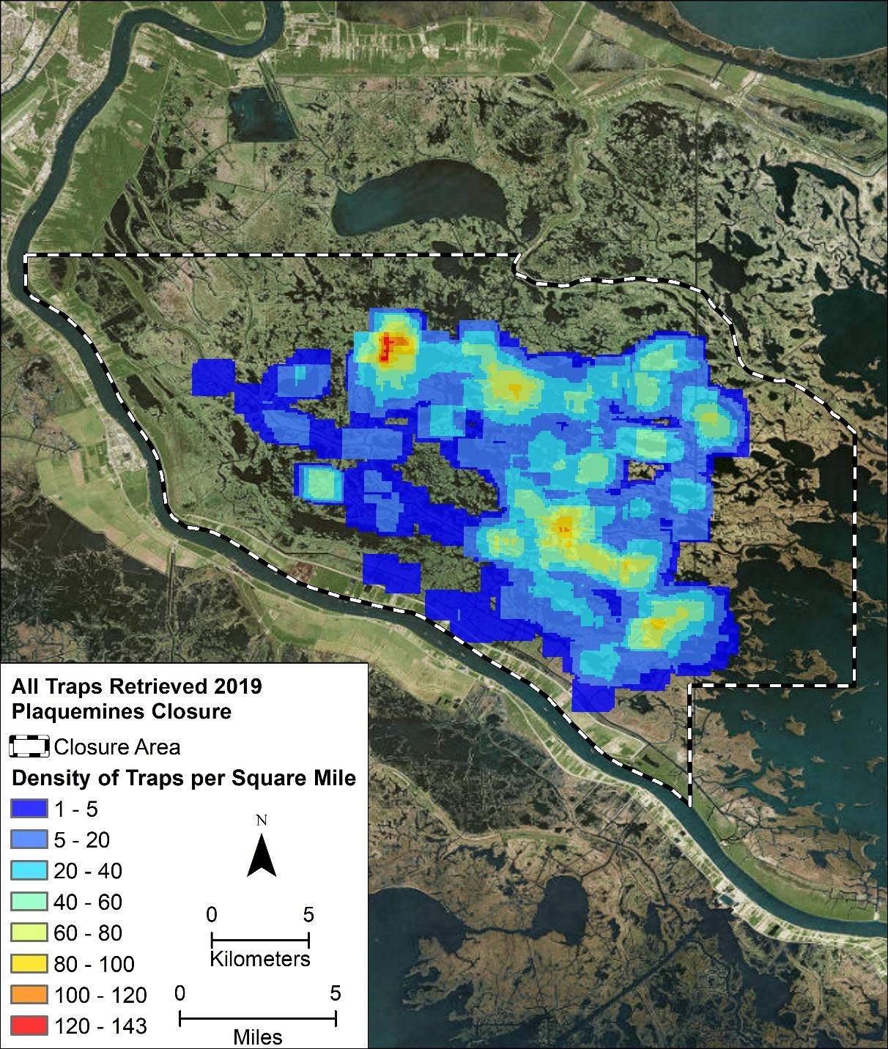
After14 working days LPBF had removed a total of 2,301 derelict crab traps
Efforts by LDWF resulted in the removal of 201 traps, resulting in a total of 2,502 derelict crab traps removed.
Grand Lake
Four Horse
Lake
Bakers Bay
Density of crab traps removed by LPBF within the Plaquemines closure area. (Areas in red = 120—143 traps per sq. mile).

Slide 25
Derelict Trap Removal in the Pontchartrain Basin: 2016 - 2019

Slide 27
2017 = 2,096
2018 = 3,255
2019 = 2,301

Slide 28
2017 = 2,096
2018 = 3,255
2019 = 2,301

Slide 29
2017 = 2,096
2018 = 3,255
2019 = 2,301

Slide 31
Future Plans and Next Steps

Slide 32
NOAA Marine Debris Grant
2 year grant to remove 3000-6000 derelict traps from the Pontchartrain Basin in 2020 and 2021.
Specific emphasis on using Side Scan Sonar to find and remove derelict traps with no floats.
RFID Technology
Experiment using scanner technology to potentially keep inventory of traps.
Expedite the removal process during closures by allowing crabbers to remove their own derelict traps once located.
Help prevent theft of traps.
Research and test other ways to prevent large number of traps becoming derelict.
Expand removal success of Pontchartrain Basin to other Louisiana basins.

Slide 33
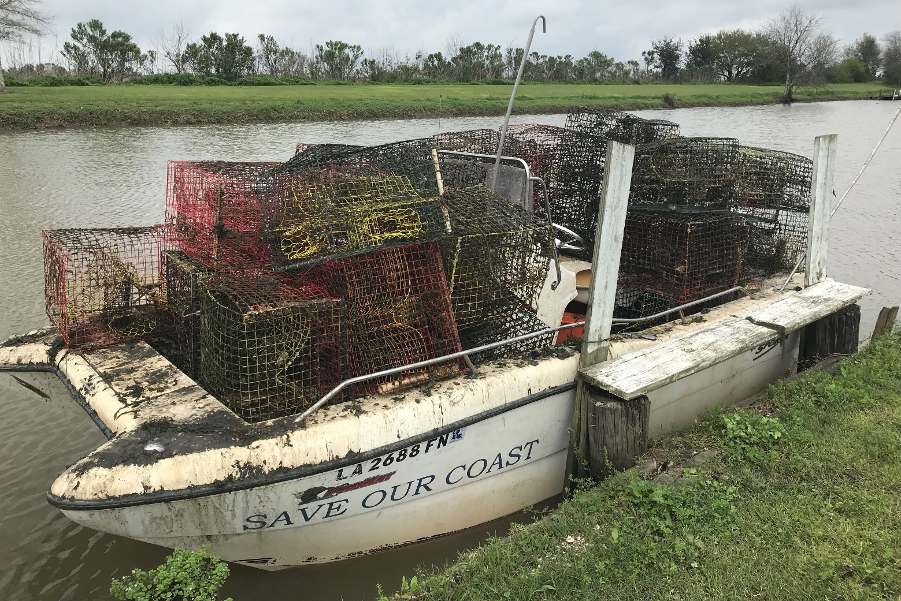
Thank you! Questions?

