Slide 1
Feral Hog Survey in Terrebonne – Project Report
Benjamin Hall and Dr. Kim Marie Tolson
Department of Biology, College of Arts, Education, and Sciences, University of Louisiana at Monroe, Monroe, LA

Slide 2
Acknowledgments
I would like to thank the following for all the generous help, knowledge, and support that has been given to me during the course of this study.
Foremost, I would like to thank the Barataria-Terrebonne National Estuary Program, the USFWS, and the Louisiana Department of Wildlife and Fisheries for the funding and resources to carry out this project.
I would also like to thank Catherine Normand and Jennifer Hogue with the Louisiana Department of Wildlife and Fisheries for all of their help during the aerial surveys.
I would like to thank Mr. Greg Linscombe with Continental Land and Fur Co. for sharing his knowledge of the area, as well as answering questions I had.

Slide 3
Contents
Research objectives
Study site
Materials and Methods
Results
Flight one
Flight two
Damage comparisons
Geospatial analysis
Discussion
Conclusion

Slide 4
Research Objectives
Conduct aerial surveys to document feral hog damage
Compare hog damage from the first aerial survey to the second survey to determine if more damage has occurred and if any plant regeneration has taken place
Perform a geospatial analysis of the study site in an attempt to identify habitat qualities that feral hogs select in coastal marshes

Slide 5
Study Site
Research took place inside a 500,000 acre block of land in Terrebonne Parish
Study Site contains four coastal marsh types: fresh, intermediate, brackish, and salt
Majority of land is undeveloped, but does have some developed areas in the northeast portion around Houma, La as well as sparsely distributed structures throughout
Waterways consist of a combination of bayous, lakes, bays, and manmade canals
Vegetation of the study site varies widely and is dictated by water salinity and soil moisture

Slide 6
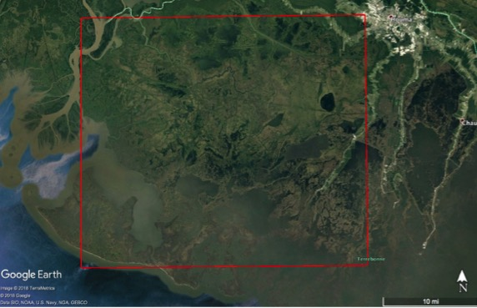
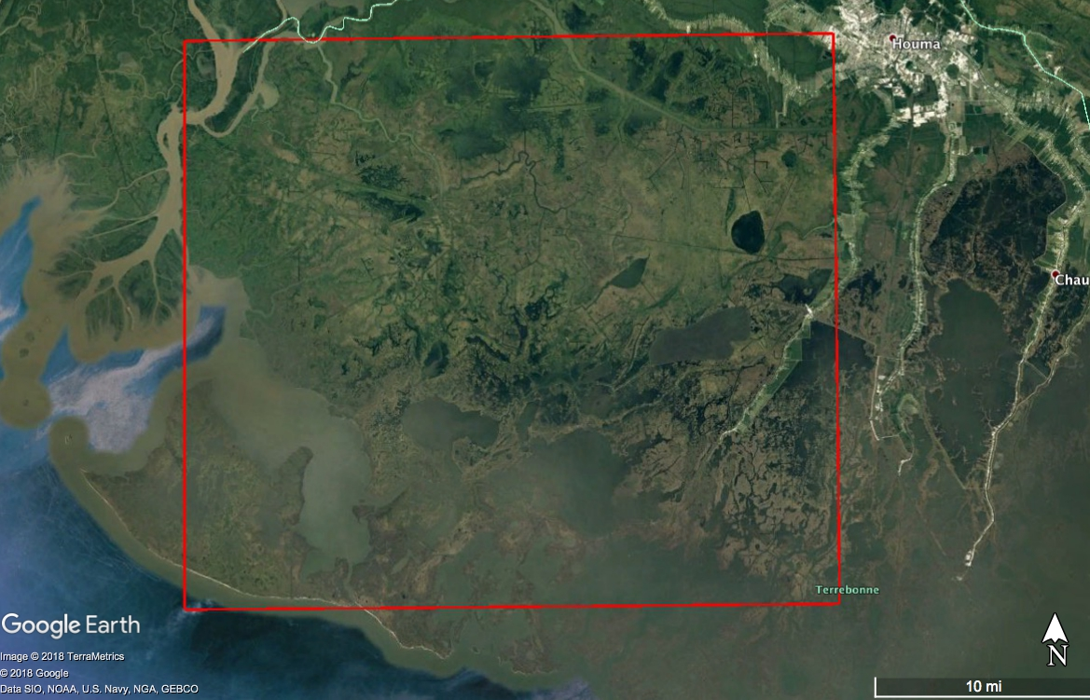
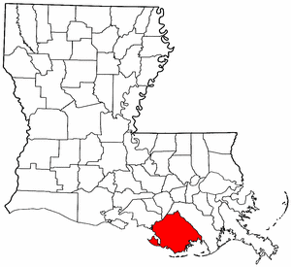
Study Site

Slide 7
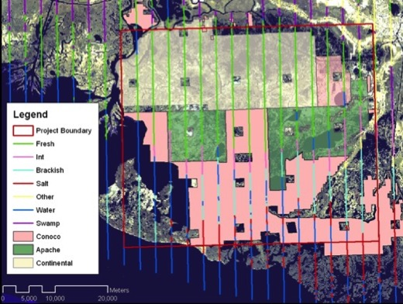
Study site with transects and land ownership

Slide 8
Materials and Methods Aerial Surveys
Flown in Bell 206 Jet Ranger helicopter
Altitude of 200ft
70-100 mph
17 North-South transects
Transects were 1.87 miles apart
Transects were 26 miles long
Total survey width of .5 miles (.25 miles left and right of transect)
Once damage was spotted, the helicopter flew around the damage site to survey the area
After the initial circling of the damage, the helicopter made one more pass around. This time, an onboard computer linked to the helicopter’s GPS traced the path in Arcmap and path was saved as a shapefile

Slide 9
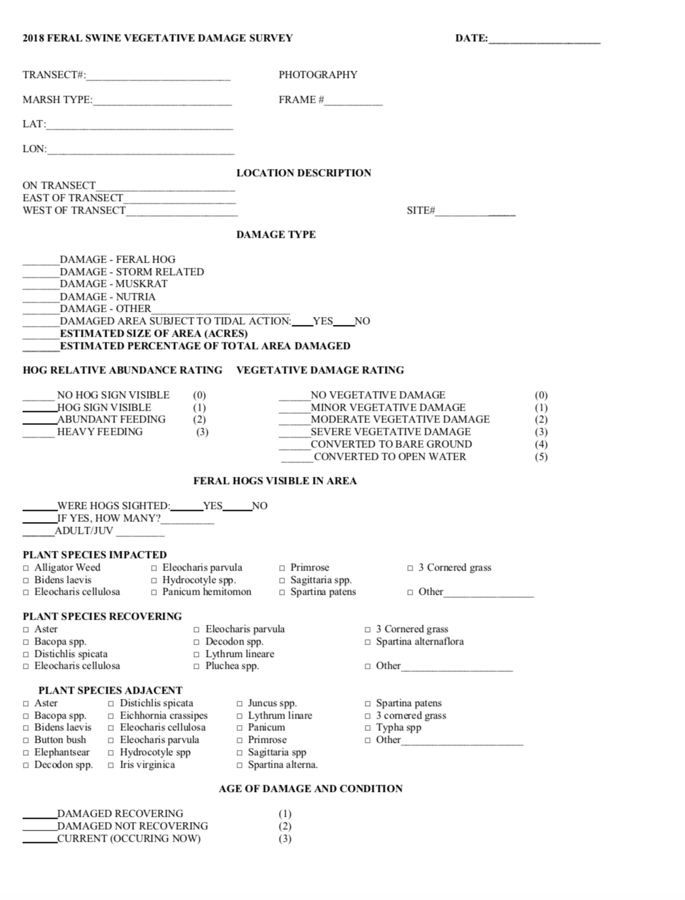
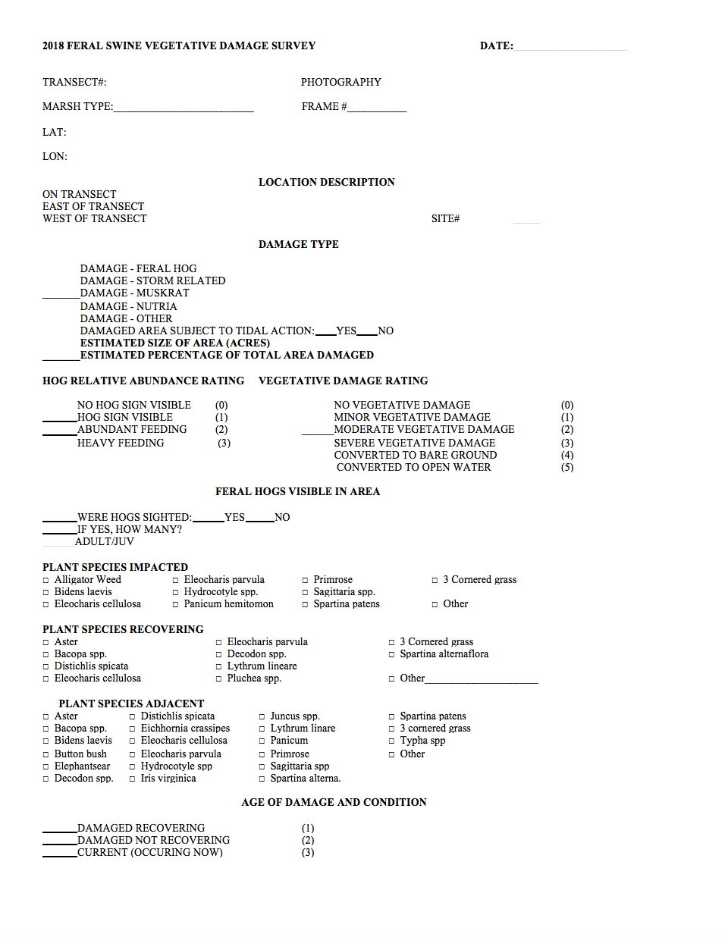
Aerial Survey Cont.
After a shapefile of the damage was saved, helicopter went down and hovered 5-10ft above the ground so a data sheet could be filled out
After data sheet was completed, helicopter ascended back to 200ft for pictures to be taken for documentation

Slide 10
Comparison of Damage
After the second aerial survey, a comparison was done by comparing damage site polygons from the first survey to the second survey
Photos and data sheet from the first and second surveys were compared to see if any plant regeneration has occurred

Slide 11
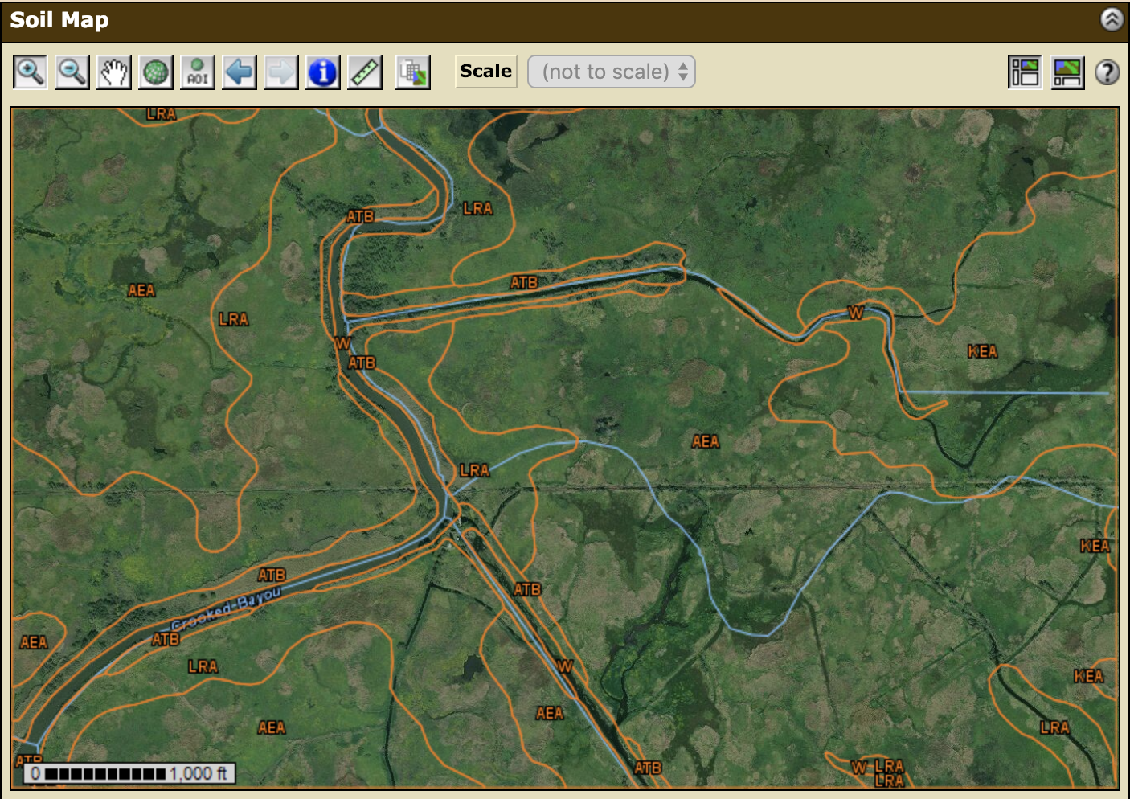
Geospatial Analysis
The geospatial analysis will be performed in ArcGIS in attempt to identify habitat qualities that feral hogs select for in coastal marsh habitat
Marsh types
Soil types
LIDAR data
Vegetation
Various other factors
https://websoilsurvey.nrcs.usda.gov/app/WebSoilSurvey.aspx

Slide 12
Results Flight One – March 22, 2018
Total of 13 damage sites observed
All sites found in northwestern portion of survey area
11 of the 13 sites occurred in freshwater marsh, the two remaining sites were in intermediate marsh
Total area within flight path polygons was 467.94 acres
Total actual damage within flight path polygons was 88.042 acres
31 feral hogs seen at 7 of the 13 damage sites
18 adults
13 juveniles
All damage sites were within 230 meters of a body of water

Slide 13
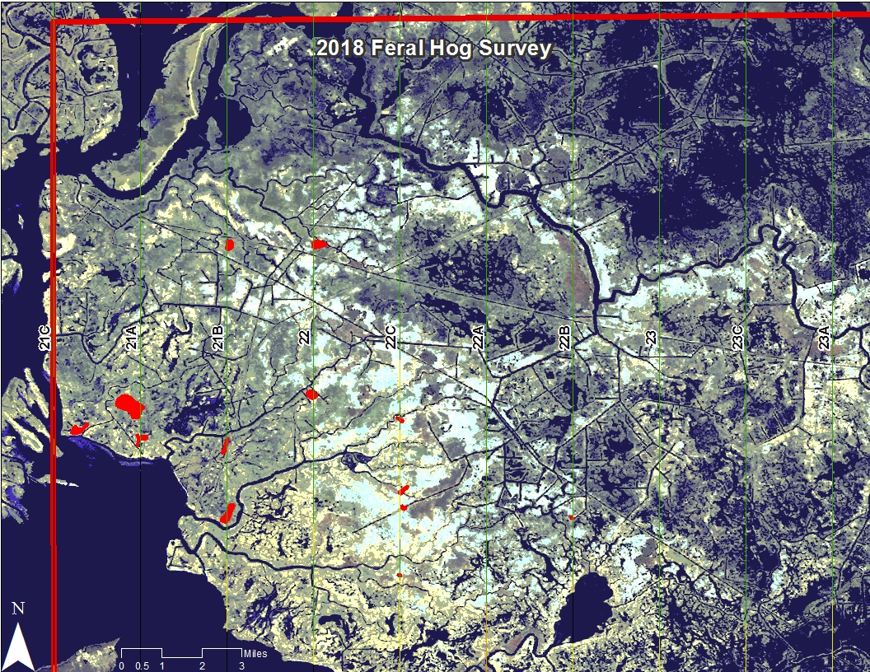
Damage sites in red

Slide 14
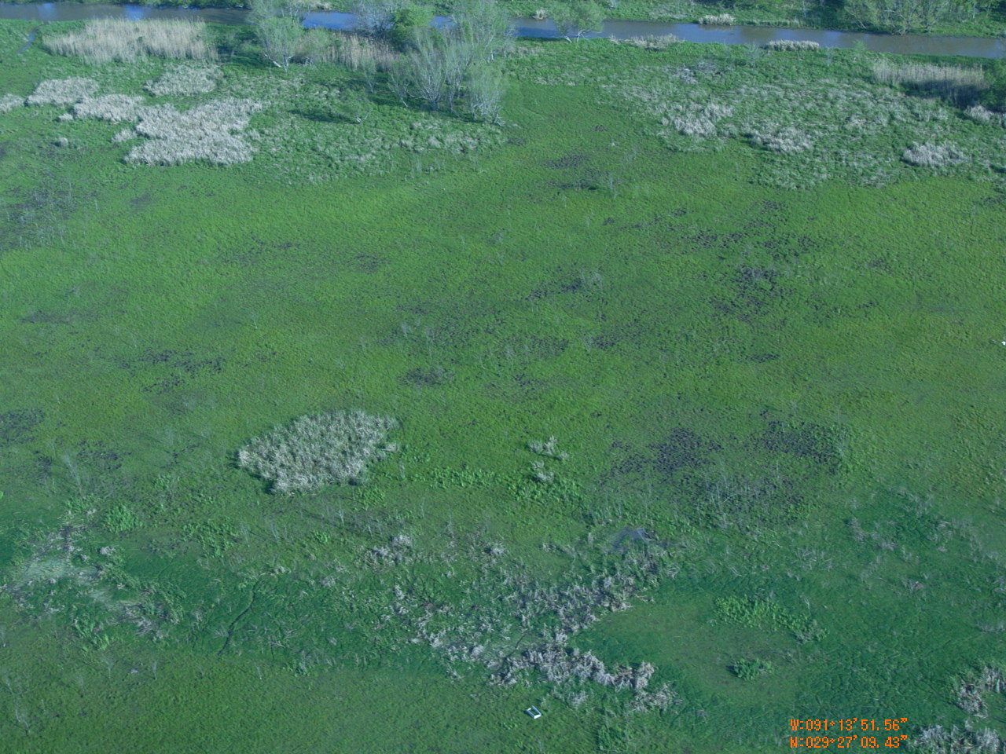
Damage Site 3

Slide 15
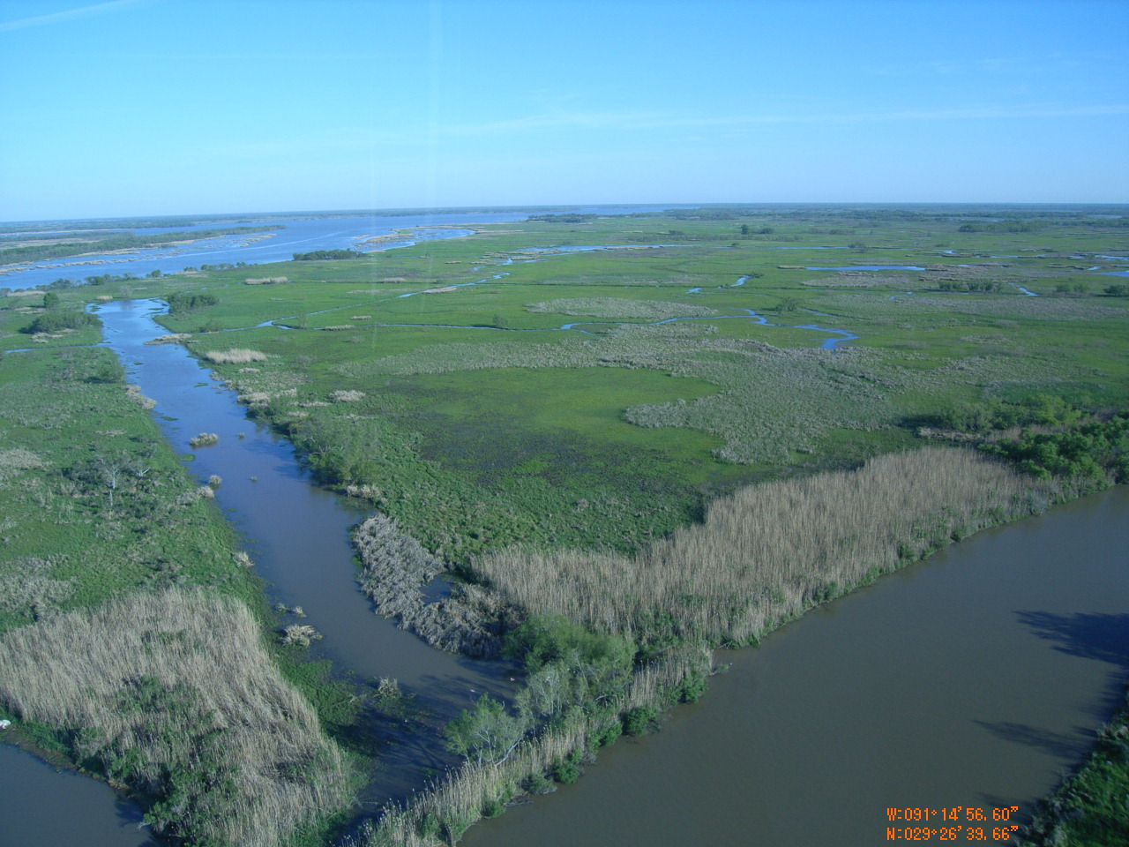
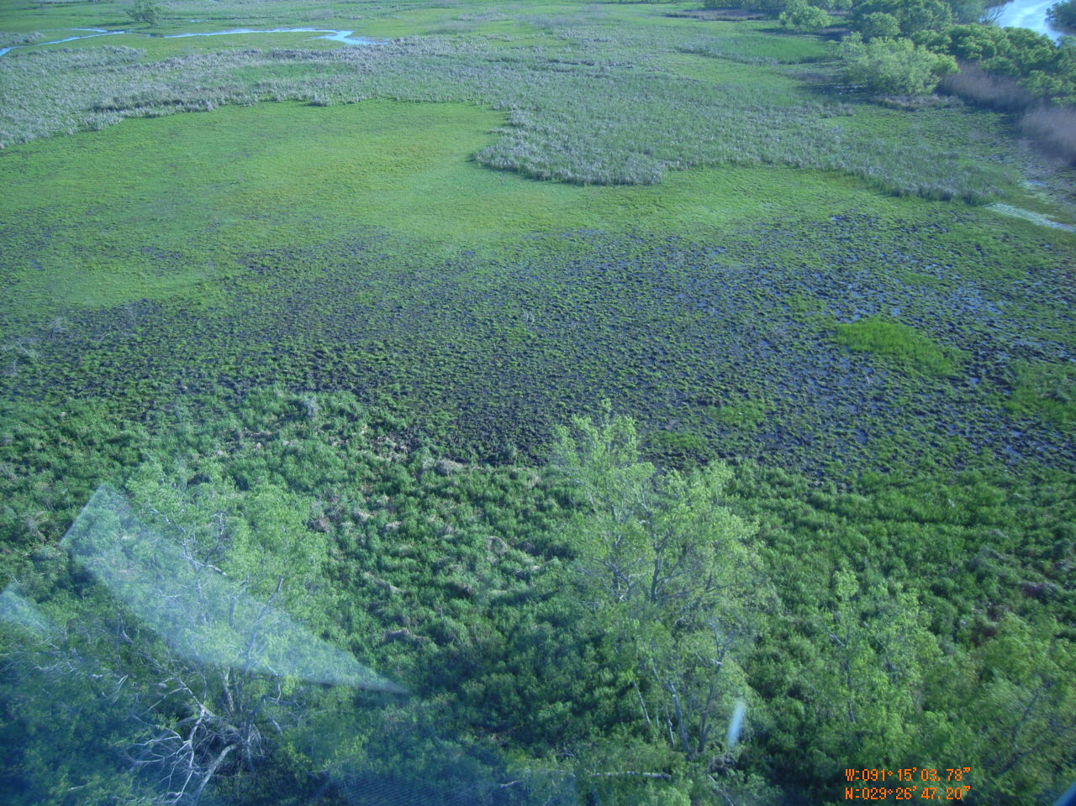
Photos of damage site 1

Slide 16
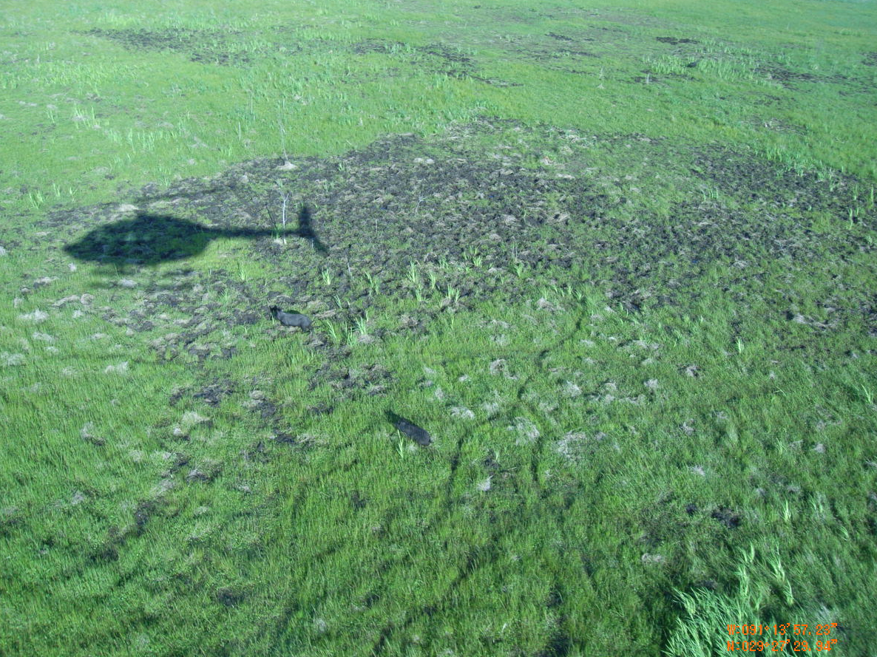
Feral hogs at damage site 3
Feral hogs at damage site 8

Slide 18
Flight Two – August 6, 2018
Re-visited all 13 damage sites from the first flight and flew transects in the northwest quadrant
All 13 damage sites had full plant regeneration
No additional damage discovered
No pigs were observed

Slide 19
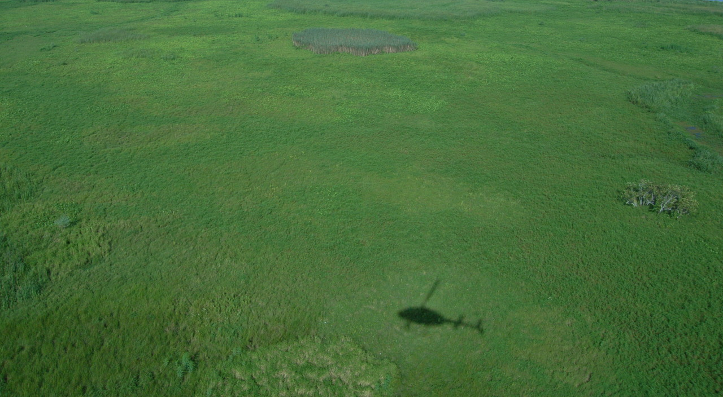
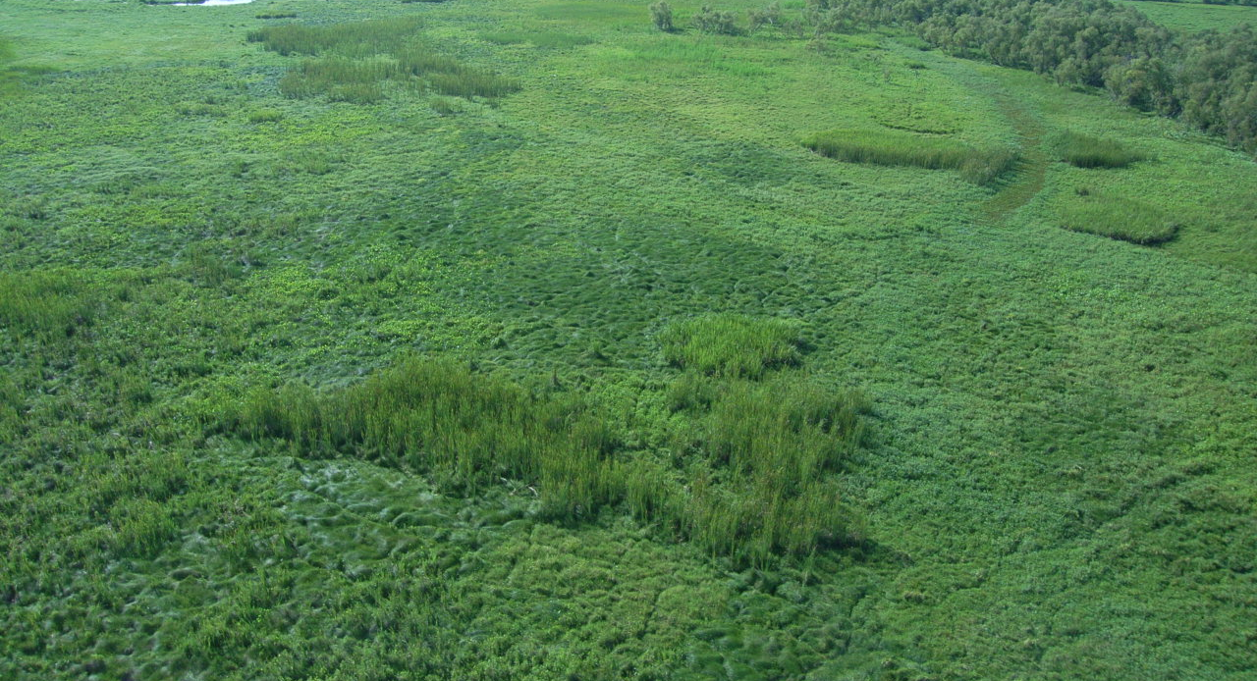
Damage site 4
Damage site 6

Slide 20
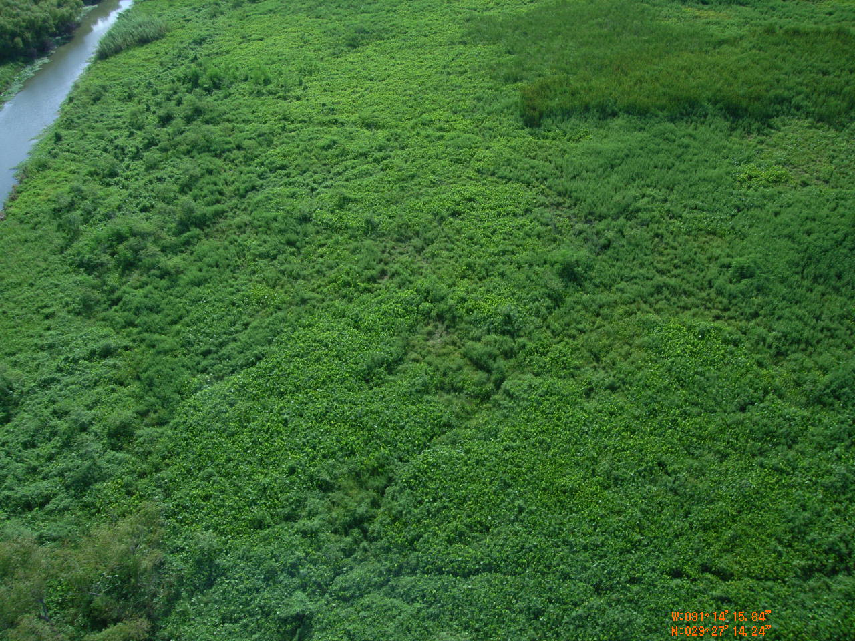
Damage Site Comparisons
All sites had full regeneration
Sites from flights 1 and 2 had the same vegetation
No feral hogs were seen during second flight
Damage site 1 – First flight
Damage site 1 – Second flight

Slide 21
Geospatial Analysis
Damage Sites | Soil Type
Site 1 | Allemands muck – Larose muck
Site 2 | Allemands muck
Site 3 | Allemands muck
Site 4 | Allemands muck – Barbary muck
Site 5 | Allemands muck
Site 6 | Allemands muck
Site 7 | Allemands muck – Larose muck
Site 8 | Allemands muck – Barbary muck
Site 9 | Allemands muck – Larose muck
Site 10 | Allemands muck – Kenner muck
Site 11 | Kenner muck
Site 12 | Clovelly muck* – Lafitte muck*
Site 13 | Kenner muck

Slide 22
Discussion
First flight and second flights were polar opposites.
Did the hogs leave? If so, where did they go and why?
If they are still in same area, where are they and what are they eating since no rooting is taking place?
Thoughts
Feral hogs are highly opportunistic when searching for food
Sugar cane fields to the North, but they’re approximately 15 miles away
Different food source in marsh has come available due to change in seasons
Due to maximum vegetation growth it may be very difficult to see them. It may also obscure any damage

Slide 23
Conclusion
Based off what is known, feral hogs are probably still in the same areas
Future surveys should be conducted in early spring for maximum effectiveness
Control methods such as aerial gunning should occur in the late winter to early spring before before the growing season
Future studies in feral hog movement in this study area combined with stomach analyses during different times of the year could greatly improve control methods

Slide 24
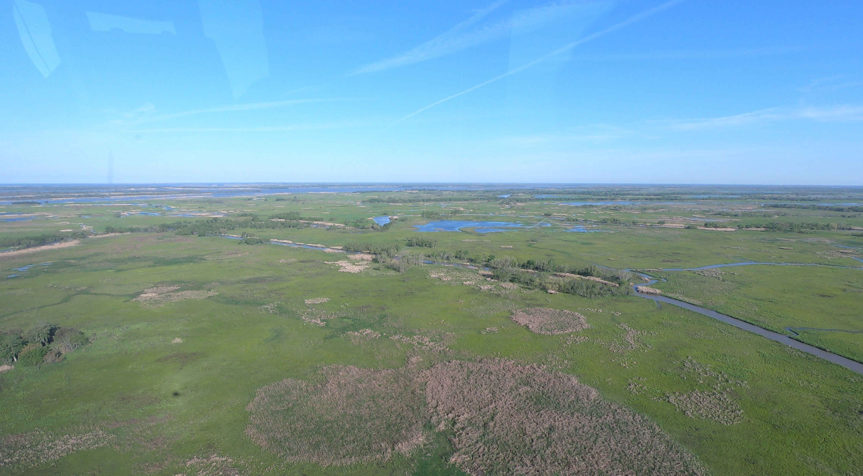
Questions?

