Slide 1
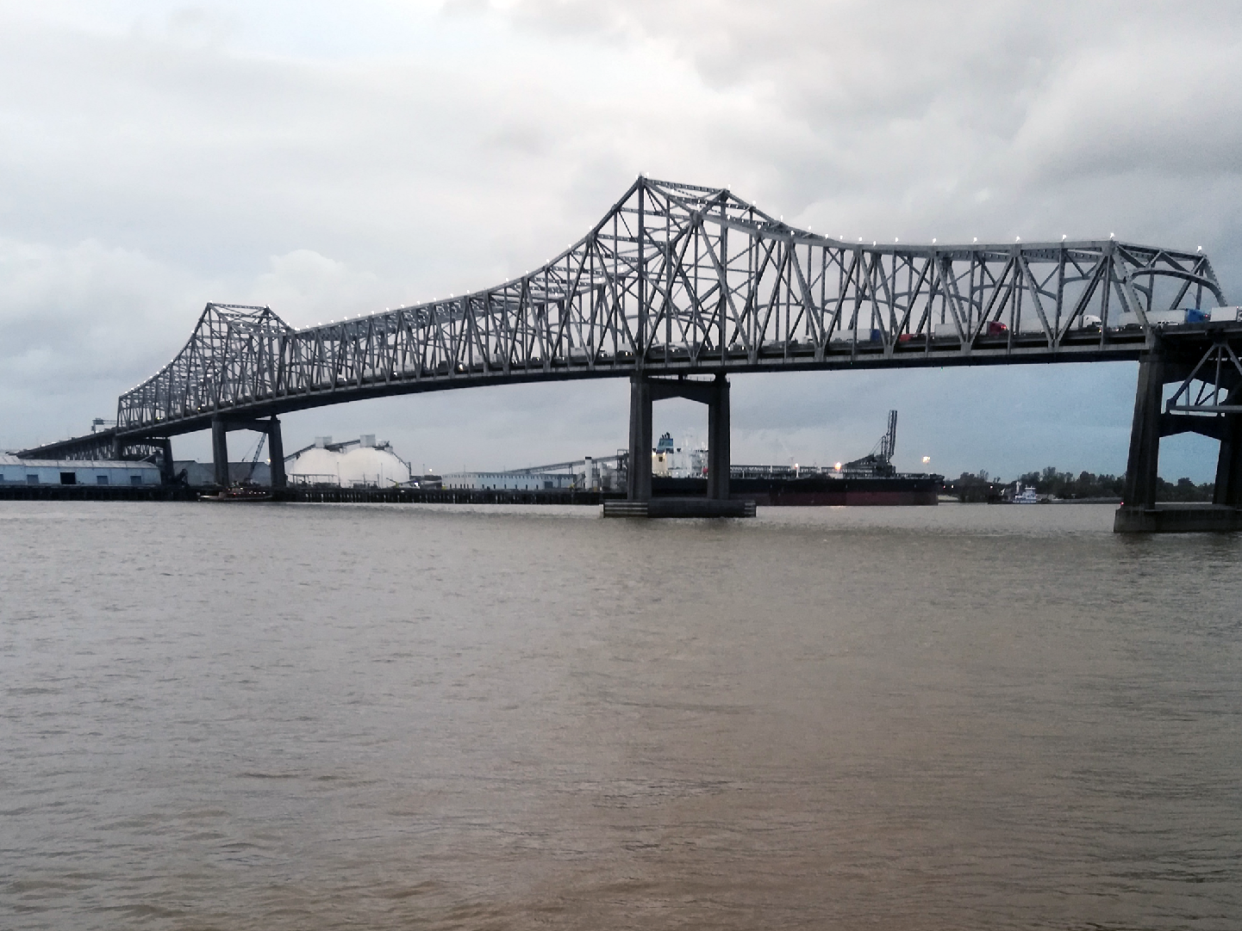
Plastics in Louisiana Coastal Waters
The Mississippi River as a Major Conduit to the Gulf of Mexico

Slide 2
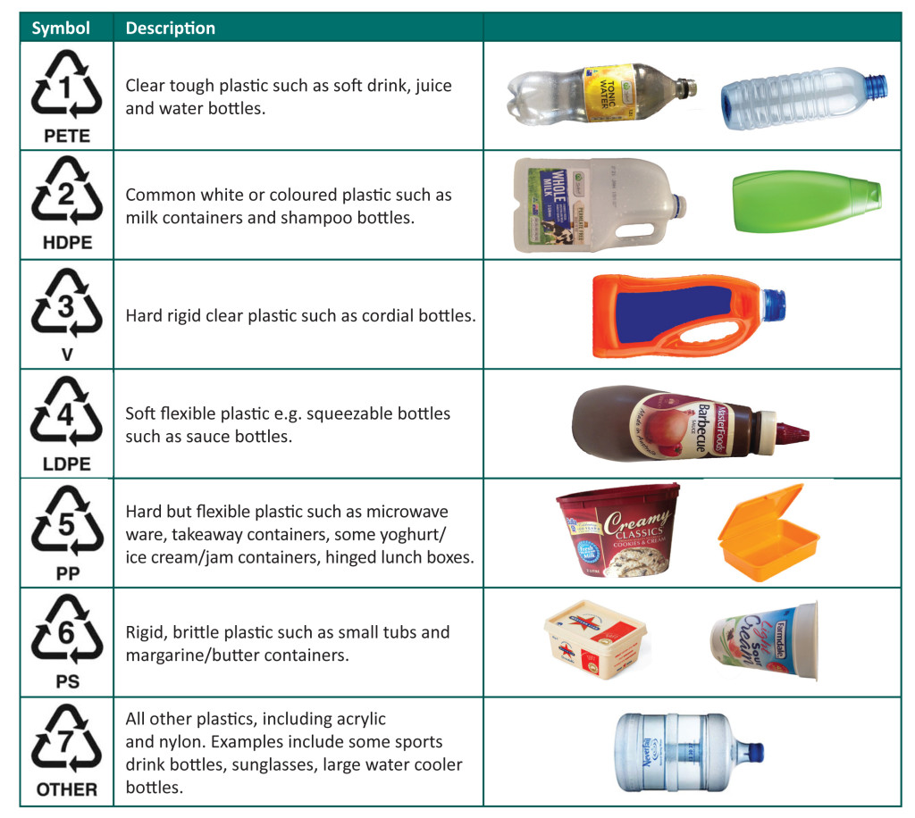
Image: KS Environmental

Slide 3
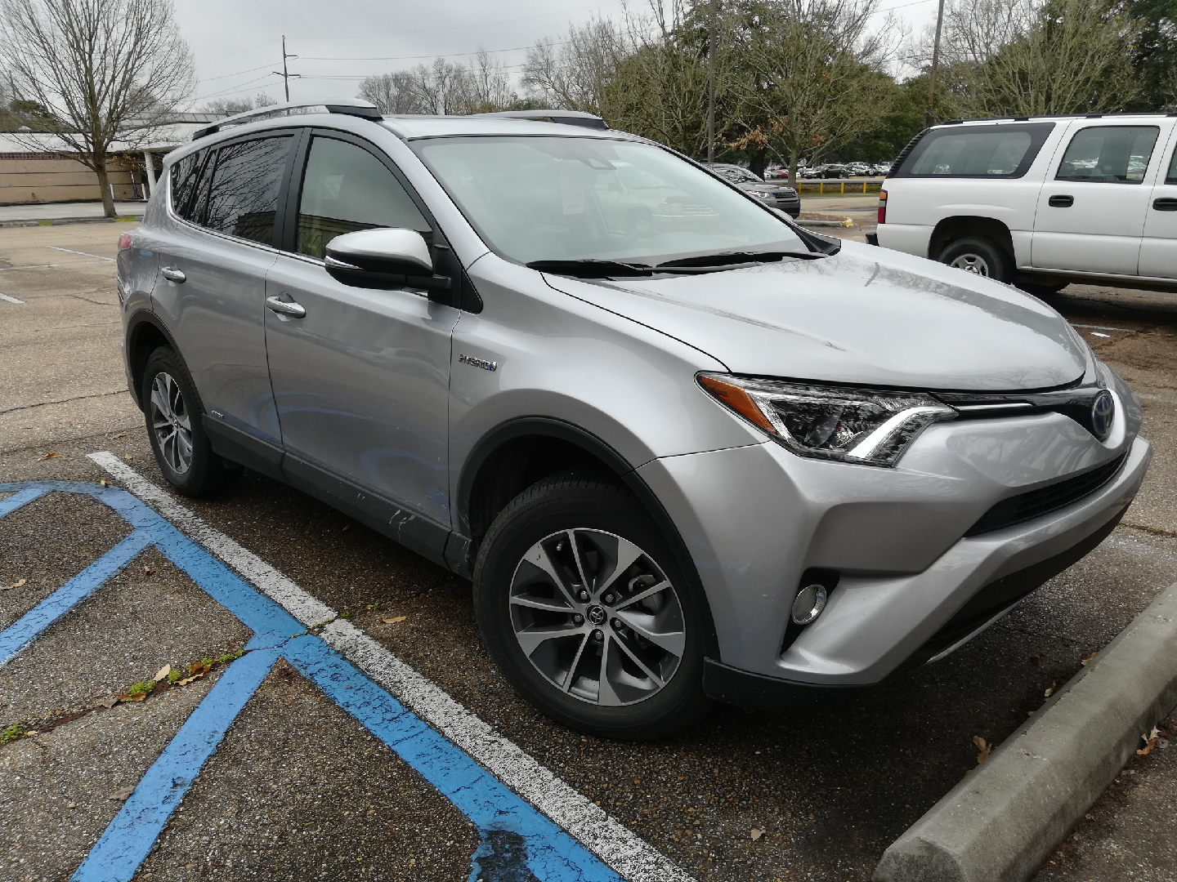
Image: Mark Benfield

Slide 4
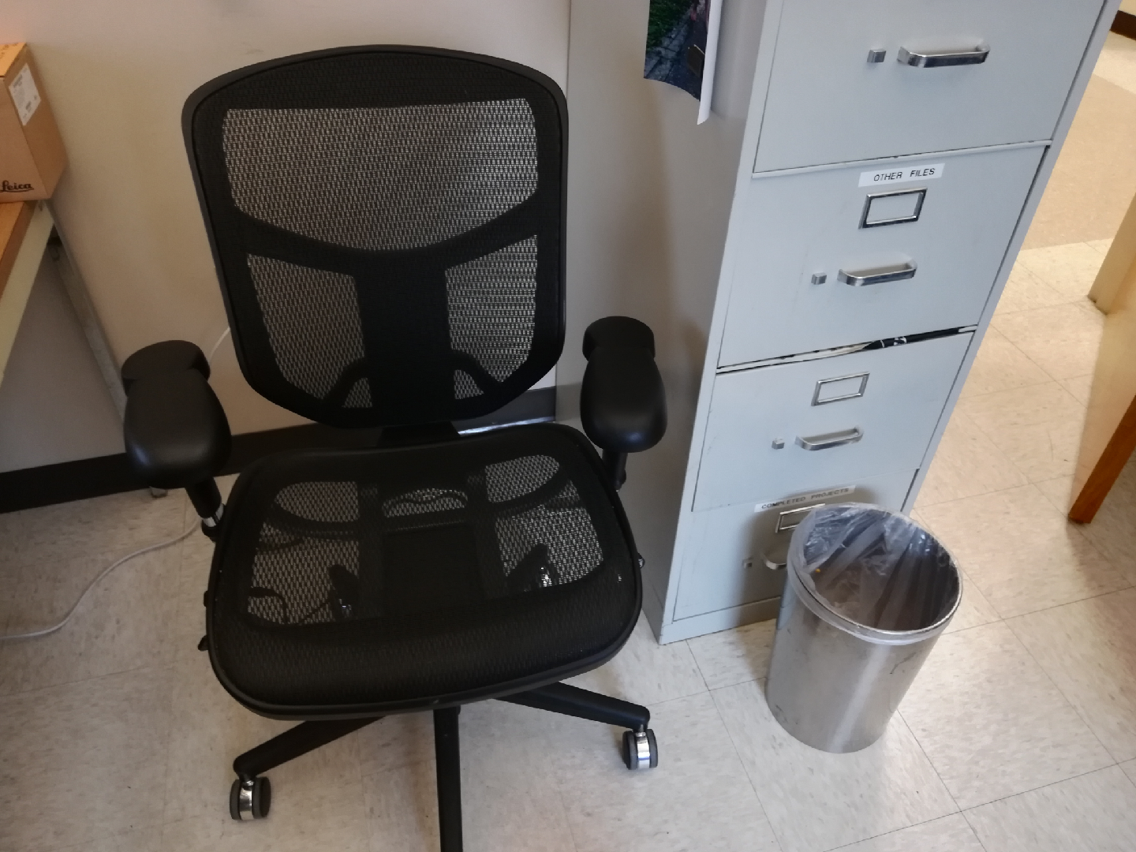
Image: Mark Benfield

Slide 5
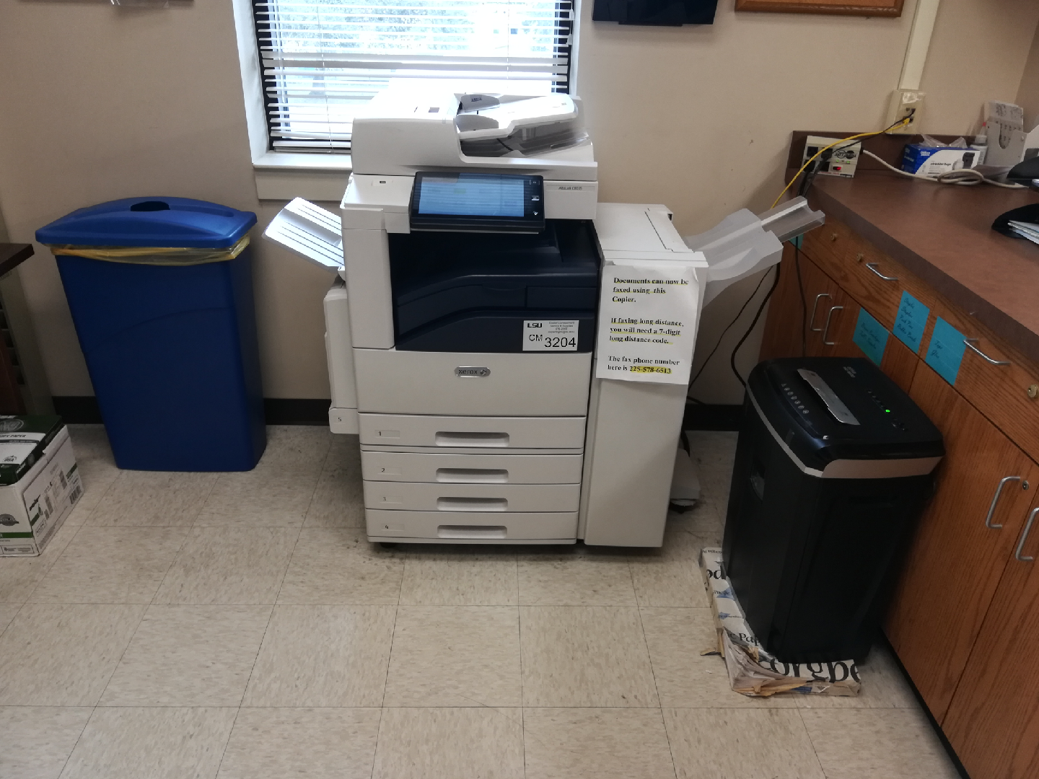
Image: Mark Benfield

Slide 6
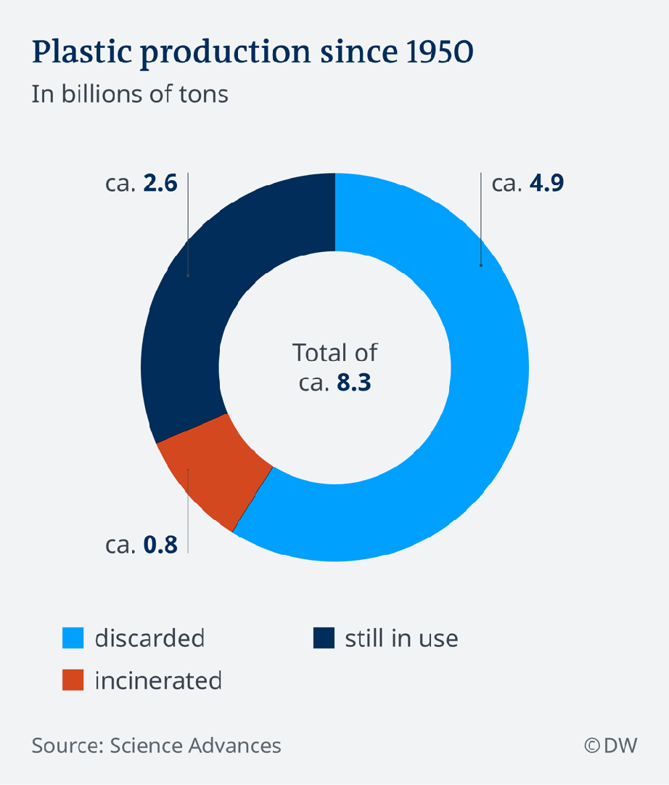

Slide 7
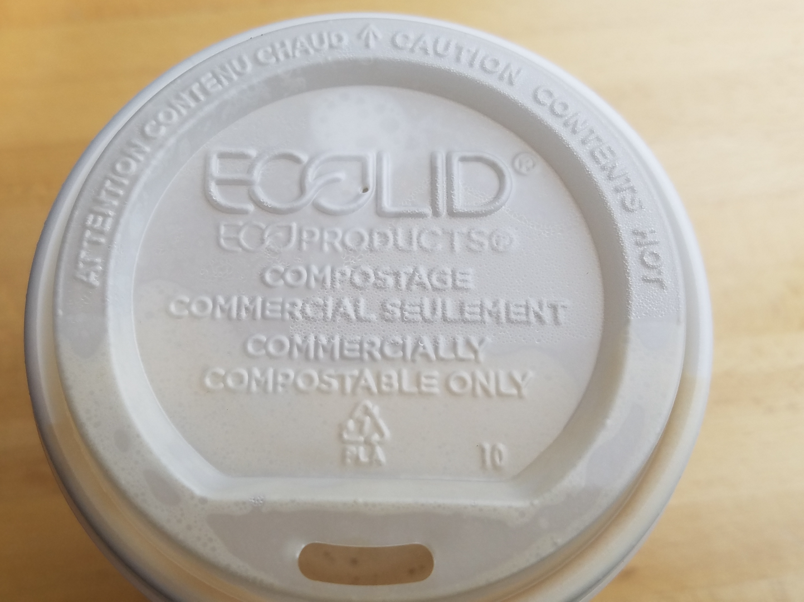
Image: Mark Benfield

Slide 8
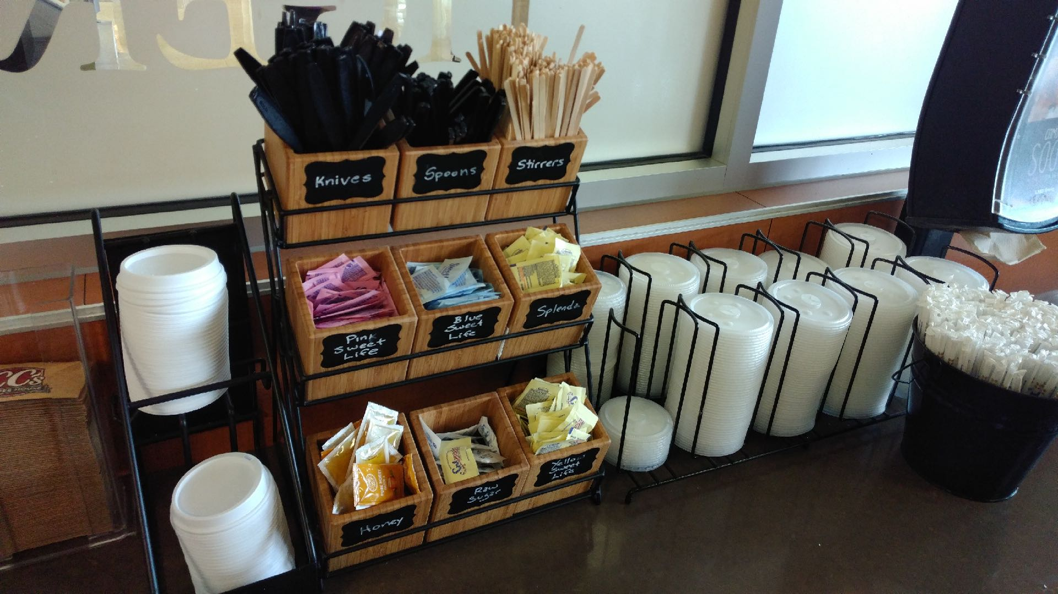
Image: Mark Benfield

Slide 9
Image: Mark Benfield

Slide 10
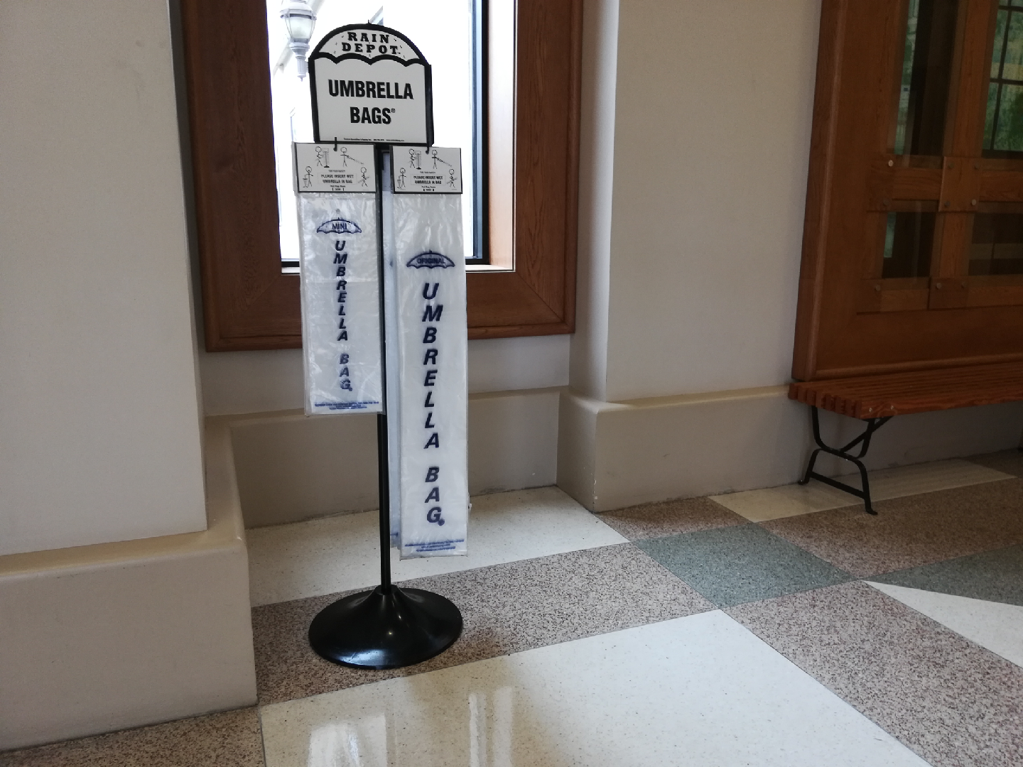
Image: Mark Benfield

Slide 11
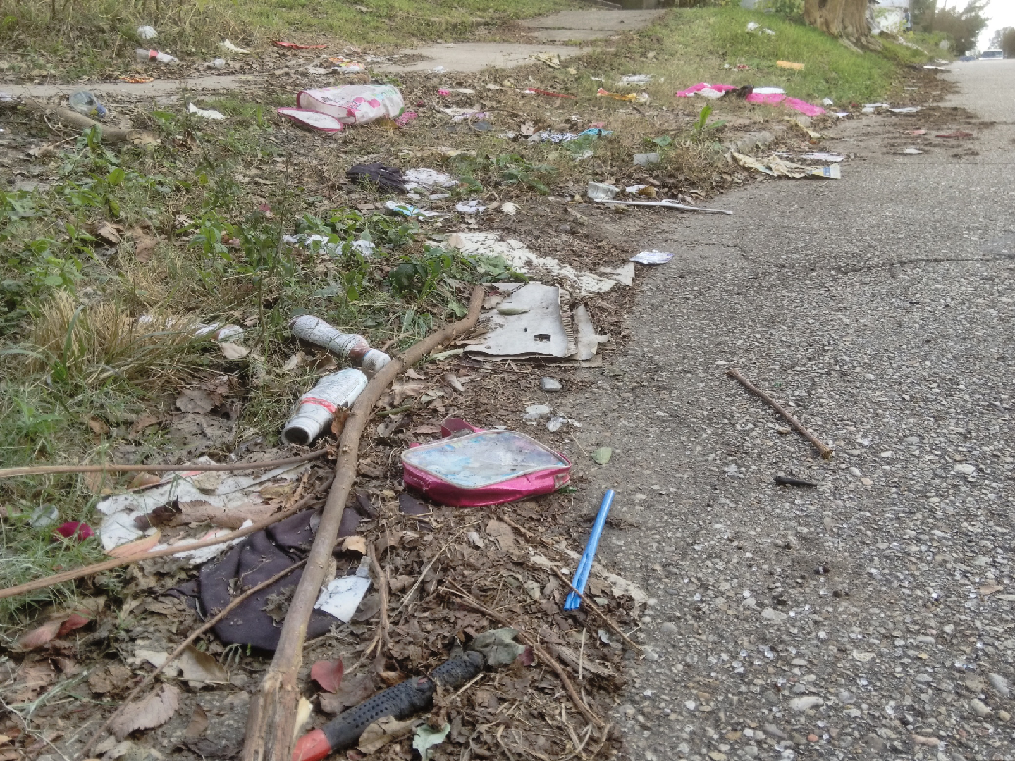
Image: Mark Benfield

Slide 12
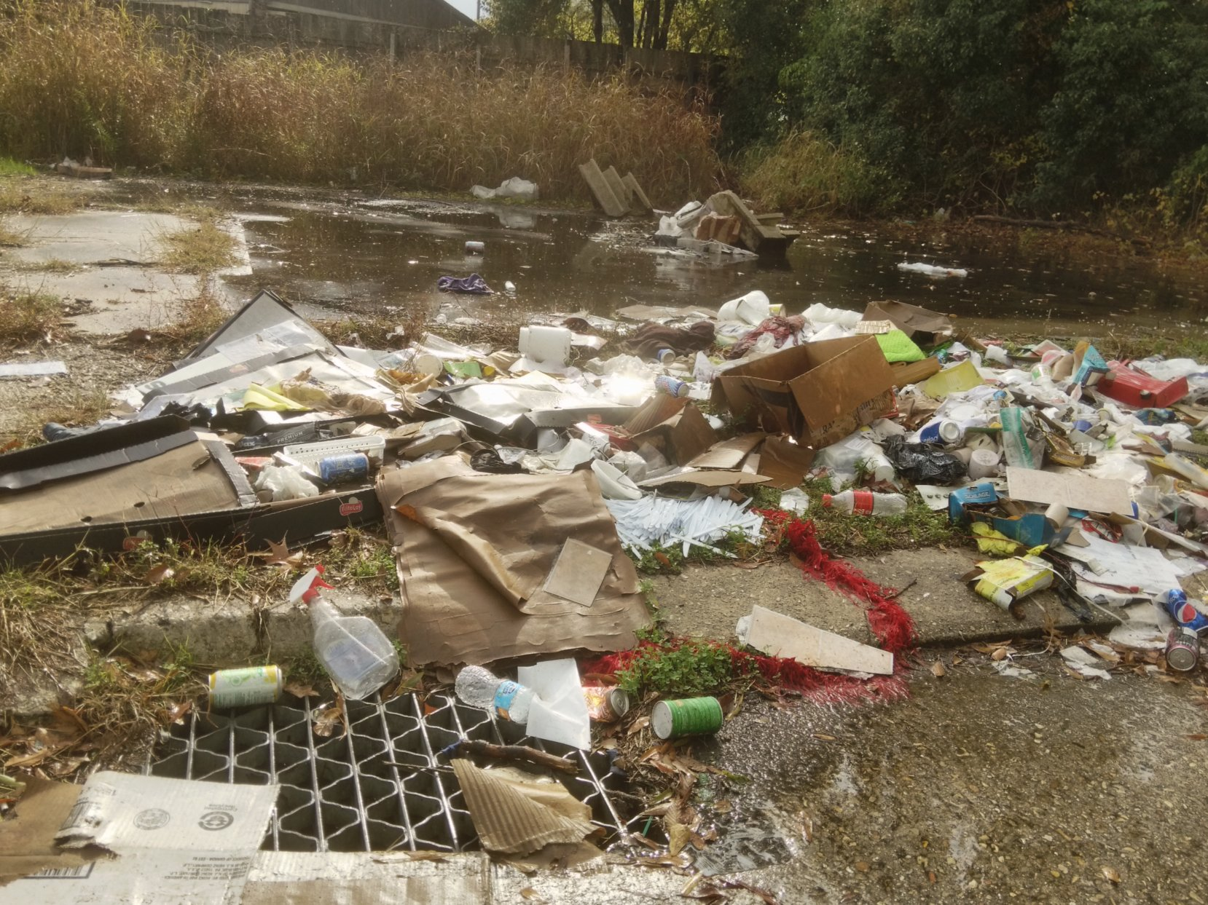
Image: Mark Benfield

Slide 13
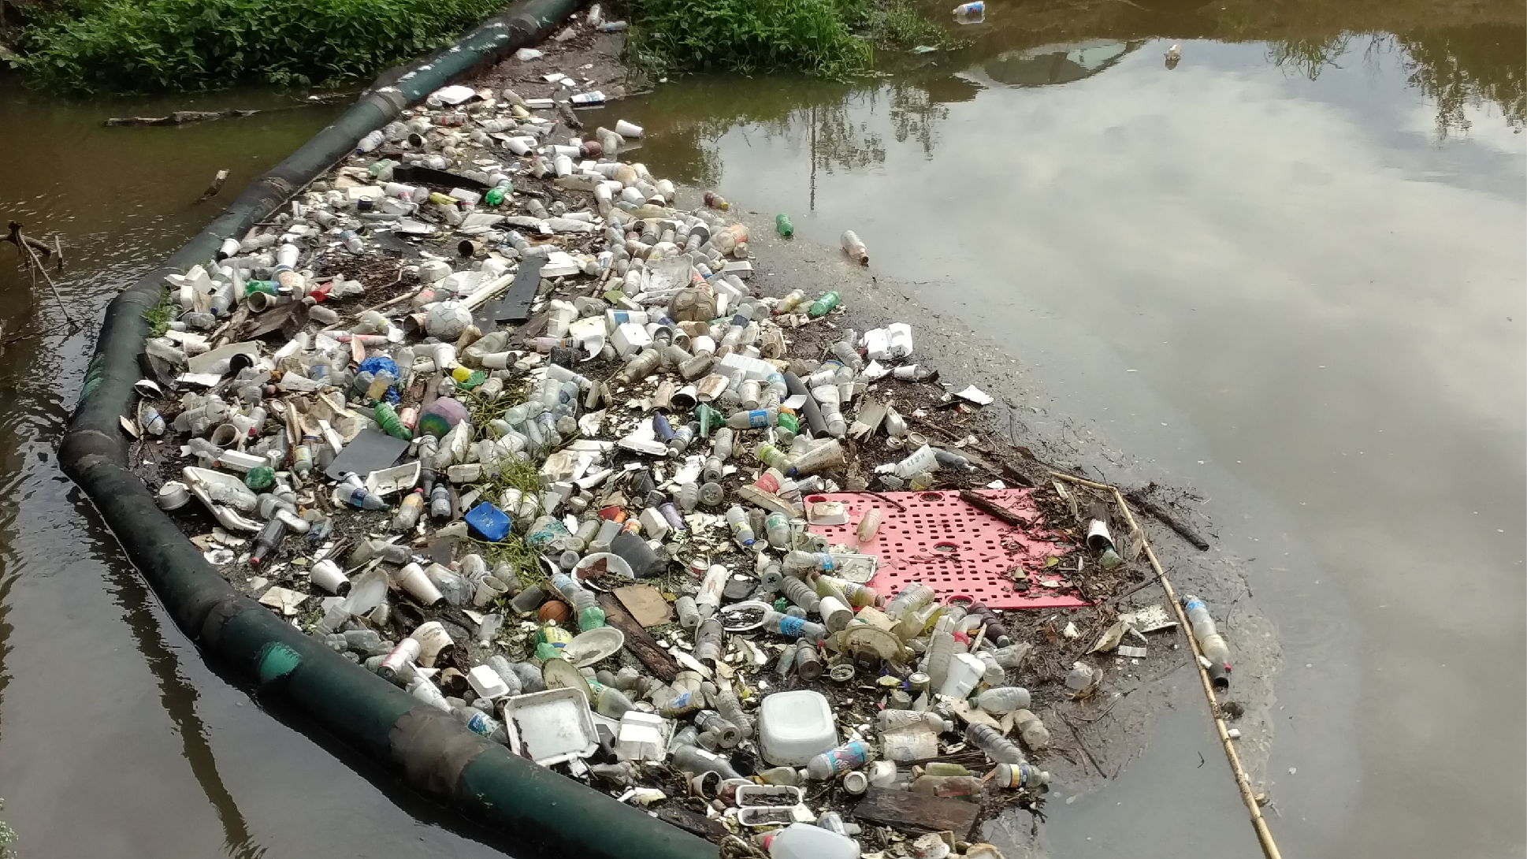
Image: Mark Benfield

Slide 14
Image: Mark Benfield

Slide 15
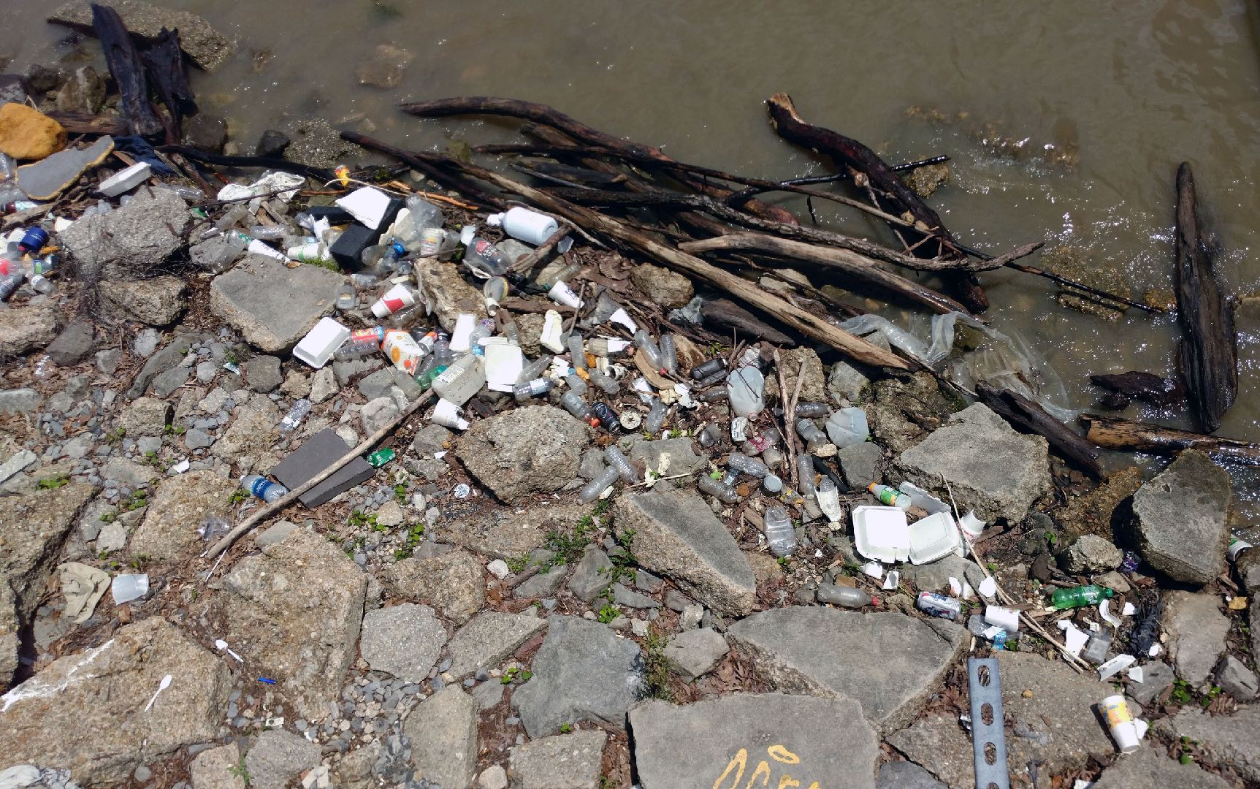
Image: Mark Benfield

Slide 16
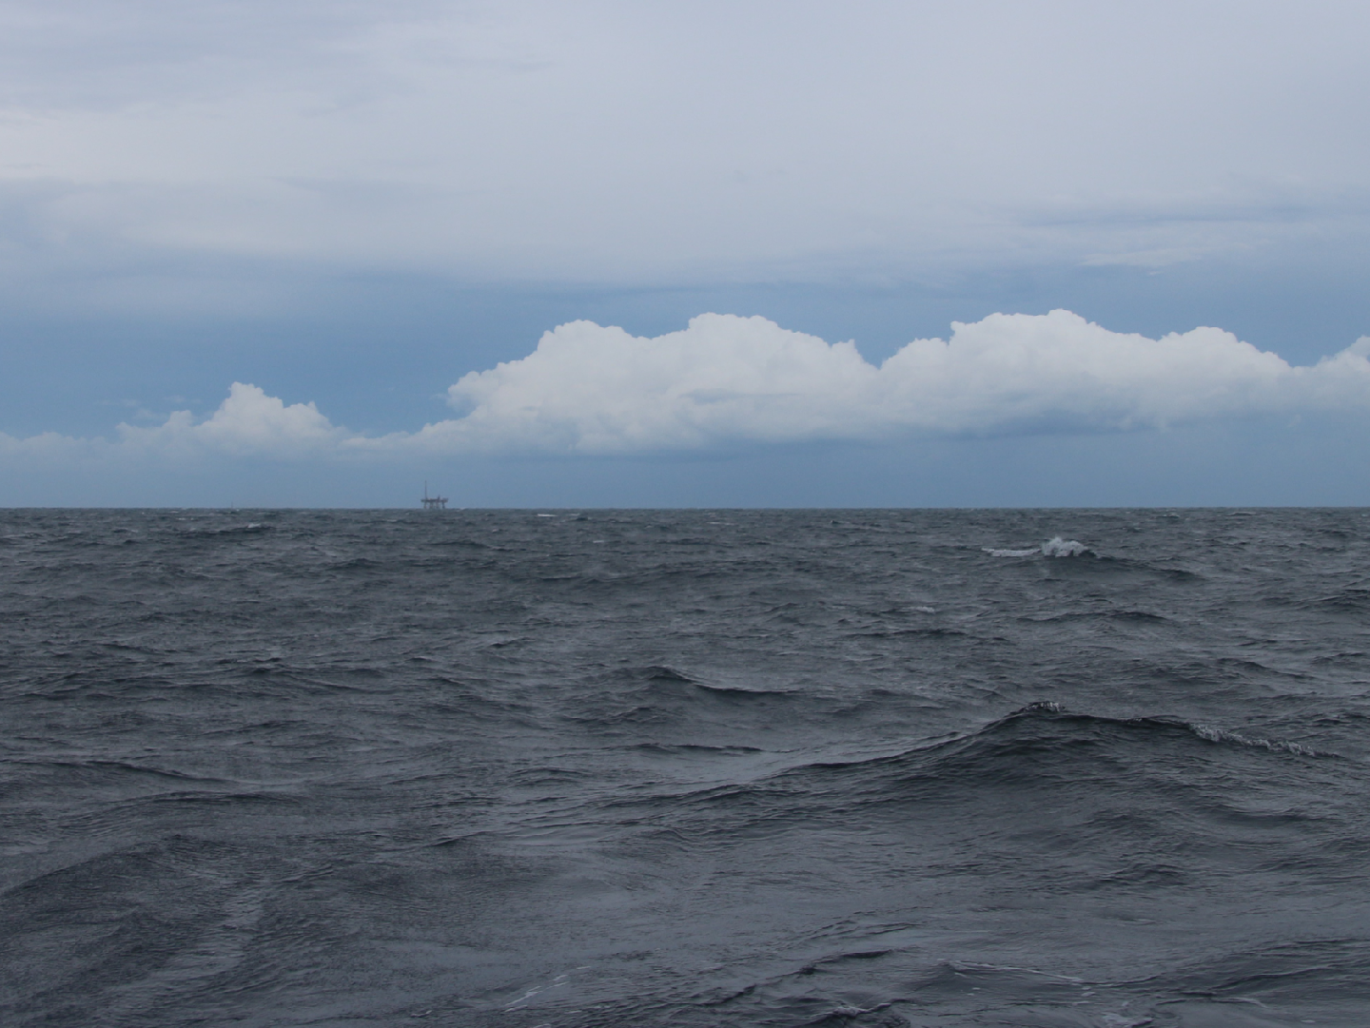
Image: Mark Benfield

Slide 17
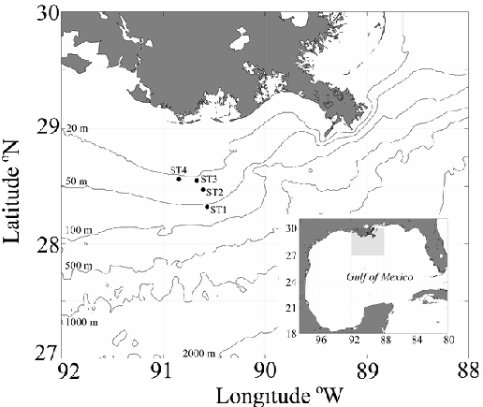
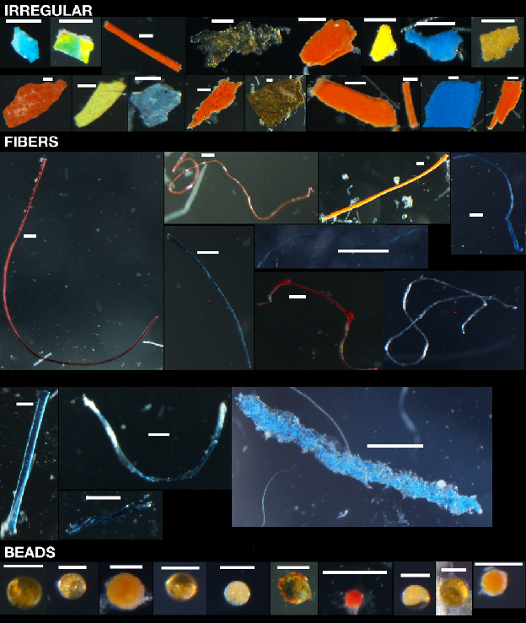
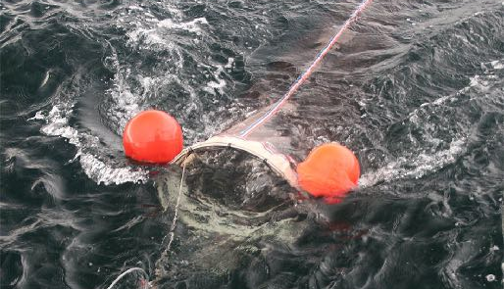
Microplastics in the Gulf of Mexico
Scale Bar = 100 microns

Slide 18
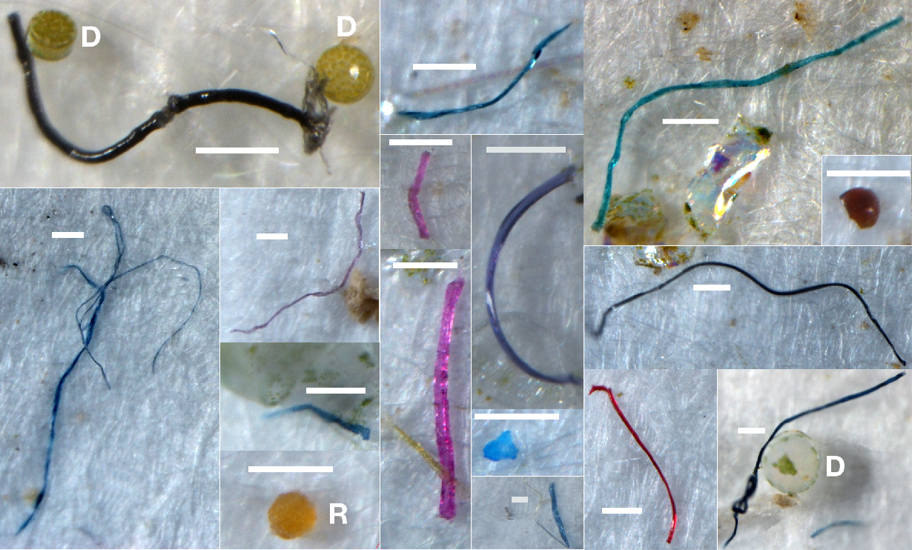
The Small Stuff
Scale Bar = 100 microns

Slide 19
GoM Compared to Other Areas
Particles m⁻³

Slide 20
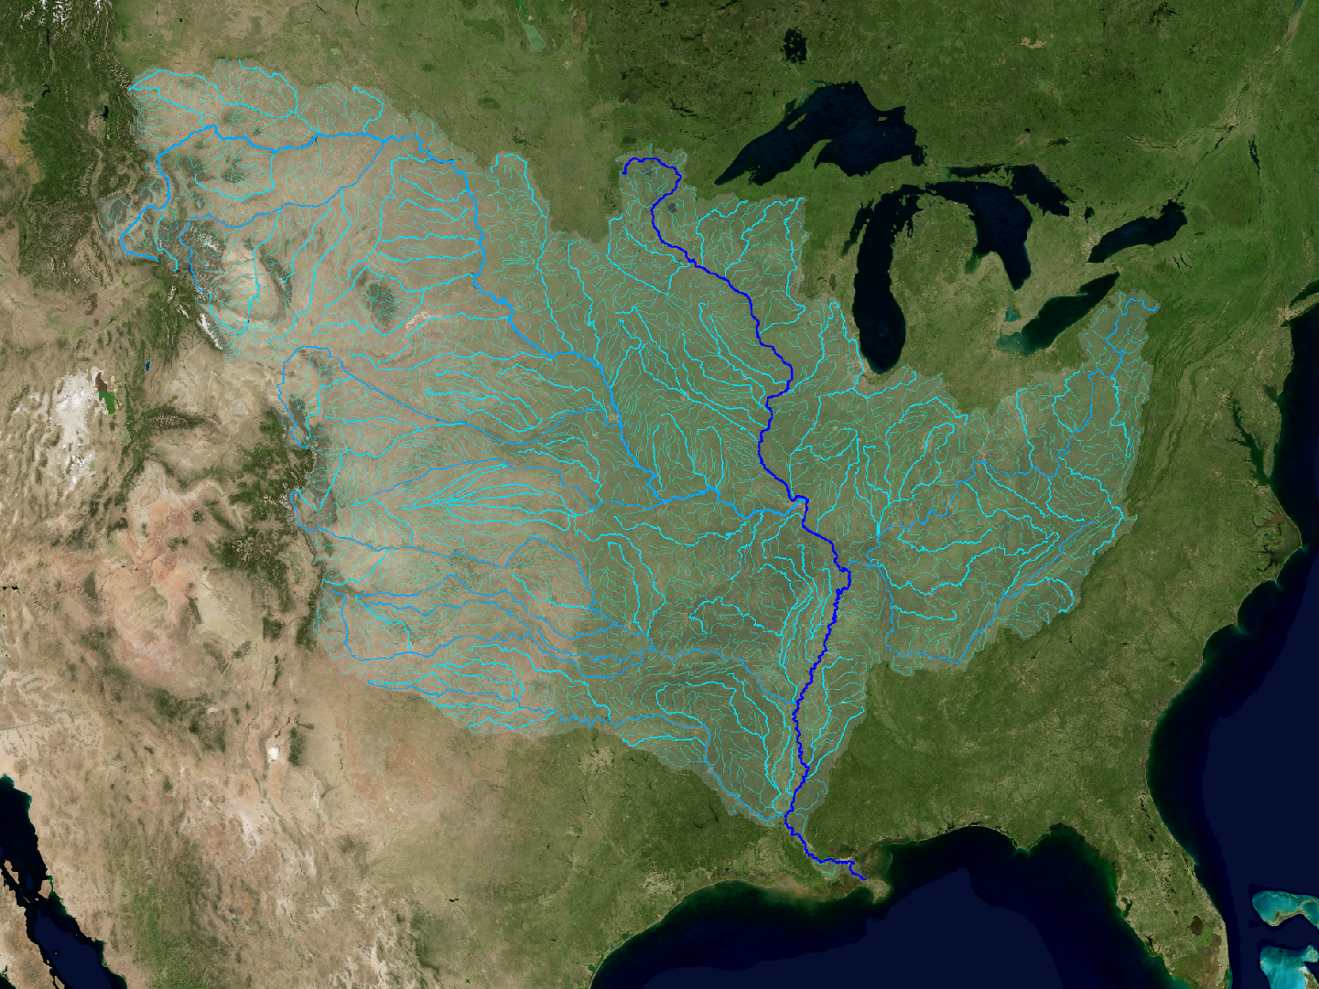
100 Million People
Image: NASA Scientific Visualization
Notes:
So when you think about all these sources, you can start to appreciate that we live in a city that is a microplastic factory. A highly effective one too. But we aren’t alone and Baton Rouge isn’t exceptional. We live on on the banks of the biggest river in North America and it drains many towns and cities. Every day, the Mississippi is carrying quantities of microplastic that are too large to even conceptualize to the Gulf of Mexico.

Slide 21
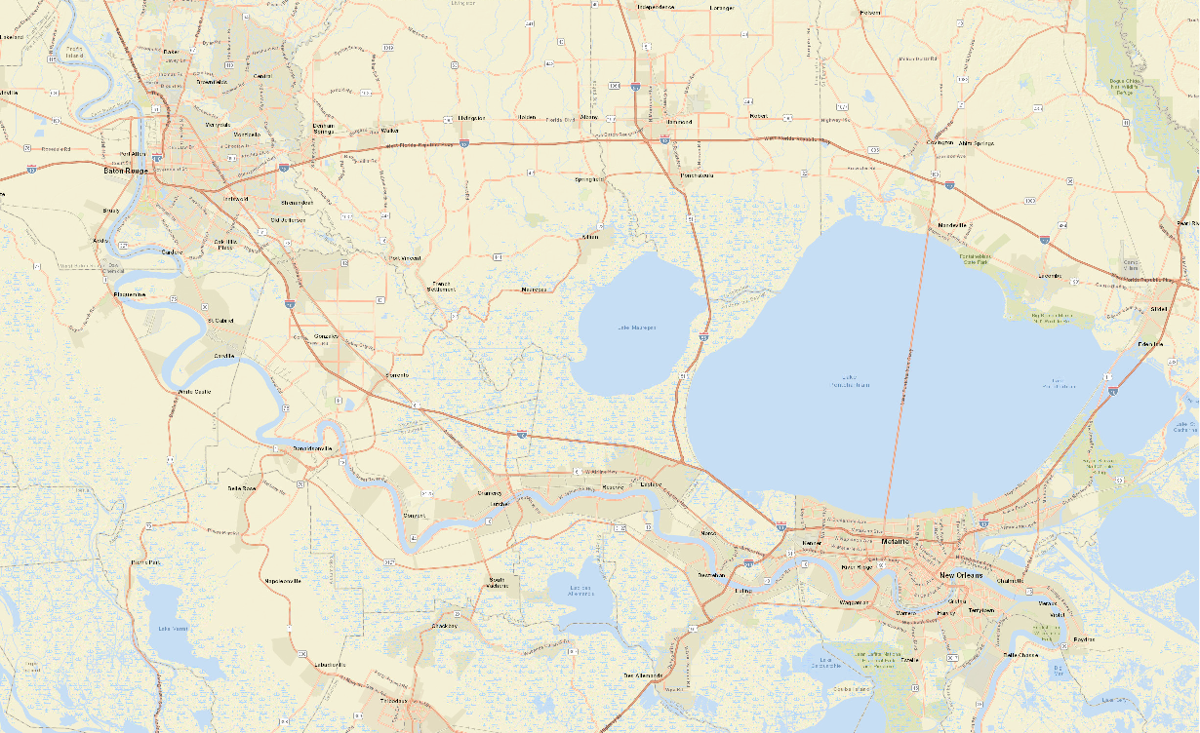
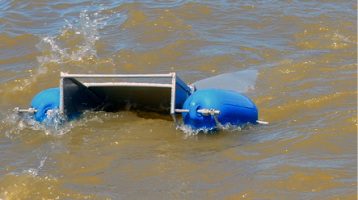
Focus on the Mississippi River
Quarterly sampling
4 cross-stream replicate tows with a Manta net equipped with 333 micron mesh
2 replicate pump samples >100 L for >10 micron particles
BR Upstream
BR Midstream
BR Downstream
NO Upstream
Davis Pond Outfall
NO Downstream

Slide 22
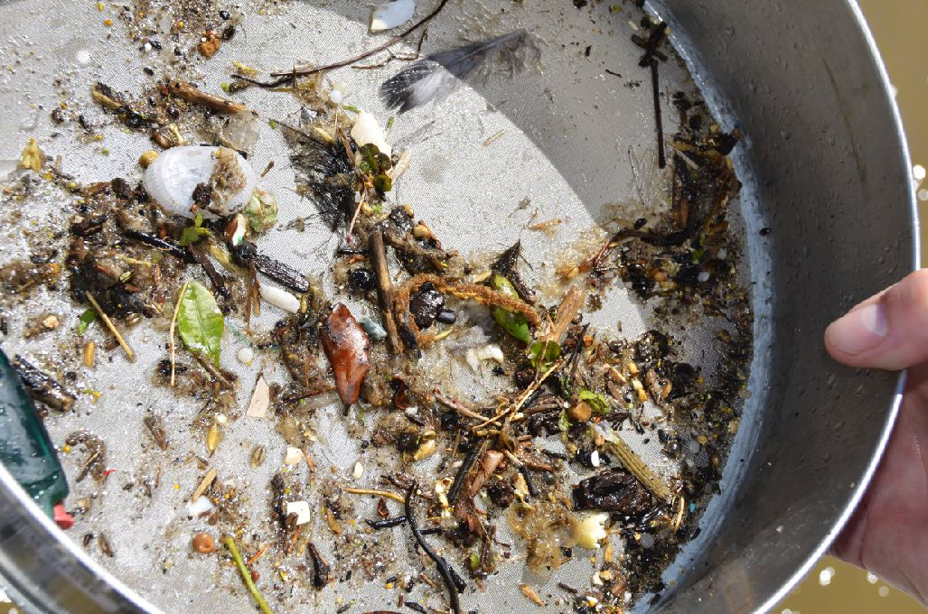
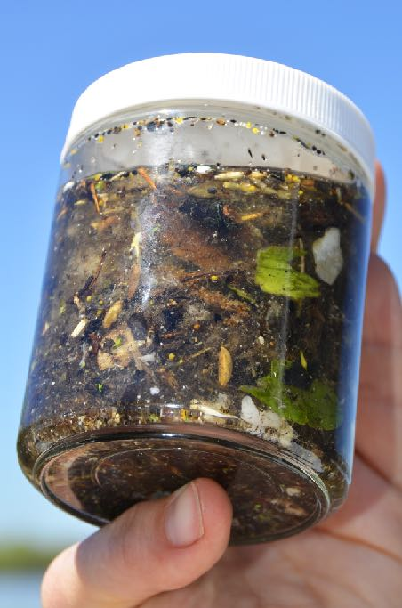
Lots of plastic
Images: Dani Dilullo/La Sea Grant

Slide 23
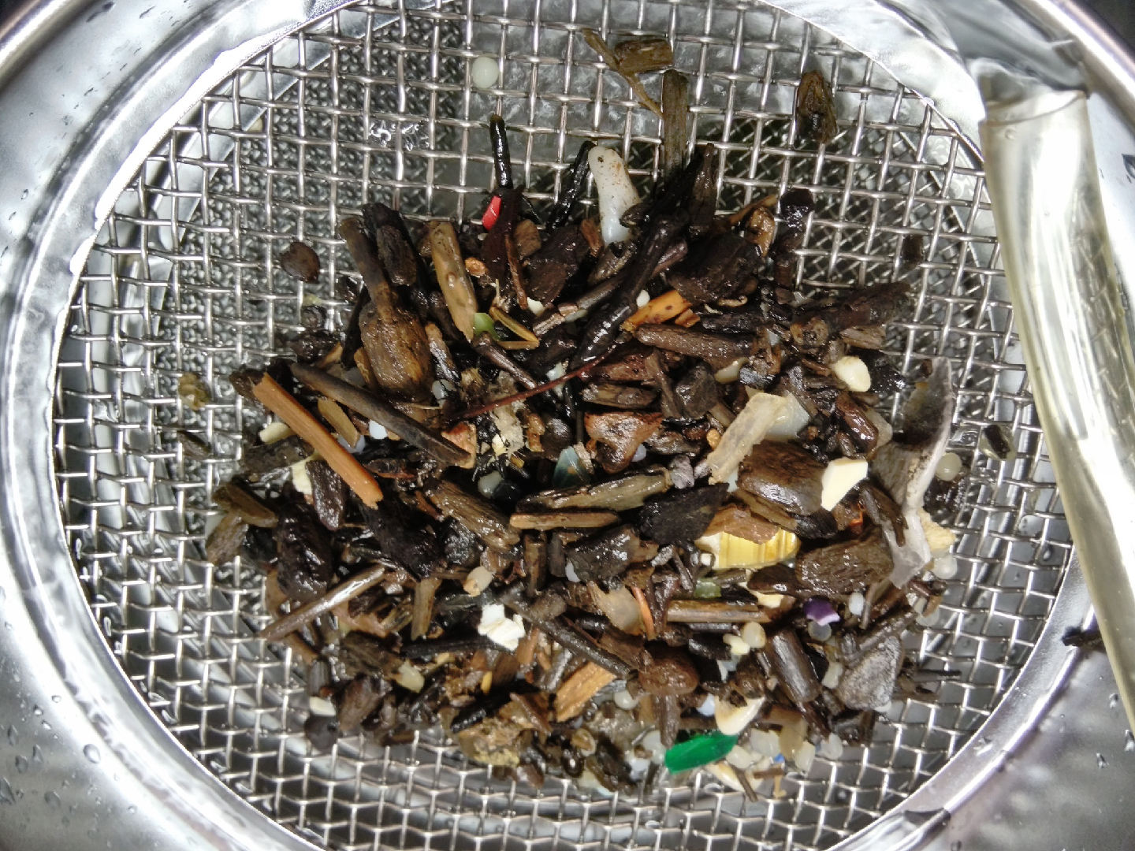
Image: Mark Benfield

Slide 24
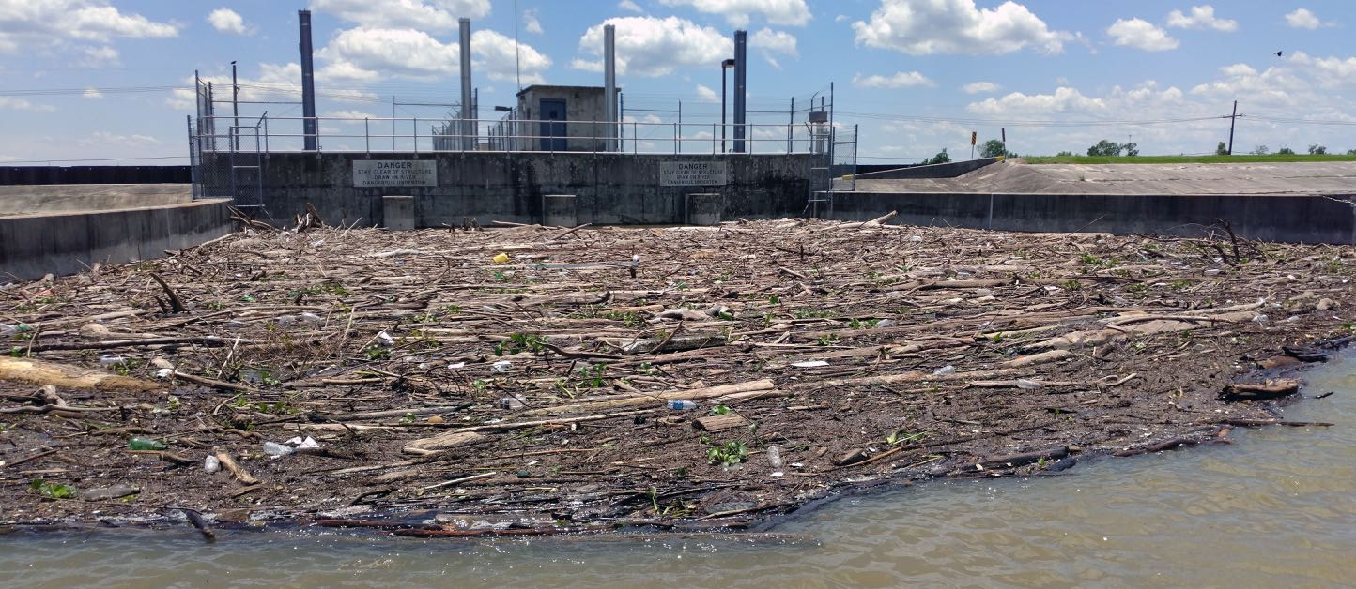
Relationship to the Coastal Master Plan
River diversions enable sediment-laden water to flow from Mississippi River to coastal estuaries
Image: Mark Benfield

Slide 26
Relationship to the Coastal Master Plan
Diversions are also fluxing a large quantity of debris into coastal estuaries

Slide 27
Relationship to the Coastal Master Plan
Diversions are also fluxing a large quantity of debris into coastal estuaries

Slide 28
Relationship to the Coastal Master Plan
Diversions are also fluxing a large quantity of debris into coastal estuaries

Slide 29
Microplastics from Davis Pond Diversion

Slide 30
Implications
388,781,515 particles d⁻¹
濃度
Notes:
Microplastic Concentrations and Fluxes

Slide 32
Characteristics of Microplastics
Image: Mark Benfield
Notes:
Small Size. Operationally 5 mm or less.

Slide 33
Sources of Microplastics
Fragmentation of Macroplastics
Personal Care Products
Paint Flakes
Spillage of Raw Resin
Spillage of
of Raw Resin
Laundering of Synthetic Fabrics
Bead Blasting
Tire Wear
Notes:
Before I return to rivers and their role in transporting microplastics, I want to review what microplastics are. Microplastics are plastics with a diameter of less than 5 mm.

Slide 34
Characteristics of Microplastics
Image: Mark Benfield
Notes:
Constantly fragmenting into smaller particles

Slide 35
Characteristics of Microplastics
Image: Mark Benfield
Notes:
Large surface area relative to their volume. And this surface is sticky for organic pollutants.

Slide 36
Image: Flickr

Slide 39
A Tasty Snack?

Slide 40
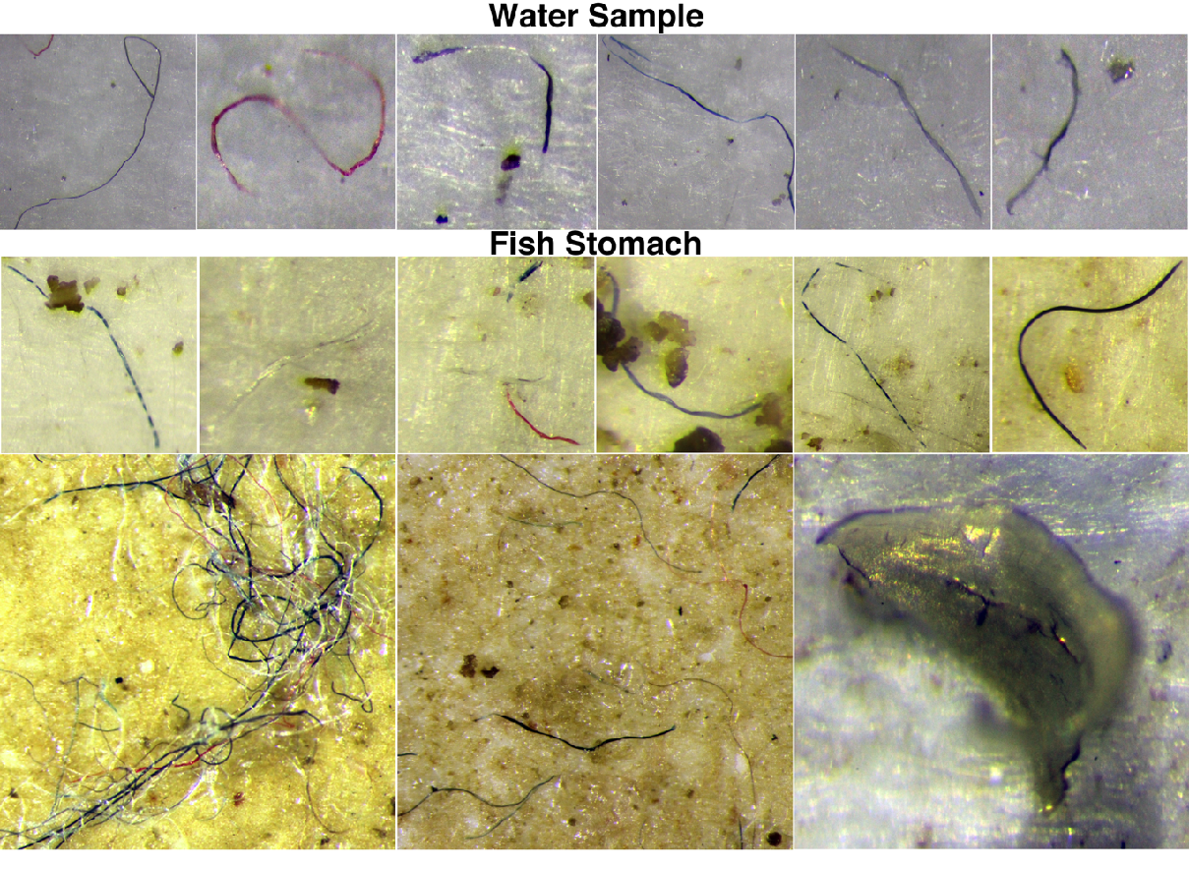
Putative Plastic Fibers from an Atlantic Bumper Stomach

Slide 41
Image: Mark Benfield

Slide 42
New Instrumentation
Image: Mark Benfield

Slide 43
Image: Mark Benfield

Slide 46
When Fear the Walking Dead set designers were asked what they did to transform Los Angeles into a post-apocalyptic wasteland.
They said, “We just picked up some of the trash.”

