Slide 1
2023 Coastal Master plan committed to our coast
Barataria-Terrebonne National Estuary Program
Management Conference
Stuart Brown | November 1, 2018

Slide 2
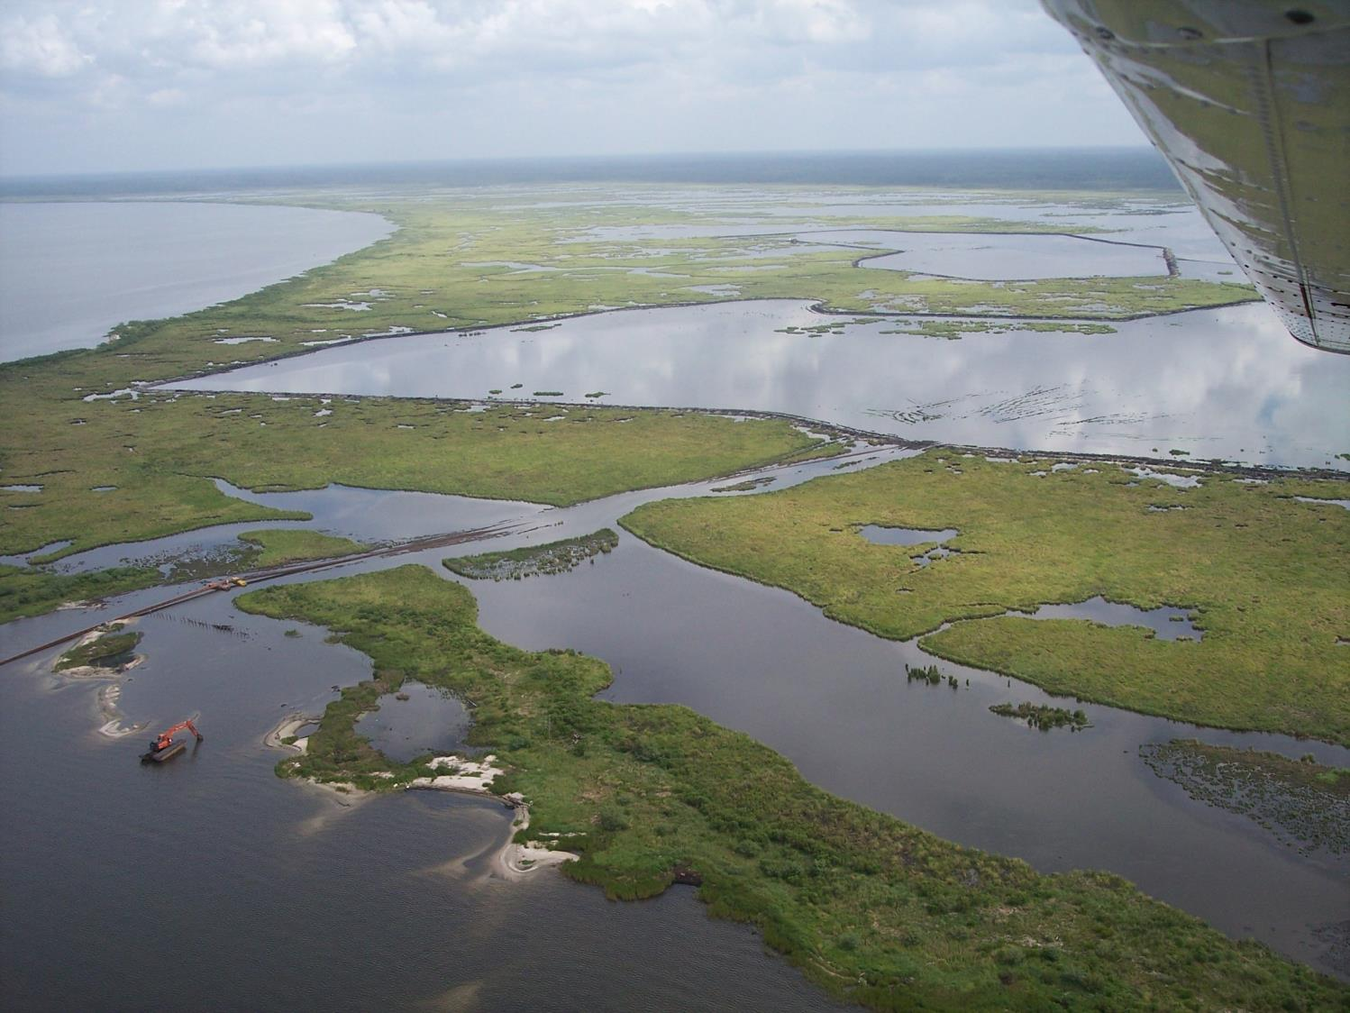
COASTAL PROTECTION AND RESTORATION AUTHORITY
Single state entity with authority to articulate a clear statement of priorities to achieve comprehensive coastal protection for Louisiana.
Mandate is to develop, implement, and enforce a comprehensive coastal protection and restoration Master Plan.

Slide 3
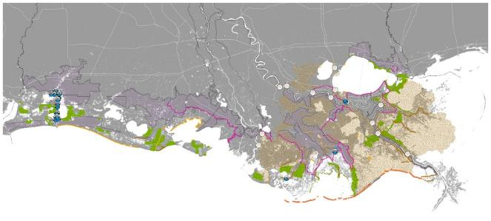
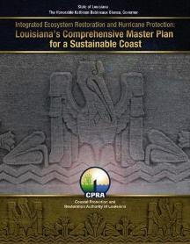
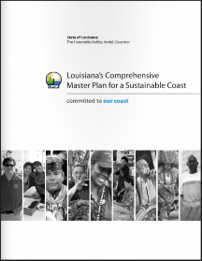
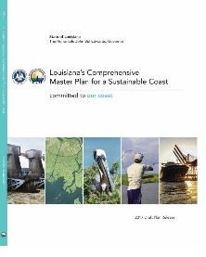
WHAT IS THE COASTAL MASTER PLAN?
Required by law to be updated every six years
Built on world class science and engineering
Incorporates extensive public input and review
Advances a comprehensive and integrated approach to protection and restoration
Identifies investments that will pay off, not just for us, but for our children and grandchildren

Slide 4
HOW ARE CPRA PROJECTS IMPLEMENTED?
Coastal Master Plan
Conceptual design
every 6 years
Operations, Maintenance, and Adaptive Management
Feasibility Studies
< 30% design
ongoing
Construction
Engineering and Design
100% design

Slide 5
CPRA AND THE MASTER PLAN PROCESS
2017 COASTAL MASTER PLAN RECAP

Slide 6
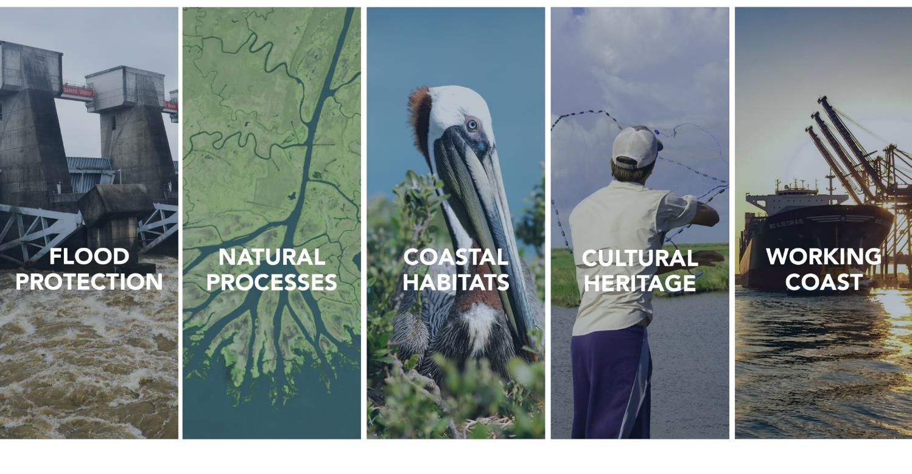
2017 COASTAL MASTER PLAN OBJECTIVES
Notes:
The Coastal Master Plan is designed to provide the direction and path forward needed to save our coast.
These objectives reflect the key issues affecting people in and around Louisiana’s coast, seeking to improve flood protection for families and businesses, recreate the natural processes that built Louisiana’s delta, sustain our unique cultural heritage, and ensure that our coast continues to be both a Sportsman’s Paradise and a hub for commerce and industry.

Slide 7
2017 COASTAL MASTER PLAN DEVELOPING THE PLAN

Slide 8
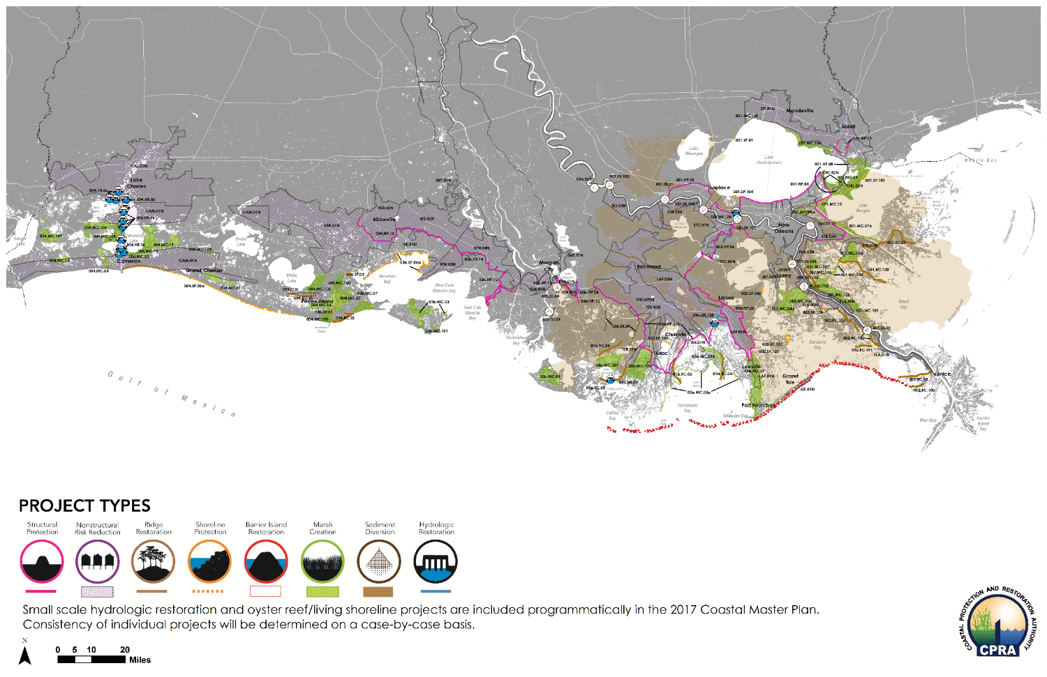
2017 COASTAL MASTER PLAN
124
PROJECTS
FLOOD DAMAGE REDUCED BY $150B
802
LAND CREATED
SQUARE
MILES OF

Slide 9
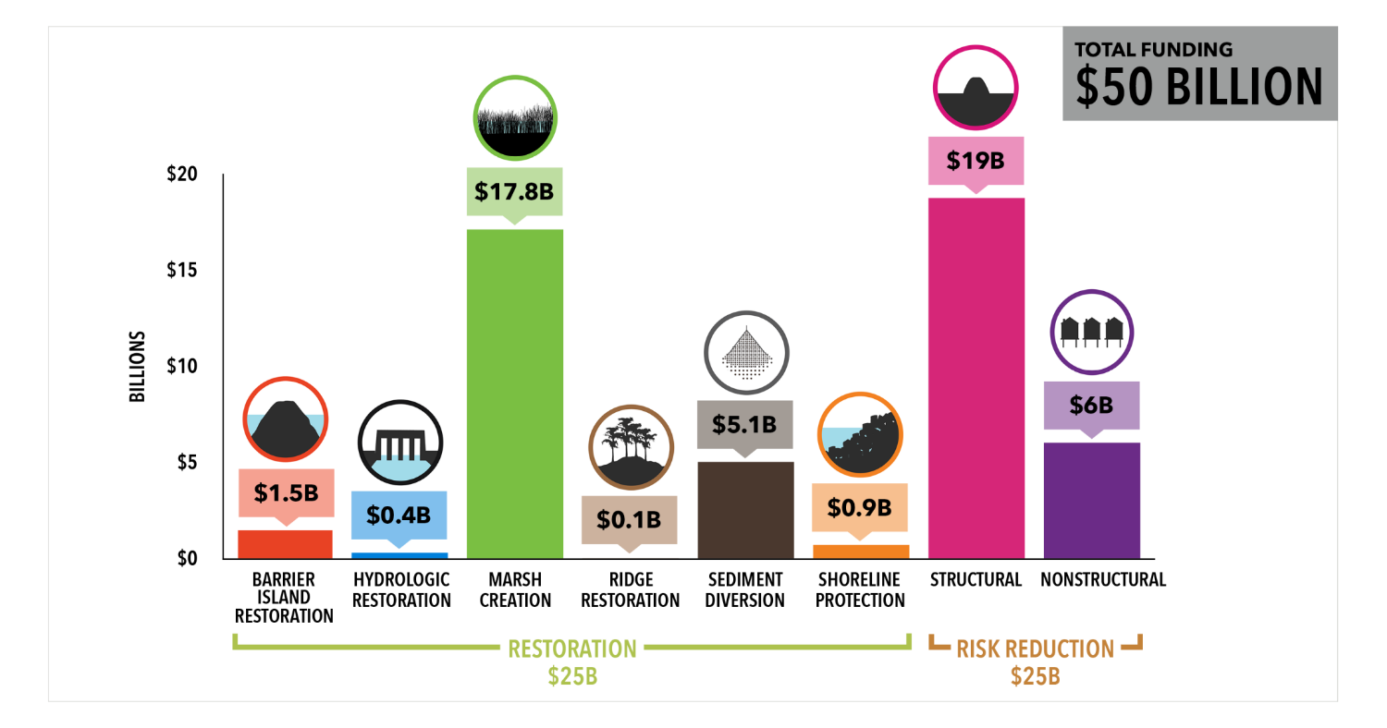
2017 COASTAL MASTER PLAN FUNDING BY PROJECT TYPE

Slide 10
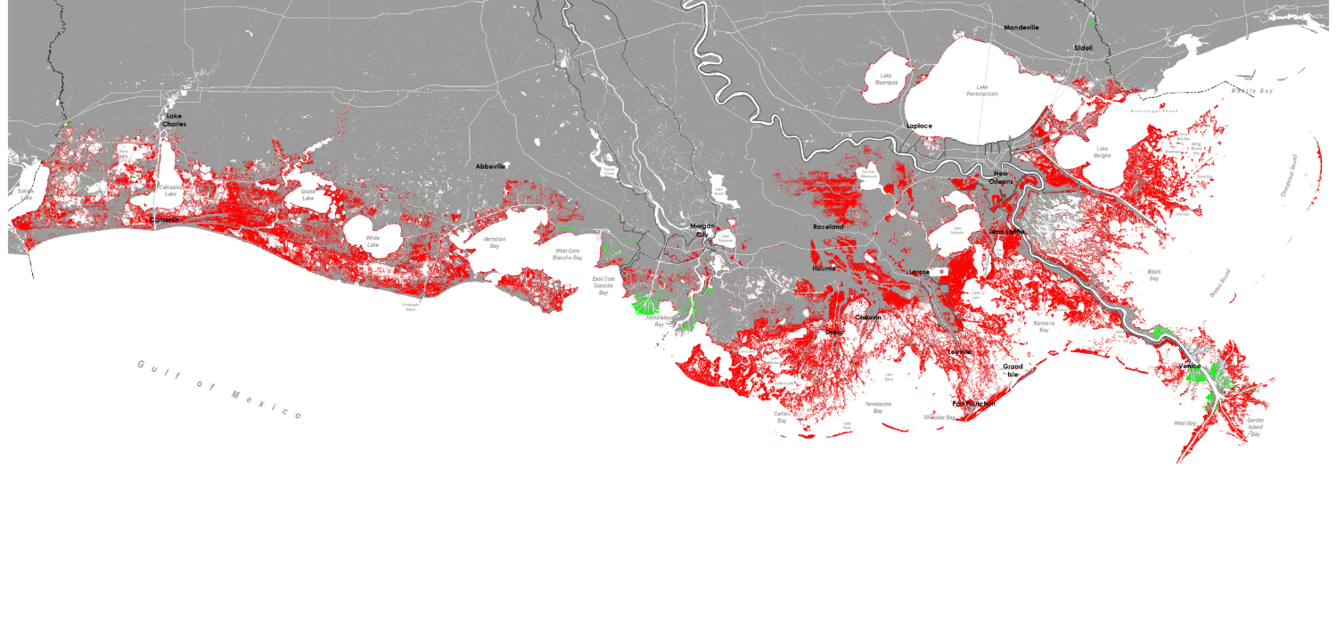
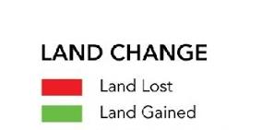
2017 COASTAL MASTER PLAN FUTURE WITHOUT ACTION | MEDIUM SCENARIO | YEAR 50

Slide 11
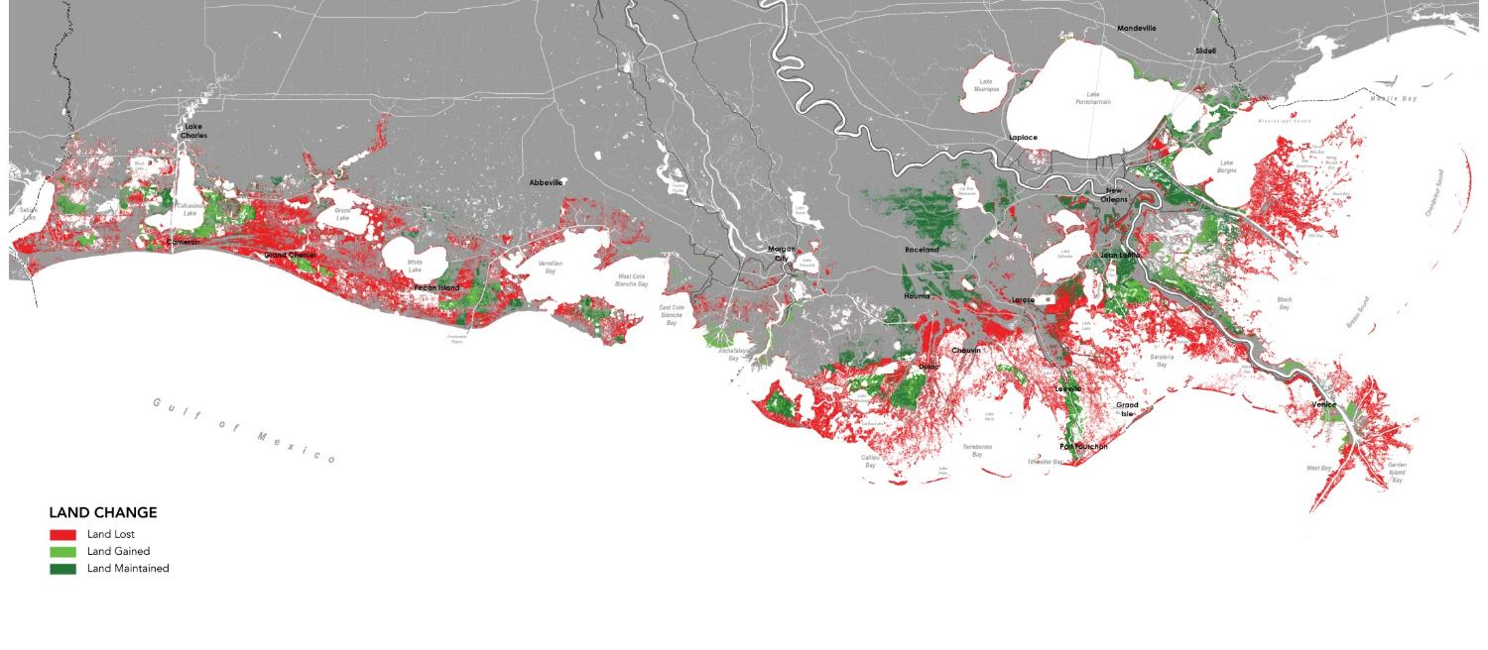
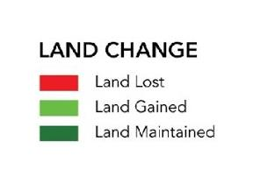
2017 COASTAL MASTER PLAN FUTURE WITH ACTION | MEDIUM SCENARIO | YEAR 50

Slide 12
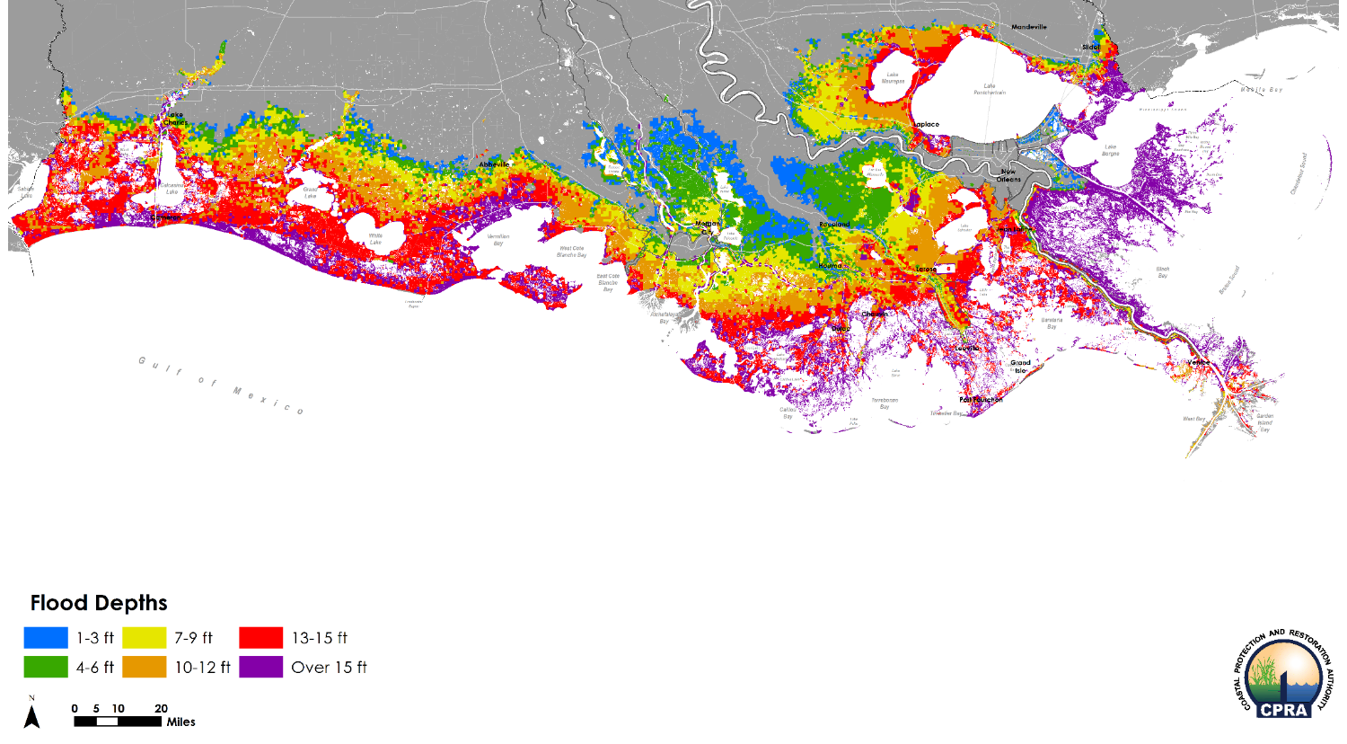
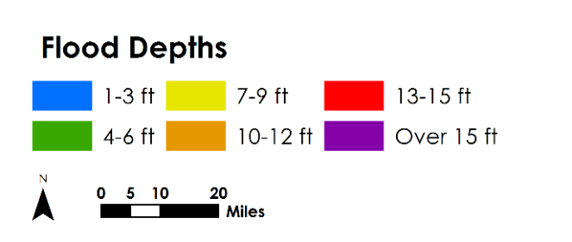
2017 COASTAL MASTER PLAN FUTURE WITHOUT ACTION | MEDIUM SCENARIO | YEAR 50

Slide 13
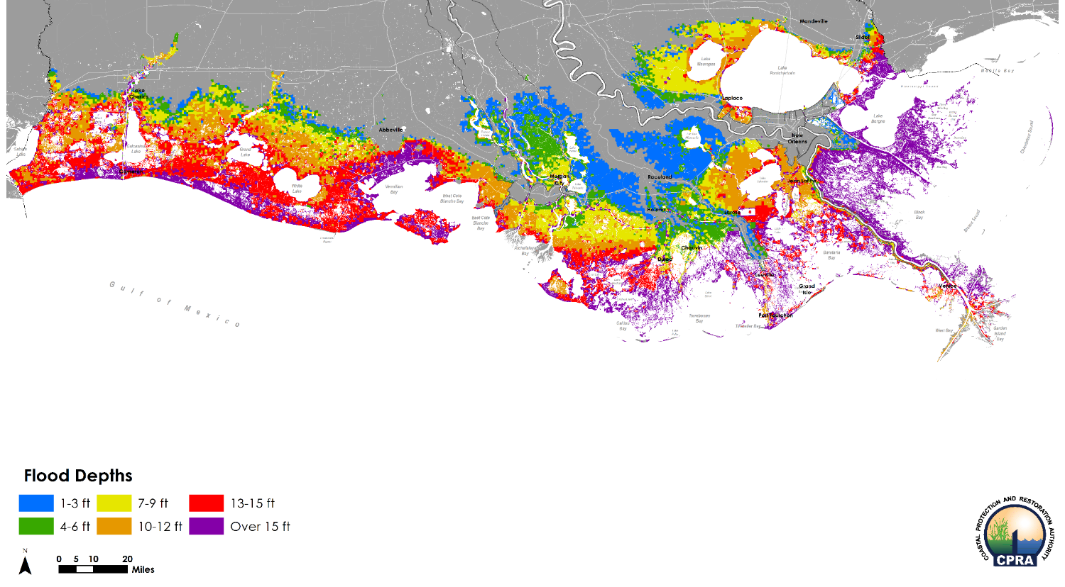
2017 COASTAL MASTER PLAN FUTURE WITH ACTION | MEDIUM SCENARIO | YEAR 50

Slide 14
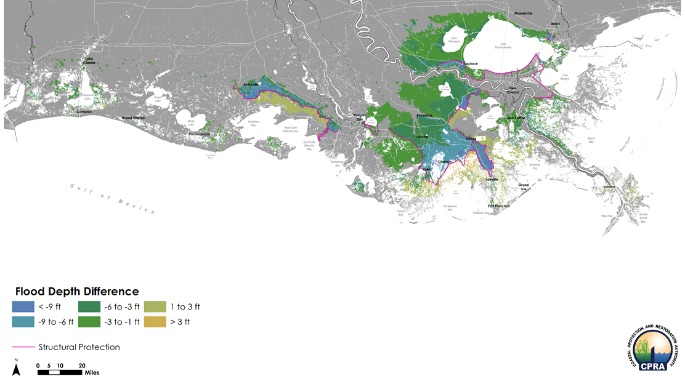
2017 COASTAL MASTER PLAN FWA - FWOA DIFFERENCE | MEDIUM SCENARIO | YEAR 50

Slide 15
2023 COASTAL MASTER PLAN

Slide 16
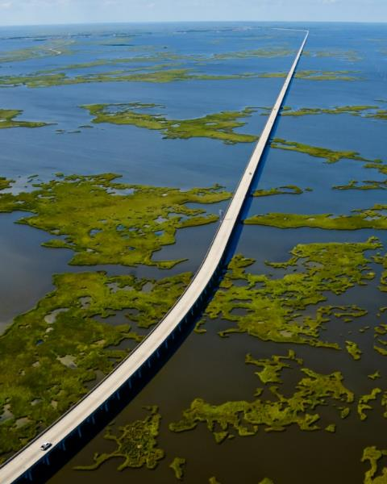
2023 COASTAL MASTER PLAN
Focus:
Project Sequencing
Managing Transitions/ Adaptation
Illustrating Medium-term Outcomes
Solving Future Problems
Outcome: a final plan that is realistic and practical, better links protection and restoration projects, and focuses on a message of transition and adaptation

Slide 17
2023 COASTAL MASTER PLAN
Activity | 2018 | 2019 | 2020 | 2021 | 2022 | 2023
New Project Development
Model Updates and Cal/ Val
Update Scenarios and FWOA List
New FWOA Runs
Project Attributes (projects)
New Project Modeling
Project Attributes (alternatives)
Alternatives Modeling (draft plan)
Document Development (draft)
Formal Public Meetings
CPRA Board Meeting
Final Master Plan to Legislature
FWOA = Future Without Action

Slide 18
2023 COASTAL MASTER PLAN
Technical Analysis

Slide 19
TECHNICAL ANALYSIS
2017 PREDICTIVE MODELS

Slide 20
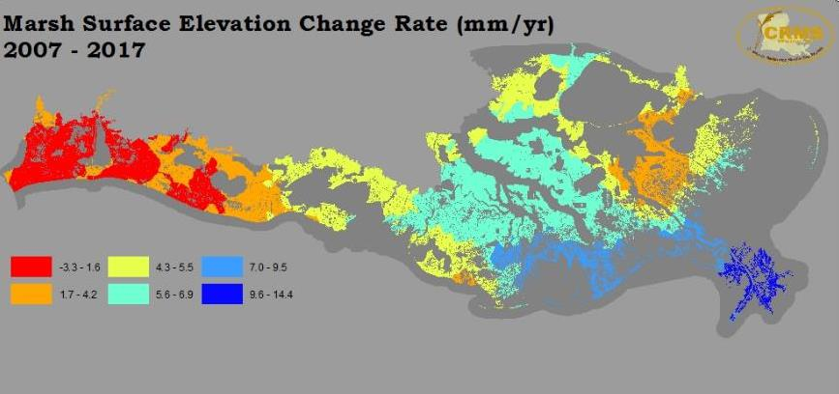
TECHNICAL ANALYSIS PREDICTIVE MODEL UPDATES
ICM and Storm Surge and Risk Assessment Models:
Revisit key assumptions with new, potentially implementable insights
Consider incorporation of newly available or improved data
Address straightforward improvements identified during the 2017 analyses

Slide 21
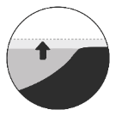
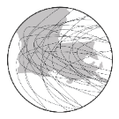
TECHNICAL ANALYSIS 2017 ENVIRONMENTAL SCENARIOS
SCENARIO | SEA LEVEL RISE | SUBSIDENCE | STORM FREQUENCY | AVG. STORM INTENSITY | PRECIPITATION | EVAPO-TRANSPIRATION
LOW | 1.41’ | 20% OF RANGE | -28% | +10.0% | >HISTORICAL | <HISTORICAL
MEDIUM | 2.07' | 20% OF RANGE | -14% | +12.5% | >HISTORICAL | HISTORICAL
HIGH | 2.72’ | 50% OF RANGE | 0% | +15.0% | HISTORICAL | HISTORICAL

Slide 22
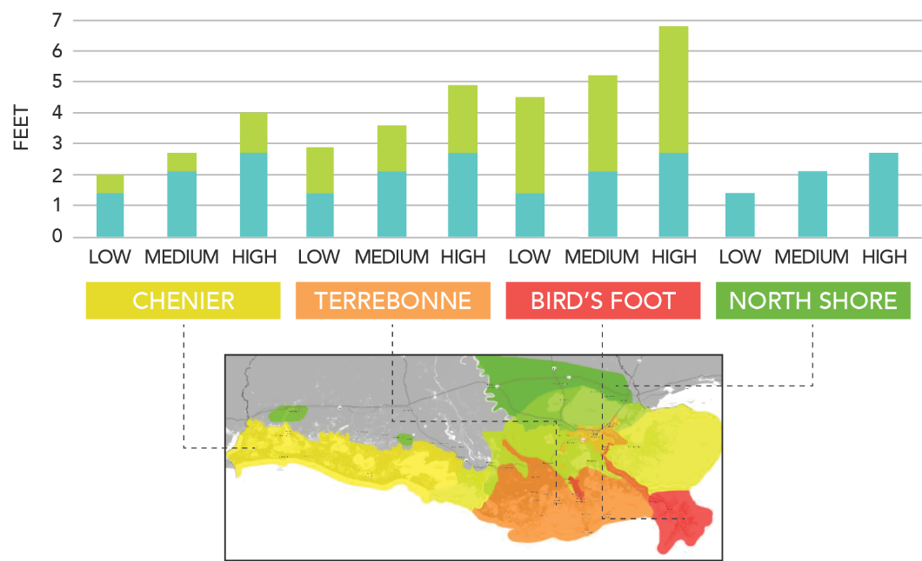
TECHNICAL ANALYSIS 2017 ENVIRONMENTAL SCENARIOS
Relative Sea Level Rise = Sea Level Rise + Subsidence

Slide 23
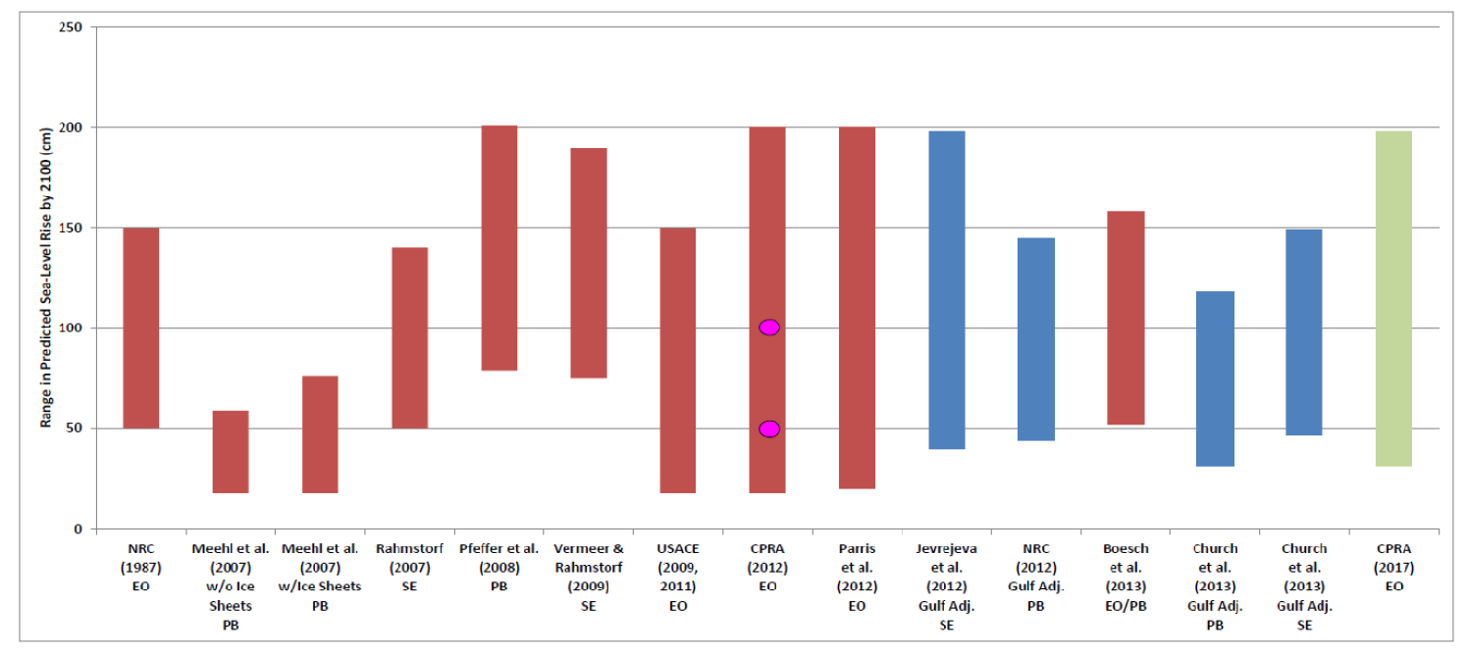
TECHNICAL ANALYSIS 2017 ENVIRONMENTAL SCENARIOS

Slide 24
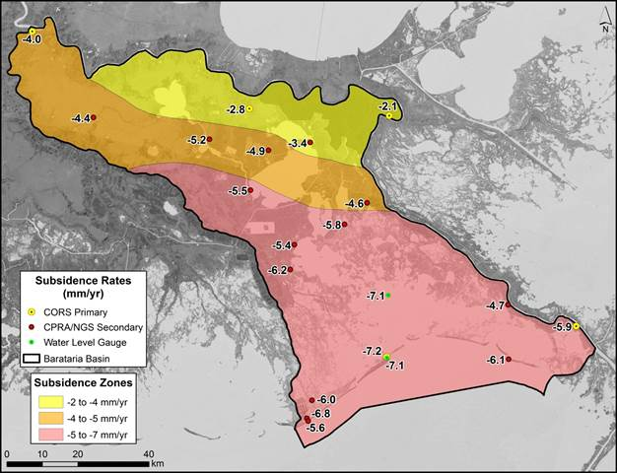
TECHNICAL ANALYSIS ENVIRONMENTAL SCENARIO UPDATES

Slide 25
TECHNICAL ANALYSIS 2017 PROJECT EVALUATION

Slide 26
2023 COASTAL MASTER PLAN
Coordination with Other Efforts

Slide 27
ONGOING EFFORTS
CPRA
Lowermost Mississippi River Study (CPRA)
Flood Risk and Resilience Program
Economic impacts assessment and interagency flood risk outreach (CPRA)
Parish Capacity Assessment (CPRA)
Other
EDF Studies
Purdue Flood Risk Viewer
Louisiana Watershed Initiative

Slide 28
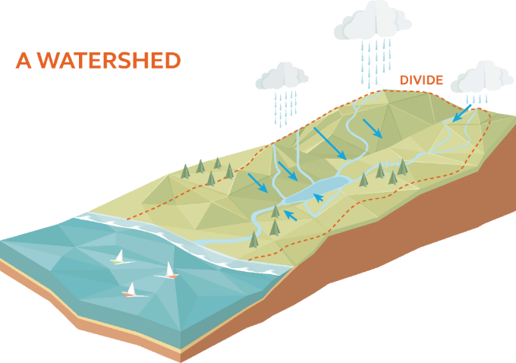
ONGOING EFFORTS LOUISIANA WATERSHED INITIATIVE
Louisiana Senate Resolution 172 directed the Department of Transportation and Development, in consultation with other state agencies, to:
“… provide recommendations to establish, implement, and enforce floodplain management plans for each watershed in Louisiana.”

Slide 29
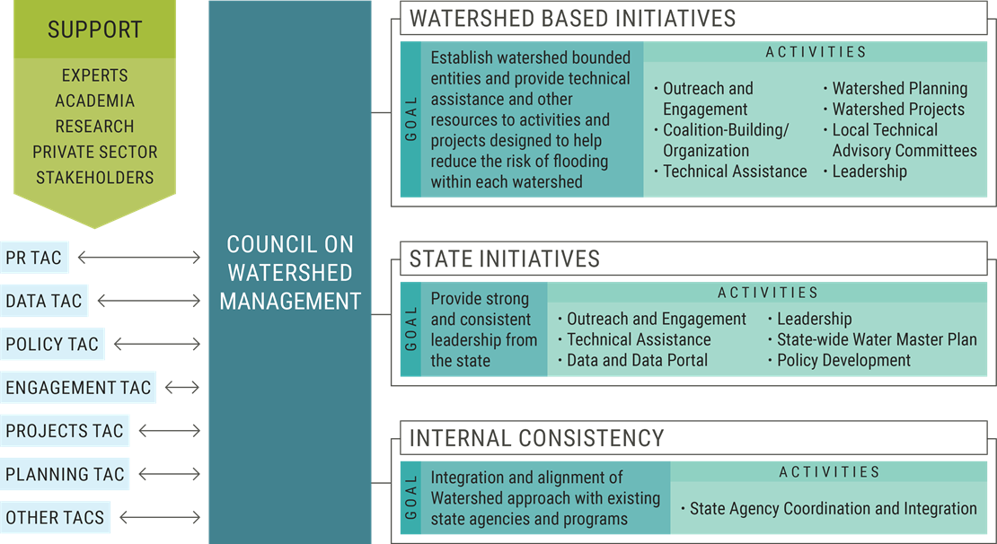
ONGOING EFFORTS

Slide 30
2023 COASTAL MASTER PLAN
New Project Development

Slide 31
NEW PROJECT DEVELOPMENT BIG PICTURE
CPRA will accept proposals for new projects to be included in the 2023 Coastal Master Plan.
Goal: facilitate an engaged process to identify project concepts that will improve master plan outcomes, particularly for areas where FWA conditions are stark.
FWA = Future With Action

Slide 32
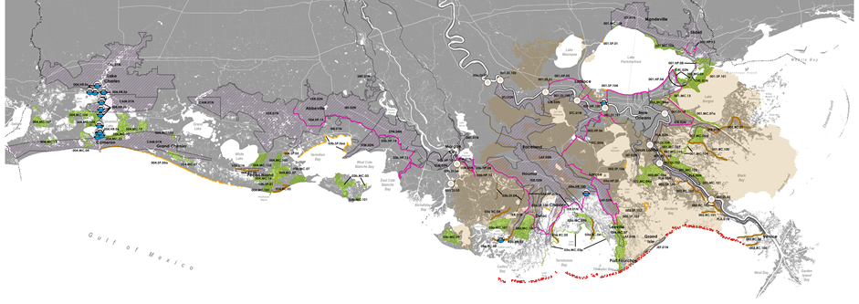
PUBLIC SOLICITATION GUIDELINES AND CRITERIA
New projects can be proposed by any source, including academia, parishes, elected officials, agencies, NGOs, landowners, business/ industry, and the general public.

Slide 33
PUBLIC SOLICITATION GUIDELINES
Projects can be proposed that:
Build and/ or sustain land (including “Integrated Projects”)
Provide significant Flood Risk Reduction
Respond to landscape shifts (e.g., resulting from hurricanes or other disasters)
Address future uncertainty challenges or directly support future transitions in the coastal ecosystem

Slide 34
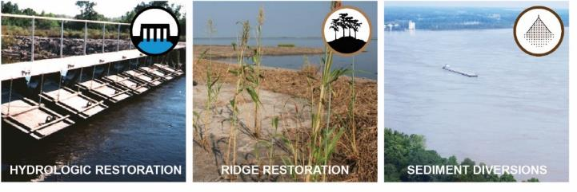
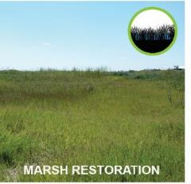
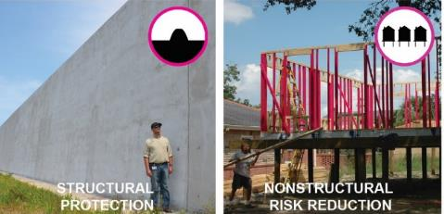
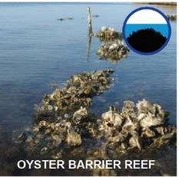
PUBLIC SOLICITATION
PROJECT TYPES
Included in Public Solicitation for new project ideas:
To be considered programmatically:

Slide 35
PUBLIC SOLICITATION PROJECT TYPES
“Programmatic” approach:
Barrier islands- develop plans for the system rather than as piecemeal projects.
Oyster reefs, shoreline protection, small-scale hydrologic restoration, etc.- support through programs that evaluate benefits on a case-by-case basis (e.g., CWPPRA)

Slide 36
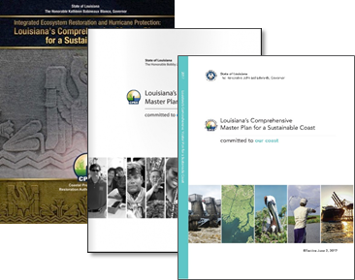
PUBLIC SOLICITATION SCREENING CRITERIA
Like the 2017 plan, a screening process will be used to determine whether a project has the potential to be included in the 2023 analysis
Screening Criteria include:
Consistency with Master Plan Objectives and Principles
Magnitude of Expected Effects
Geographic Area
Duplicative Effects
Adequate Information

Slide 37
PUBLIC SOLICITATION SUBMITTAL DETAILS
Proposals to be delivered electronically, in .pdf format, to MasterPlan@la.gov or mailed to the 2023 Coastal Master Plan Project Development Program at P.O. Box 44027, Baton Rouge, Louisiana, 70804 and received by March 1, 2019.
Proposals to be no more than 7 pages
1-2 pages for Cover Sheet and Contact Information
2 pages for Project Description
1 page for Map
1-2 pages for Project Attributes
Questions can be sent to MasterPlan@la.gov

Slide 38
QUESTIONS?
2023 Coastal Master Plan

