Slide 1
Assistance Available
Through the
Natural Resources Conservation Service
Presented by: Samuel A. Terry
Lacy Bellanger
Darren Boudreaux
Program Liaison
USDA Natural Resources Conservation Service

Slide 2
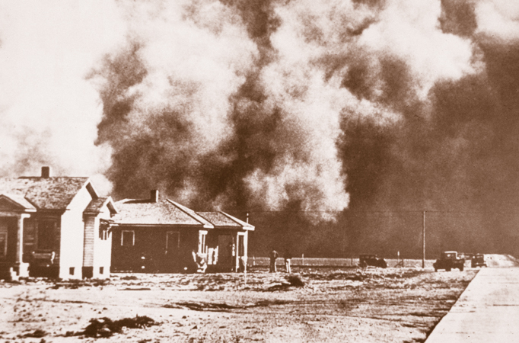
Long History of Conservation
1933
Soil Erosion Service
1935
Soil Conservation Service
1994
Natural Resources Conservation Service
Notes:
75 years ago, during one of the bleakest times in America’s agricultural history, national leaders established the Soil Conservation Service to help save America’s soil resources.
America was losing thousands of tons of topsoil as a result of relentless dust storms caused by years of catastrophic drought conditions and poor farming practices—and action had to be taken to save our country’s farmlands.
The Soil Conservation Service was established in 1935 to carry out a continuing program of soil and water conservation on America’s privately owned farms, ranches, and forest lands.
In 1938, the Louisiana Legislature established the State Soil and Water Conservation Committee and authorized it to work with local farmers to establish local conservation districts.

Slide 3
Our Employees
Soil Scientists
Resource Conservationists
Grazing Lands Specialists
Engineers
Biologists
Botanists
Agronomists
Foresters
Conservation Technicians
Administrative Staff
Notes:
Photos: Randolph Joseph, ASTC FO Lafayette; Kevin Stilley, District Conservationist Franklinton FO; Landowner Chief Warhorse Gillum

Slide 4
Our Partners
44 Local Soil and Water Conservation Districts
State and Federal Agencies
Community Based Organizations
Grassroots Organizations
Federal, state, and local agencies working together to conserve and protect Louisiana’s natural resources.
Notes:
The Soil Conservation Service was established in 1935 to carry out a continuing program of soil and water conservation on America’s privately owned farms, ranches, and forest lands.
In 1938, the Louisiana Legislature established the State Soil and Water Conservation Committee and authorized it to work with local farmers to establish local conservation districts.
The historic partnership between local, state, and federal agencies in Louisiana is a key factor in achieving conservation success in Louisiana.

Slide 5
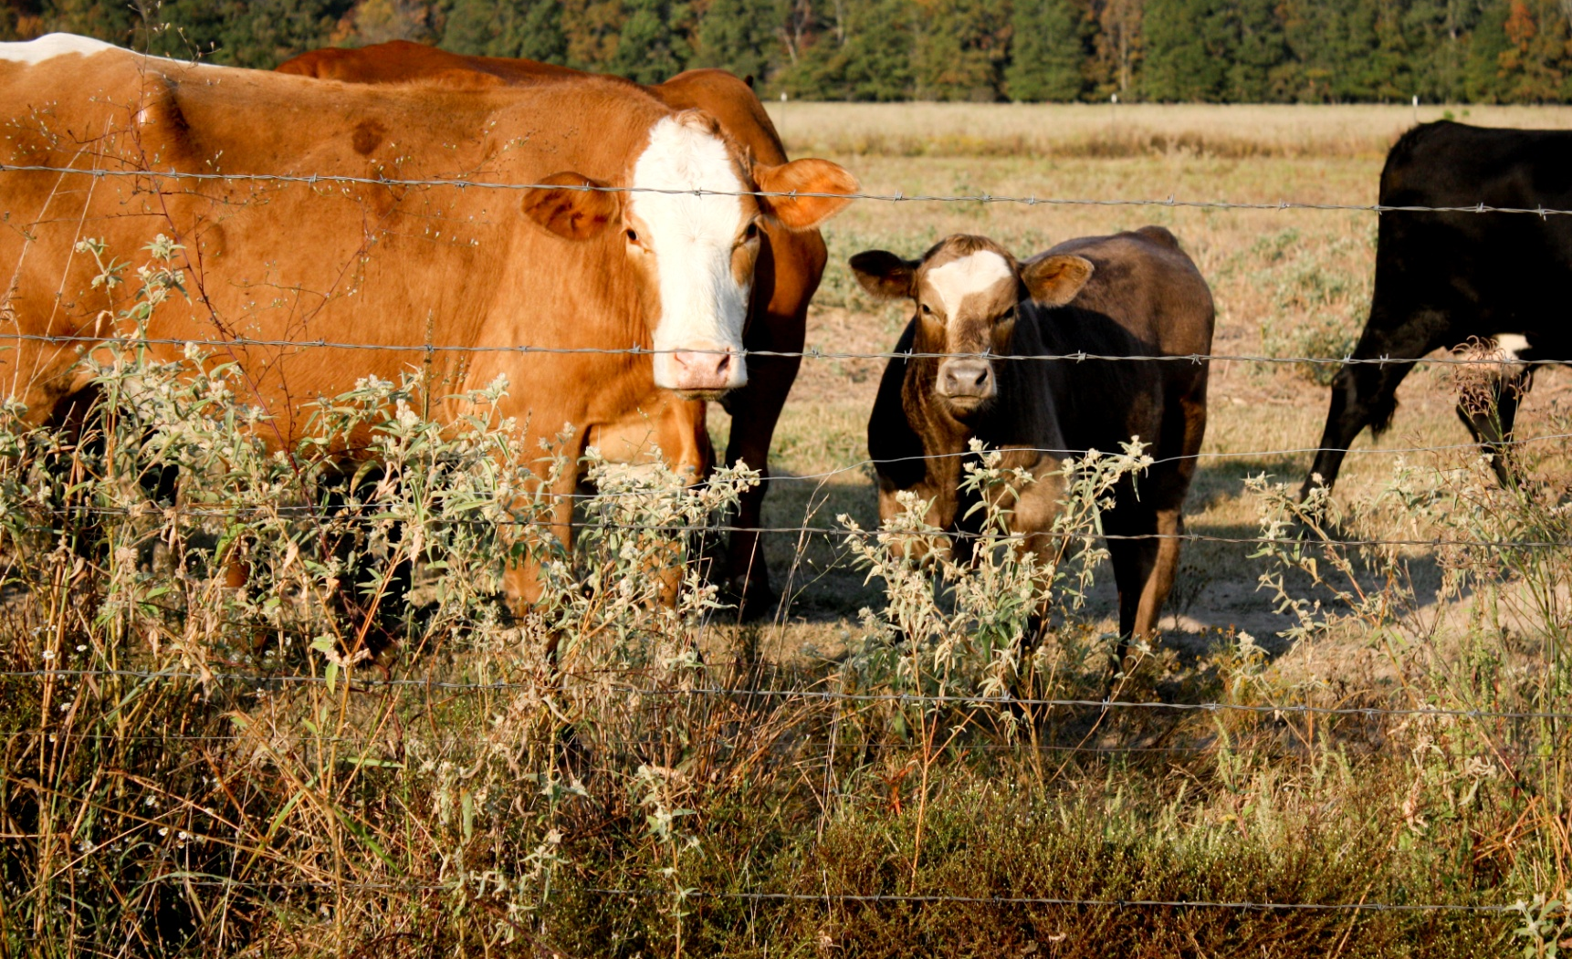
Our Job
NRCS provides
Technical and Financial assistance for all farms

Slide 6
Notes:
Our programs are translating into benefits for rural America and rural communities.
Investments in four of our largest assistance programs translated into help for not only the producer who received the support, but others in the community as well.
From 2014-2017:
$2.6 billion was invested in the planning and implementation of conservation practices through our Conservation Technical Assistance program generating an average of $1 billion in annual economic activity and supporting 12,100 jobs each year.
The CTA program helps farmers develop a conservation plan that will help their operation succeed. These plans provide a roadmap for producers, helping them meet both their production and natural resource goals.
Our unique ability to offer both financial and technical assistance helps ensure that we can meet the diverse needs of our customers.
It translates into more conservation on the land because we can offer producers not only personalized advice from expert conservationists, but also the means to make those recommendations happen if the producer chooses to move forward.
This holistic approach helps us ensure the highest level of customer service while at the same time providing the most conservation return on taxpayer investment.
The father of soil conservation Hugh Hammond Bennett said, “There is no virtue in planning merely for the sake of planning. Unless plans can be translated into action, planning becomes a profitless mental exercise.”

Slide 7
Conservation Plan
Road map for how a producer wants to manage their farm.

Slide 8
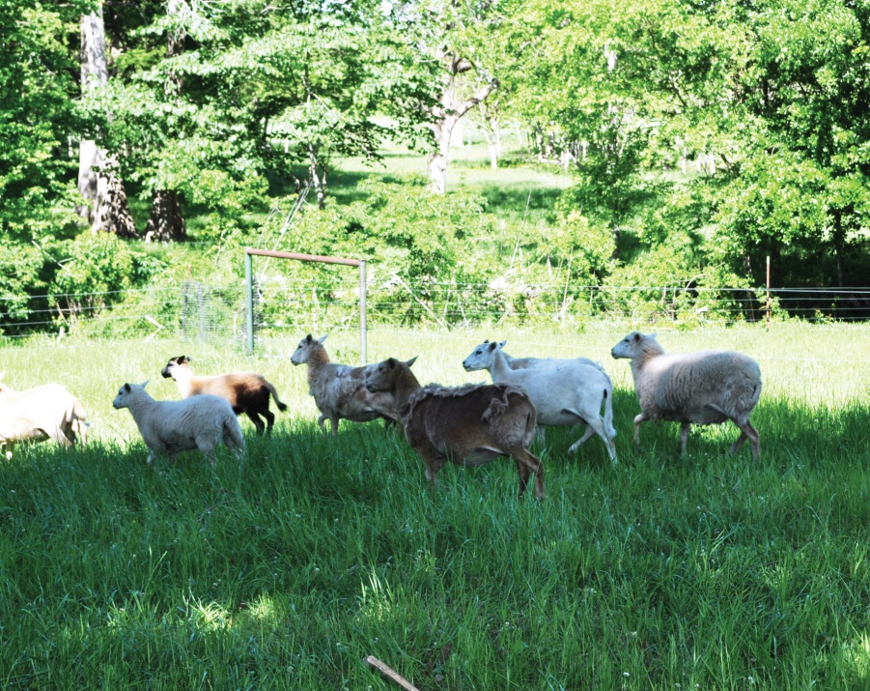
Conservation Plan
Takes the producer’s objectives and blends them with the landscape of their farm.

Slide 9
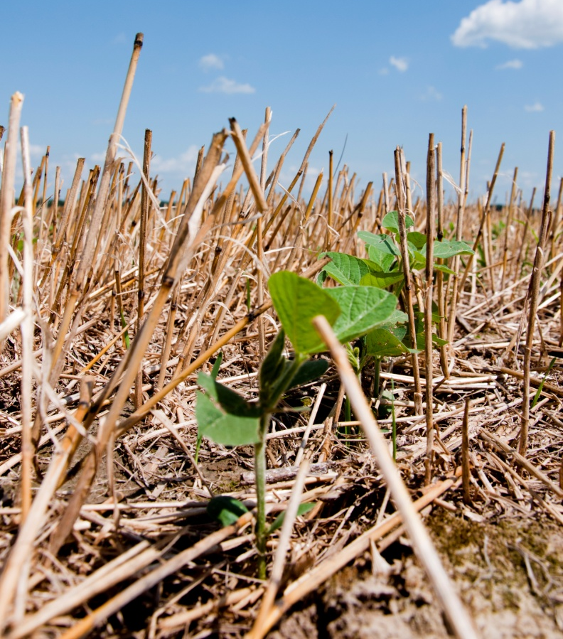
Conservation Plan
Provides management alternatives that will sustain farm for future generations.

Slide 10
Farm Bill Programs
Provide landowners and managers financial incentives for resource protection.

Slide 11
Farm Bill Programs
Financial Assistance
EQIP: Environmental Quality Incentives Program
CSP: Conservation Stewardship Program
AMA: Agricultural Management Assistance Program
Easements
ACEP: Agricultural Conservation Easement Program
HFRP: Healthy Forests Reserve Program
Notes:
Highlights of Program Changes from 2008 to 2014 Farm Bill Conservation Title
The Conservation Title of the 2014 Farm Bill streamlines and simplifies NRCS conservation programs and allows better targeting of conservation and priority resource concerns. Among other changes, the new law:
incorporates the Wildlife Habitat Incentive Program into the Environmental Quality Incentives Program.
combines three conservation easement programs into one with consistent authority and definitions;
consolidates four regional conservation programs into one comprehensive program;
Maintains, with minor or no adjustments, many of the smaller programs or support provisions;

Slide 12
Farm Bill Programs
Partnerships
RCPP: Regional Conservation Partnership Program
Other
VPAHIP:
Voluntary Public Access and Habitat Incentive Program
CIG: Conservation Innovation Grants
ACES: Agricultural Conservation Experience Services Program
Notes:
Highlights of Program Changes from 2008 to 2014 Farm Bill Conservation Title
The Conservation Title of the 2014 Farm Bill streamlines and simplifies NRCS conservation programs and allows better targeting of conservation and priority resource concerns. Among other changes, the new law:
incorporates the Wildlife Habitat Incentive Program into the Environmental Quality Incentives Program.
combines three conservation easement programs into one with consistent authority and definitions;
consolidates four regional conservation programs into one comprehensive program;
Maintains, with minor or no adjustments to many of the smaller programs or support provisions;

Slide 13
Farm Bill Programs
Four Major Programs
Environmental Quality Incentives Program
Conservation Stewardship Program
Agricultural Conservation Easement Program
Regional Conservation Partnership Program
EQIP
CSP
ACEP
RCPP
Notes:
Environmental Quality Incentives Program (EQIP)
EQIP continues to offer financial and technical assistance to farmers and ranchers to install or implement conservation practices on eligible agricultural land to protect water, air and soil quality as well as wildlife habitat.
Conservation Stewardship Program (CSP)
CSP continues to provide technical and financial assistance to farmers and ranchers to actively manage and maintain existing conservation systems and to implement additional conservation activities on land in agricultural production. Authorizes the enrollment of an additional 10,000,000 acres each of fiscal years 2014 through 2022.
Agricultural Conservation Easement Program (ACEP)
ACEP consolidates the Farm and Ranch Lands Protection Program (FRPP), Grassland Reserve Program (GRP) easement options, and the Wetlands Reserve Program (WRP) into one program. The program enrolls wetland reserve easements and facilitates partner purchases of agricultural land easements.
Regional Conservation Partnership Program (RCPP)
Combines the purposes of the Cooperative Conservation Partnership Initiative (CCPI), Agricultural Water Enhancement Program (AWEP), Chesapeake Bay Watershed Initiative (CBWI), and Great Lakes Basin Program for Soil Erosion and Sediment Control to create a single regional partnership program.

Slide 14
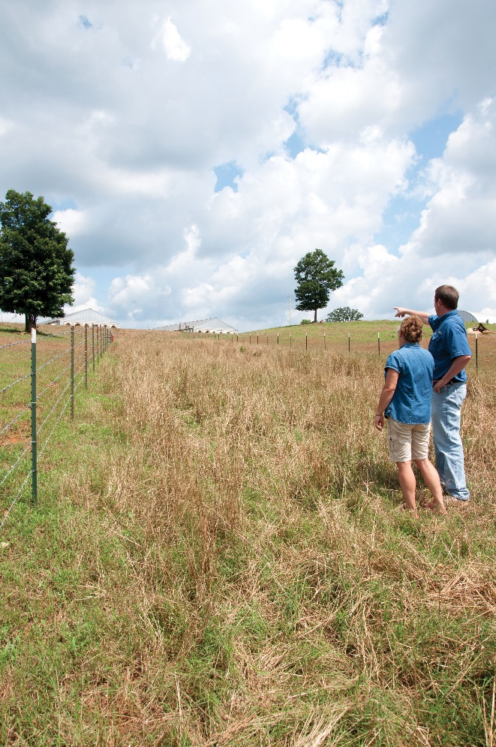
Farm Bill Programs
Environmental Quality Incentives Program
The Environmental Quality Incentives Program (EQIP) is a voluntary program that provides financial and technical assistance to agricultural producers through contracts up to a maximum term of ten years.

Slide 15
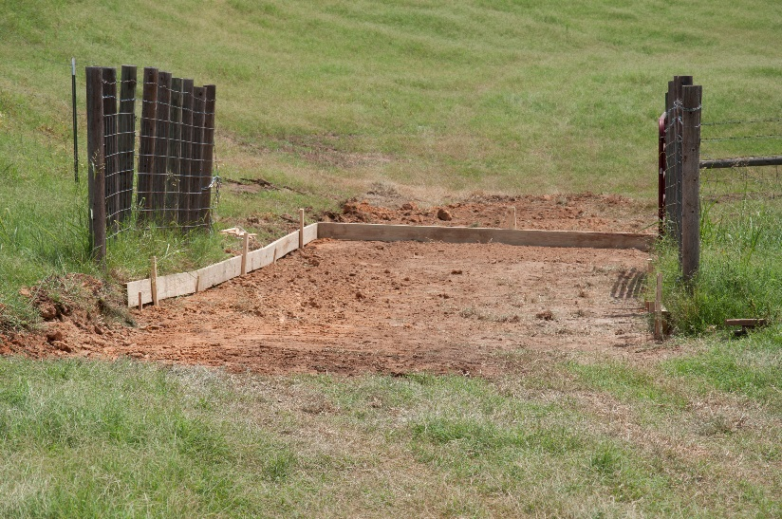
Farm Bill Programs
Environmental Quality Incentives Program
These contracts provide financial assistance to help plan and implement conservation practices that address natural resource concerns and for opportunities to improve soil, water, plant, animal, air and related resources on agricultural land and non-industrial private forestland.

Slide 17
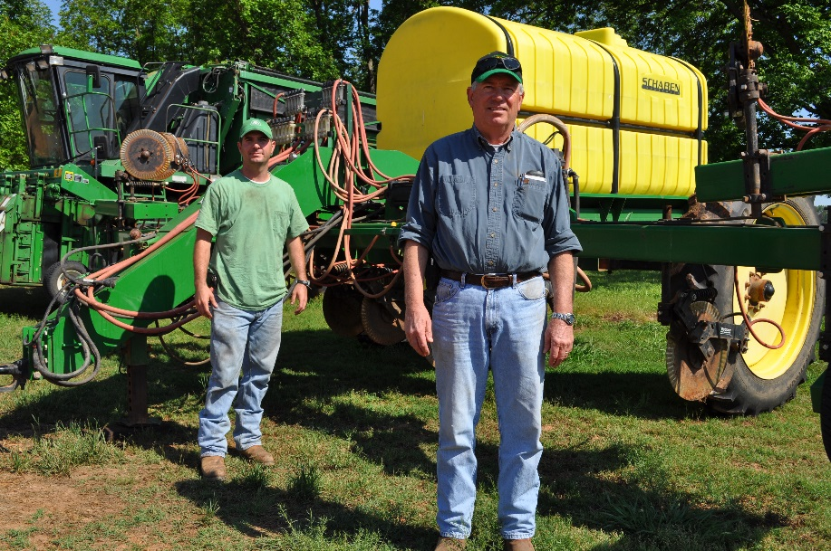
Farm Bill Programs
Conservation Stewardship Program
CSP provides technical and financial assistance to farmers and ranchers to actively manage and maintain existing conservation systems and to implement additional conservation activities on land in agricultural production.

Slide 19
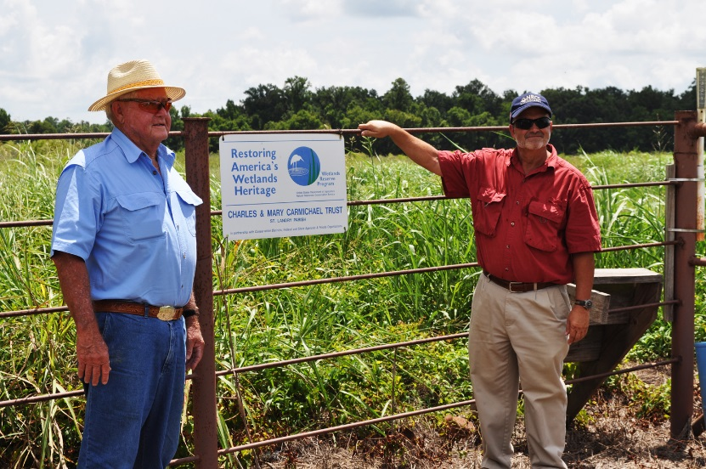
Farm Bill Programs
Agricultural Conservation Easement Program
The Farm Bill consolidates three conservation easement programs, WRP, FRPP, and GRP into a single program – ACEP - with two components, Wetlands Reserve Easements and Agricultural Lands Easements.

Slide 20
Farm Bill Programs
Agricultural Conservation Easement Program
Combine the purposes and coordinate the functions of the WRP, GRP, and FRPP.
Restore, protect, and enhance wetlands on eligible land.
Protect the agricultural use, viability, and related conservation values of eligible land by limiting non-agricultural uses.
Protect grazing uses and related conservation values by restoring and conserving eligible land.

Slide 21
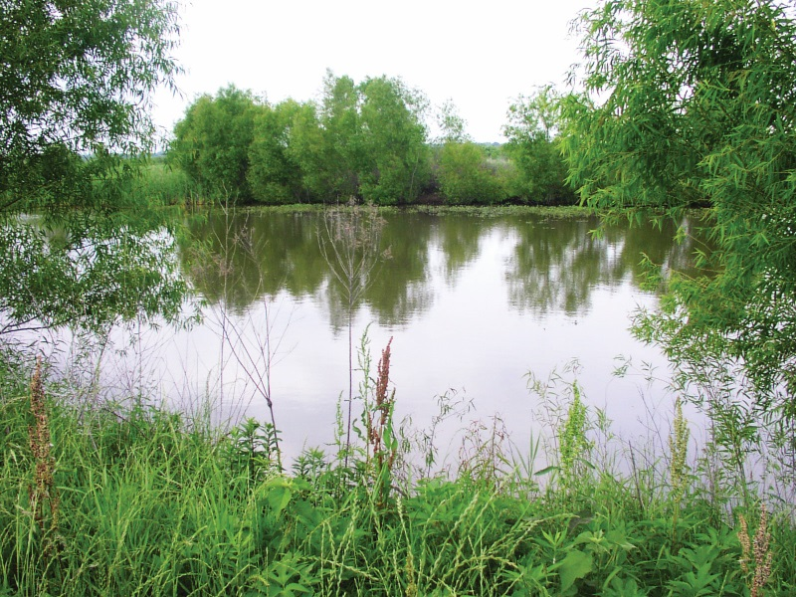
Farm Bill Programs
Agricultural Conservation Easement Program
Wetland Reserve Easement
Component
Establishes ownership requirement prior to enrollment of 2 years.
Authorizes waiver process to allow enrollment of CRP land established to trees.
No option to enroll stand-alone restoration cost-share agreements.

Slide 23
Farm Bill Programs
Regional Conservation Partnership Program
RCPP promotes the implementation of conservation activities through partnership agreements and conservation program contracts with landowners and producers.

Slide 24
Farm Bill Programs
Regional Conservation Partnership Program
Projects may focus on water quality and quantity, erosion, wildlife habitat, drought and flood control or other regional priorities.

Slide 25
Farm Bill Programs
Regional Conservation Partnership Program
By encouraging partners to cooperate with producers, NRCS hopes to further the conservation, restoration, and sustainable use of soil, water, wildlife and related natural resources on a regional or watershed scale.

Slide 26
Farm Bill Programs
Regional Conservation Partnership Program
NRCS may enter into partnership agreements with an eligible partner to implement a project that will assist eligible producers with installing and maintaining a conservation activity.
NRCS will conduct a competitive process to select applications for partnership agreements and may assess and rank applications with similar conservation purposes as a group.

Slide 27
Farm Bill Programs
Regional Conservation Partnership Program
RCPP contracts with producers are implemented, as applicable, through the Agricultural Conservation Easement Program; the Environmental Quality Incentives Program; the Conservation Stewardship Program; or the Healthy Forests Reserve Program.
Notes:
Eligible Partners
Partners may include agricultural or silvicultural producer associations or other groups of producers, State or local governments, Indian tribes, farmer cooperatives, municipal water treatment entities, water districts, or other organizations with specific water delivery authority to producers on agriculture land, irrigation districts, conservation driven nongovernmental organizations, and institutions of higher education are also eligible.
Partnership Agreements:
NRCS may enter into partnership agreements with an eligible partner to implement a project that will assist eligible producers with installing and maintaining a conservation activity. NRCS will conduct a competitive process to select applications for partnership agreements and may assess and rank applications with similar conservation purposes as a group.
NRCS will make public the criteria used in evaluating applications
NRCS may give higher priority to applications that:
Deliver high percentages of applied conservation to address conservation priorities or local, State, regional, or national conservation initiatives
Significantly leverage non-Federal financial and technical resources and coordinate with other local, State, regional, or national efforts
Provide innovation in conservation methods and delivery
Assist producers in meeting or avoiding the need for a natural resource regulatory requirement
Examples of eligible conservation activities include:
Water quality restoration or enhancement projects, including nutrient management and sediment reduction
Water quality conservation,
restoration or enhancement projects relating to surface water
groundwater resources (including the conversion of irrigated cropland to the production of less water-intensive commodities),
dry land farming
irrigation system improvement
Drought mitigation
Flood prevention
Water retention
Habitat conservation, restoration, and enhancement
Erosion control
Forest restoration
Partnership agreements may not exceed 5 years; however, NRCS may extend the agreement 1 time for up to 12 months when an extension is necessary to meet the objectives of the program.
The partnership agreement defines the scope of the project.
Partners are responsible for conducting outreach and education to eligible producers for potential participation in the project and for conducting an assessment of the project’s effects. In addition, partners are responsible to act on behalf of the eligible landowner or producer in applying for assistance and for leveraging financial or technical assistance provided by NRCS with additional funds to help achieve the project objectives.
Before closing the agreement the partner must provide an assessment of the project costs and conservation effects.

Slide 28
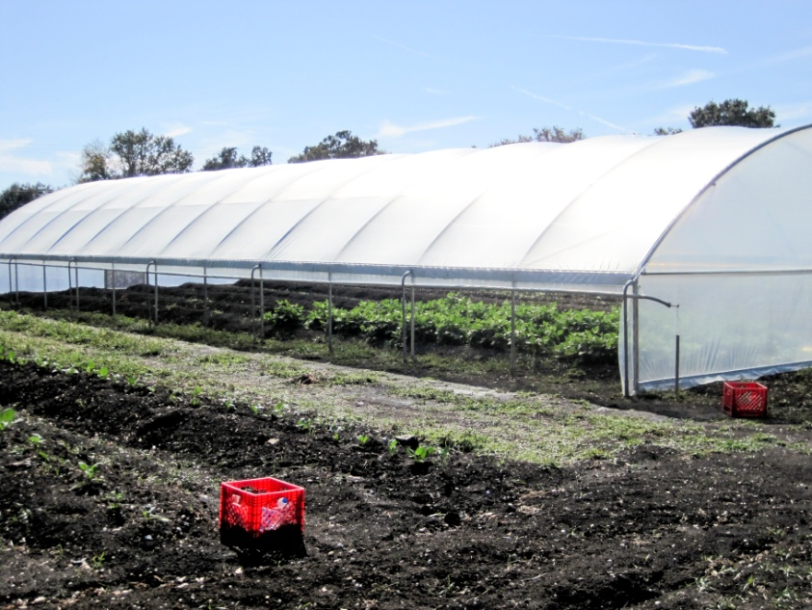
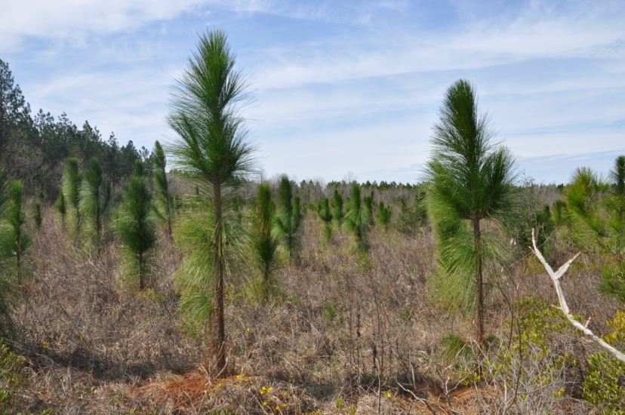
Farm Bill Programs
Special Initiatives
Organic
Longleaf Pine
High Tunnel/Hoop House
NWQI
Bayou Folse Watershed Complex

Slide 30
Getting Started
Contact a local NRCS office
Set up an appointment with the District Conservationist
Discuss your farm objectives with District Conservationist
Work with NRCS to develop your personalized conservation plan
Implement your plan

Slide 31
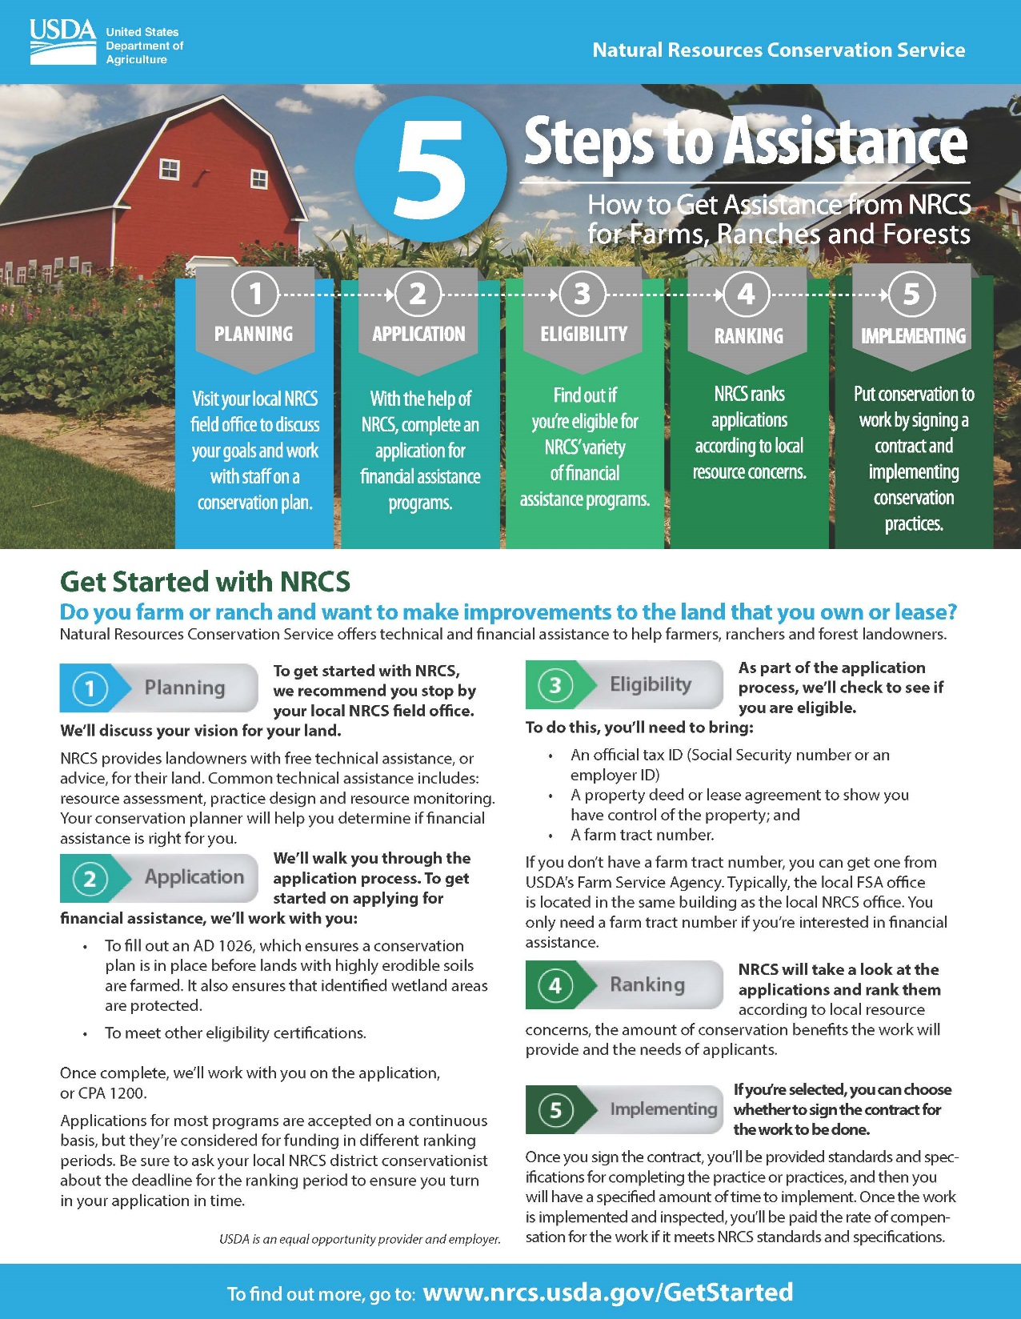

Slide 32
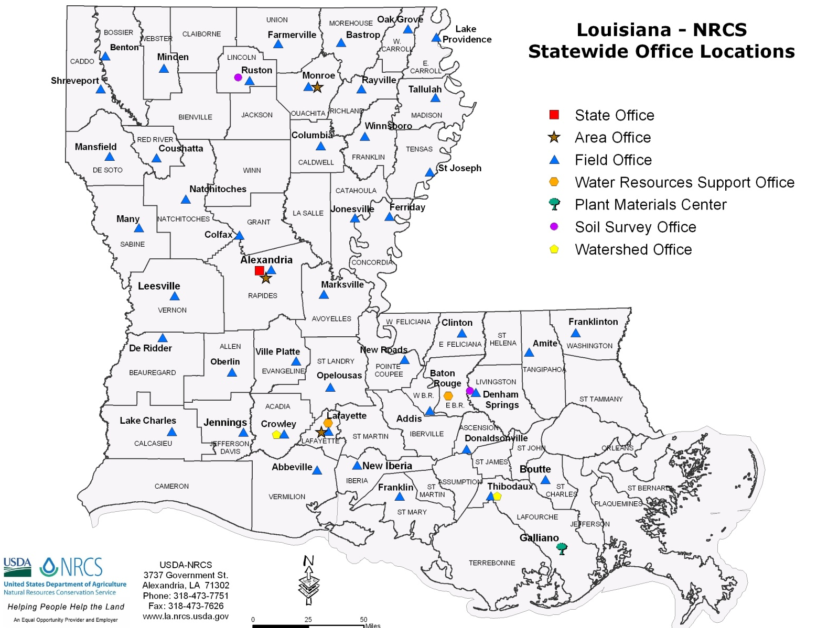
Our Offices

Slide 33
Our Offices
Visit our website for a complete directory of NRCS offices in Louisiana:
www.la.nrcs.usda.gov

Slide 34
The U.S. Department of Agriculture (USDA) prohibits discrimination in all its programs and activities on the basis of race, color, national origin, age, disability, and where applicable, sex, marital status, familial status, parental status, religion, sexual orientation, genetic information, political beliefs, reprisal, or because all or a part of an individual's income is derived from any public assistance program (not all prohibited bases apply to all programs). Persons with disabilities who require alternative means for communication of program information (Braille, large print, audiotape, etc.) should contact USDA's TARGET Center at (202) 720-2600 (voice and TDD). To file a complaint of discrimination write to USDA, Director, Office of Civil Rights, 1400 Independence Avenue, S.W., Washington, D.C. 20250-9410 or call (800) 795-3272 (voice) or (202) 720-6382 (TDD).
USDA is an equal opportunity provider and employer.

