Slide 1
Climate Change and What’s at Risk
Barataria-Terrebonne National Estuary Program Management Conference
November 3, 2016

Slide 2
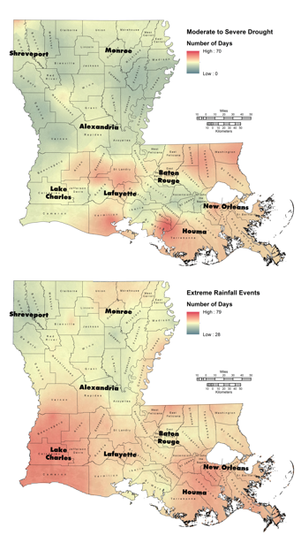
Natural and Human Adaptation to Climate Change: Understanding What’s At Risk
Sea-level rise and subsidence are common problems, and managing resources for both environmental and urban/industrial/agricultural purposes present major challenges.
Climate is changing and while the effects on some system components is well studied, understanding the interactive effects of climate stressors, e.g., drought, SLR, changing river flow on coastal ecosystems and communities is a matter of urgency.

Slide 3
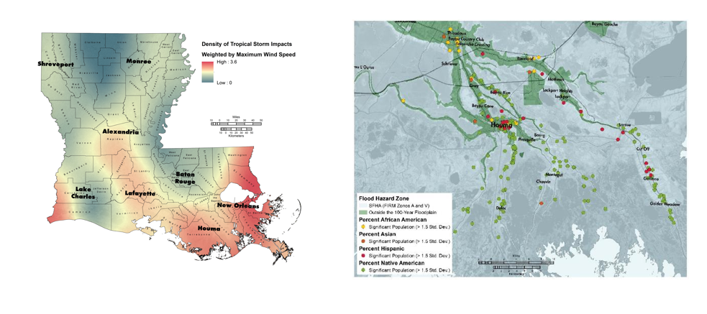
Natural and Human Adaptation to Climate Change: Understanding What’s At Risk

Slide 4
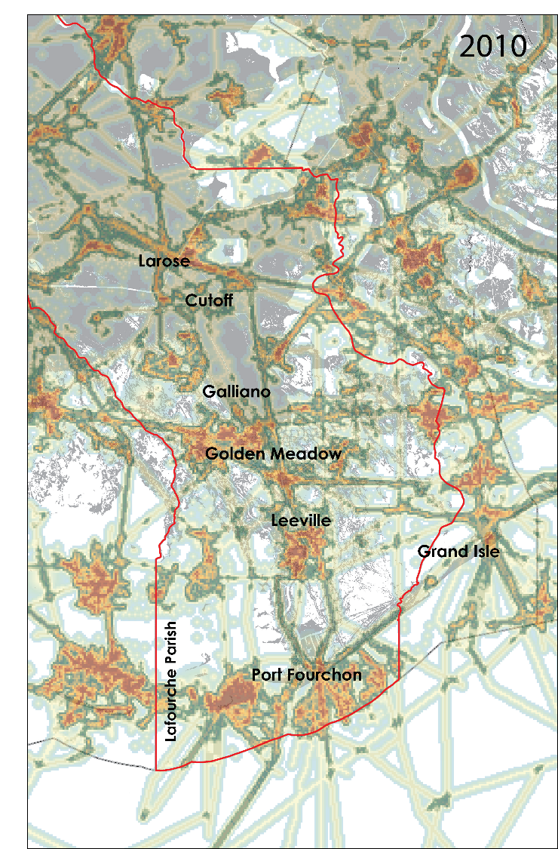
Natural and Human Adaptation to Climate Change: Understanding What’s At Risk
Coastal systems, especially with large rivers, are hubs for commerce and population growth.
In coastal communities, critical and essential facilities and industrial infrastructure vital components of community resilience in Louisiana and many other coastal systems.

Slide 5
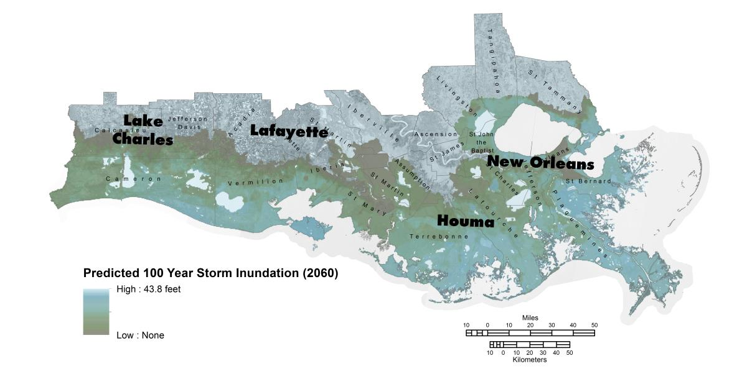
Natural and Human Adaptation to Climate Change: Understanding What’s At Risk

Slide 6
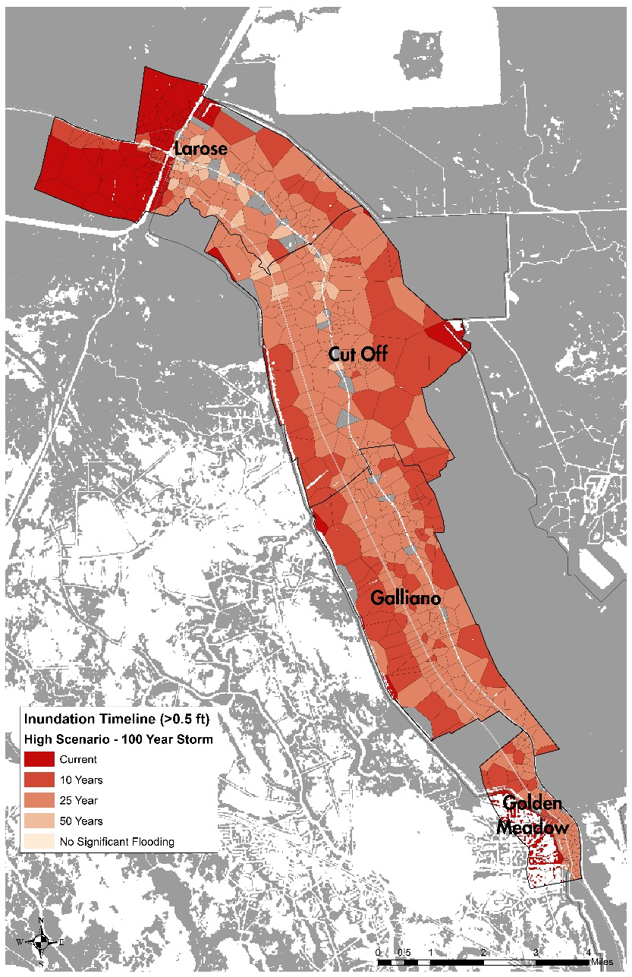
Modeling Community Inundation: Developed Land at Risk

Slide 7
Modeling Community Inundation: Current Conditions – 100 Year Storm
Census Designated Place | Low-Intensity Developed |  |  | Medium-Intensity Developed |  |  | High-Intensity Developed |  |  | Total Developed
 | Inundation Zone, in acres | Total, in acres | % | Inundation Zone, in acres | Total, in acres | % | Inundation Zone, in acres | Total, in acres | % | Inundation Zone, in acres | Total, in acres | %
Bayou Blue | 161.9 | 2032.5 | 8.0 | 20.2 | 237.7 | 8.5 | 11.1 | 113.4 | 9.8 | 193.3 | 2383.6 | 8.1
Bayou Country Club | 0.0 | 311.8 | 0.0 | 0.0 | 4.4 | 0.0 | 0.0 | 1.1 | 0.0 | 0.0 | 317.4 | 0.0
Bayou Gauche | 339.6 | 606.9 | 56.0 | 9.1 | 20.2 | 45.1 | 1.6 | 8.2 | 18.9 | 350.3 | 635.4 | 55.1
Bourg | 312.7 | 579.8 | 53.9 | 29.4 | 51.6 | 56.9 | 12.9 | 23.6 | 54.7 | 354.9 | 655.0 | 54.2
Chackbay | 0.2 | 520.8 | 0.0 | 0.0 | 32.0 | 0.0 | 0.0 | 7.1 | 0.0 | 0.2 | 560.0 | 0.0
Choctaw | 2.0 | 74.1 | 2.7 | 0.0 | 0.4 | 0.0 | 0.0 | 0.9 | 0.0 | 2.0 | 75.4 | 2.7
Cut Off | 3.8 | 999.4 | 0.4 | 0.0 | 103.2 | 0.0 | 0.0 | 26.7 | 0.0 | 3.8 | 1129.3 | 0.3
Des Allemands | 320.9 | 570.0 | 56.3 | 21.3 | 40.9 | 52.2 | 7.8 | 14.5 | 53.8 | 350.0 | 625.4 | 56.0
Galliano | 1.6 | 1377.1 | 0.1 | 0.2 | 190.4 | 0.1 | 0.0 | 88.7 | 0.0 | 1.8 | 1656.2 | 0.1
Golden Meadow | 21.3 | 421.4 | 5.1 | 1.1 | 67.2 | 1.7 | 0.4 | 18.5 | 2.4 | 22.9 | 507.1 | 4.5
Grand Isle | 560.0 | 573.1 | 97.7 | 280.7 | 289.8 | 96.9 | 258.9 | 267.1 | 96.9 | 1099.5 | 1130.0 | 97.3
Kraemer | 24.5 | 110.3 | 22.2 | 1.3 | 3.3 | 40.0 | 0.0 | 0.7 | 0.0 | 25.8 | 114.3 | 22.6
Labadieville | 0.0 | 389.9 | 0.0 | 0.0 | 15.3 | 0.0 | 0.0 | 17.1 | 0.0 | 0.0 | 422.3 | 0.0
Lafourche Crossing | 0.0 | 542.6 | 0.0 | 0.0 | 35.4 | 0.0 | 0.0 | 14.5 | 0.0 | 0.0 | 592.5 | 0.0
Larose | 513.3 | 1379.5 | 37.2 | 46.5 | 151.2 | 30.7 | 43.1 | 101.2 | 42.6 | 602.9 | 1631.9 | 36.9
Lockport Heights | 54.3 | 197.9 | 27.4 | 8.5 | 23.1 | 36.5 | 4.7 | 10.7 | 43.8 | 67.4 | 231.7 | 29.1
Lockport | 133.4 | 284.0 | 47.0 | 17.1 | 52.7 | 32.5 | 10.0 | 27.6 | 36.3 | 160.6 | 364.3 | 44.1
Mathews | 8.5 | 461.0 | 1.8 | 2.9 | 66.3 | 4.4 | 0.0 | 48.7 | 0.0 | 11.3 | 576.0 | 2.0
Raceland | 108.8 | 2394.5 | 4.5 | 1.6 | 152.1 | 1.0 | 0.4 | 96.3 | 0.5 | 110.8 | 2642.9 | 4.2
Schriever | 0.0 | 1541.4 | 0.0 | 0.0 | 121.2 | 0.0 | 0.0 | 97.9 | 0.0 | 0.0 | 1760.5 | 0.0
Thibodaux | 0.0 | 1772.0 | 0.0 | 0.0 | 432.8 | 0.0 | 0.0 | 376.3 | 0.0 | 0.0 | 2581.1 | 0.0

Slide 8
Modeling Community Inundation: Year 10 (High Scenario) – 100 Year Storm
Census Designated Place | Low-Intensity Developed |  |  | Medium-Intensity Developed |  |  | High-Intensity Developed |  |  | Total Developed
 | Inundation Zone, in acres | Total, in acres | % | Inundation Zone, in acres | Total, in acres | % | Inundation Zone, in acres | Total, in acres | % | Inundation Zone, in acres | Total, in acres | %
Bayou Blue | 397.6 | 2032.5 | 19.6 | 48.7 | 237.7 | 20.5 | 30.5 | 113.4 | 26.9 | 476.8 | 2383.6 | 20.0
Bayou Country Club | 0.0 | 311.8 | 0.0 | 0.0 | 4.4 | 0.0 | 0.0 | 1.1 | 0.0 | 0.0 | 317.4 | 0.0
Bayou Gauche | 581.6 | 606.9 | 95.8 | 18.9 | 20.2 | 93.4 | 5.6 | 8.2 | 67.6 | 606.0 | 635.4 | 95.4
Bourg | 492.6 | 579.8 | 85.0 | 41.6 | 51.6 | 80.6 | 19.8 | 23.6 | 84.0 | 554.0 | 655.0 | 84.6
Chackbay | 18.7 | 520.8 | 3.6 | 0.0 | 32.0 | 0.0 | 0.0 | 7.1 | 0.0 | 18.7 | 560.0 | 3.3
Choctaw | 22.5 | 74.1 | 30.3 | 0.0 | 0.4 | 0.0 | 0.0 | 0.9 | 0.0 | 22.5 | 75.4 | 29.8
Cut Off | 61.2 | 999.4 | 6.1 | 8.2 | 103.2 | 8.0 | 1.1 | 26.7 | 4.2 | 70.5 | 1129.3 | 6.2
Des Allemands | 499.5 | 570.0 | 87.6 | 33.8 | 40.9 | 82.6 | 12.2 | 14.5 | 84.6 | 545.5 | 625.4 | 87.2
Galliano | 180.4 | 1377.1 | 13.1 | 21.8 | 190.4 | 11.4 | 5.8 | 88.7 | 6.5 | 207.9 | 1656.2 | 12.6
Golden Meadow | 93.2 | 421.4 | 22.1 | 8.7 | 67.2 | 12.9 | 1.6 | 18.5 | 8.4 | 103.4 | 507.1 | 20.4
Grand Isle | 573.1 | 573.1 | 100.0 | 289.8 | 289.8 | 100.0 | 267.1 | 267.1 | 100.0 | 1130.0 | 1130.0 | 100.0
Kraemer | 45.4 | 110.3 | 41.1 | 1.3 | 3.3 | 40.0 | 0.0 | 0.7 | 0.0 | 46.7 | 114.3 | 40.9
Labadieville | 0.0 | 389.9 | 0.0 | 0.0 | 15.3 | 0.0 | 0.0 | 17.1 | 0.0 | 0.0 | 422.3 | 0.0
Lafourche Crossing | 0.0 | 542.6 | 0.0 | 0.0 | 35.4 | 0.0 | 0.0 | 14.5 | 0.0 | 0.0 | 592.5 | 0.0
Larose | 668.7 | 1379.5 | 48.5 | 55.4 | 151.2 | 36.6 | 47.4 | 101.2 | 46.8 | 771.5 | 1631.9 | 47.3
Lockport Heights | 123.9 | 197.9 | 62.6 | 17.6 | 23.1 | 76.0 | 8.7 | 10.7 | 81.3 | 150.1 | 231.7 | 64.8
Lockport | 182.4 | 284.0 | 64.2 | 27.4 | 52.7 | 51.9 | 14.2 | 27.6 | 51.6 | 224.0 | 364.3 | 61.5
Mathews | 105.6 | 461.0 | 22.9 | 15.3 | 66.3 | 23.2 | 0.0 | 48.7 | 0.0 | 121.0 | 576.0 | 21.0
Raceland | 608.5 | 2394.5 | 25.4 | 10.2 | 152.1 | 6.7 | 5.3 | 96.3 | 5.5 | 624.0 | 2642.9 | 23.6
Schriever | 0.0 | 1541.4 | 0.0 | 0.0 | 121.2 | 0.0 | 0.0 | 97.9 | 0.0 | 0.0 | 1760.5 | 0.0
Thibodaux | 0.0 | 1772.0 | 0.0 | 0.0 | 432.8 | 0.0 | 0.0 | 376.3 | 0.0 | 0.0 | 2581.1 | 0.0

Slide 9
Modeling Community Inundation: Year 25 (High Scenario) – 100 Year Storm
Census Designated Place | Low-Intensity Developed |  |  | Medium-Intensity Developed |  |  | High-Intensity Developed |  |  | Total Developed
 | Inundation Zone, in acres | Total, in acres | % | Inundation Zone, in acres | Total, in acres | % | Inundation Zone, in acres | Total, in acres | % | Inundation Zone, in acres | Total, in acres | %
Bayou Blue | 1673.1 | 2032.5 | 82.3 | 191.0 | 237.7 | 80.4 | 106.1 | 113.4 | 93.5 | 1970.2 | 2383.6 | 82.7
Bayou Country Club | 0.0 | 311.8 | 0.0 | 0.0 | 4.4 | 0.0 | 0.0 | 1.1 | 0.0 | 0.0 | 317.4 | 0.0
Bayou Gauche | 606.9 | 606.9 | 100.0 | 20.2 | 20.2 | 100.0 | 8.2 | 8.2 | 100.0 | 635.4 | 635.4 | 100.0
Bourg | 579.8 | 579.8 | 100.0 | 51.6 | 51.6 | 100.0 | 23.6 | 23.6 | 100.0 | 655.0 | 655.0 | 100.0
Chackbay | 206.8 | 520.8 | 39.7 | 12.0 | 32.0 | 37.5 | 2.4 | 7.1 | 34.4 | 221.3 | 560.0 | 39.5
Choctaw | 74.1 | 74.1 | 100.0 | 0.4 | 0.4 | 100.0 | 0.9 | 0.9 | 100.0 | 75.4 | 75.4 | 100.0
Cut Off | 893.4 | 999.4 | 89.4 | 87.6 | 103.2 | 84.9 | 20.5 | 26.7 | 76.7 | 1001.4 | 1129.3 | 88.7
Des Allemands | 566.7 | 570.0 | 99.4 | 40.9 | 40.9 | 100.0 | 14.5 | 14.5 | 100.0 | 622.0 | 625.4 | 99.5
Galliano | 1377.1 | 1377.1 | 100.0 | 190.4 | 190.4 | 100.0 | 88.7 | 88.7 | 100.0 | 1656.2 | 1656.2 | 100.0
Golden Meadow | 421.4 | 421.4 | 100.0 | 67.2 | 67.2 | 100.0 | 18.5 | 18.5 | 100.0 | 507.1 | 507.1 | 100.0
Grand Isle | 573.1 | 573.1 | 100.0 | 289.8 | 289.8 | 100.0 | 267.1 | 267.1 | 100.0 | 1130.0 | 1130.0 | 100.0
Kraemer | 110.3 | 110.3 | 100.0 | 3.3 | 3.3 | 100.0 | 0.7 | 0.7 | 100.0 | 114.3 | 114.3 | 100.0
Labadieville | 0.0 | 389.9 | 0.0 | 0.0 | 15.3 | 0.0 | 0.0 | 17.1 | 0.0 | 0.0 | 422.3 | 0.0
Lafourche Crossing | 65.4 | 542.6 | 12.0 | 0.0 | 35.4 | 0.0 | 0.0 | 14.5 | 0.0 | 65.4 | 592.5 | 11.0
Larose | 1175.8 | 1379.5 | 85.2 | 93.2 | 151.2 | 61.6 | 57.8 | 101.2 | 57.1 | 1326.8 | 1631.9 | 81.3
Lockport Heights | 164.1 | 197.9 | 82.9 | 20.9 | 23.1 | 90.4 | 10.7 | 10.7 | 100.0 | 195.7 | 231.7 | 84.5
Lockport | 263.3 | 284.0 | 92.7 | 46.9 | 52.7 | 89.0 | 23.8 | 27.6 | 86.3 | 334.0 | 364.3 | 91.7
Mathews | 233.7 | 461.0 | 50.7 | 28.2 | 66.3 | 42.6 | 2.9 | 48.7 | 5.9 | 264.9 | 576.0 | 46.0
Raceland | 1154.0 | 2394.5 | 48.2 | 30.2 | 152.1 | 19.9 | 11.1 | 96.3 | 11.5 | 1195.4 | 2642.9 | 45.2
Schriever | 45.4 | 1541.4 | 2.9 | 0.7 | 121.2 | 0.6 | 0.0 | 97.9 | 0.0 | 46.0 | 1760.5 | 2.6
Thibodaux | 0.0 | 1772.0 | 0.0 | 0.0 | 432.8 | 0.0 | 0.0 | 376.3 | 0.0 | 0.0 | 2581.1 | 0.0

Slide 10
Modeling Community Inundation: Year 50 (High Scenario) – 100 Year Storm
Census Designated Place | Low-Intensity Developed |  |  | Medium-Intensity Developed |  |  | High-Intensity Developed |  |  | Total Developed
 | Inundation Zone, in acres | Total, in acres | % | Inundation Zone, in acres | Total, in acres | % | Inundation Zone, in acres | Total, in acres | % | Inundation Zone, in acres | Total, in acres | %
Bayou Blue | 2032.5 | 2032.5 | 100.0 | 237.7 | 237.7 | 100.0 | 113.4 | 113.4 | 100.0 | 2383.6 | 2383.6 | 100.0
Bayou Country Club | 203.0 | 311.8 | 65.1 | 3.1 | 4.4 | 70.0 | 0.9 | 1.1 | 80.0 | 207.0 | 317.4 | 65.2
Bayou Gauche | 606.9 | 606.9 | 100.0 | 20.2 | 20.2 | 100.0 | 8.2 | 8.2 | 100.0 | 635.4 | 635.4 | 100.0
Bourg | 579.8 | 579.8 | 100.0 | 51.6 | 51.6 | 100.0 | 23.6 | 23.6 | 100.0 | 655.0 | 655.0 | 100.0
Chackbay | 520.8 | 520.8 | 100.0 | 32.0 | 32.0 | 100.0 | 7.1 | 7.1 | 100.0 | 560.0 | 560.0 | 100.0
Choctaw | 74.1 | 74.1 | 100.0 | 0.4 | 0.4 | 100.0 | 0.9 | 0.9 | 100.0 | 75.4 | 75.4 | 100.0
Cut Off | 999.4 | 999.4 | 100.0 | 103.2 | 103.2 | 100.0 | 26.7 | 26.7 | 100.0 | 1129.3 | 1129.3 | 100.0
Des Allemands | 570.0 | 570.0 | 100.0 | 40.9 | 40.9 | 100.0 | 14.5 | 14.5 | 100.0 | 625.4 | 625.4 | 100.0
Galliano | 1377.1 | 1377.1 | 100.0 | 190.4 | 190.4 | 100.0 | 88.7 | 88.7 | 100.0 | 1656.2 | 1656.2 | 100.0
Golden Meadow | 421.4 | 421.4 | 100.0 | 67.2 | 67.2 | 100.0 | 18.5 | 18.5 | 100.0 | 507.1 | 507.1 | 100.0
Grand Isle | 573.1 | 573.1 | 100.0 | 289.8 | 289.8 | 100.0 | 267.1 | 267.1 | 100.0 | 1130.0 | 1130.0 | 100.0
Kraemer | 110.3 | 110.3 | 100.0 | 3.3 | 3.3 | 100.0 | 0.7 | 0.7 | 100.0 | 114.3 | 114.3 | 100.0
Labadieville | 73.4 | 389.9 | 18.8 | 2.0 | 15.3 | 13.0 | 0.0 | 17.1 | 0.0 | 75.4 | 422.3 | 17.9
Lafourche Crossing | 373.4 | 542.6 | 68.8 | 30.9 | 35.4 | 87.4 | 12.2 | 14.5 | 84.6 | 416.5 | 592.5 | 70.3
Larose | 1379.5 | 1379.5 | 100.0 | 151.2 | 151.2 | 100.0 | 101.2 | 101.2 | 100.0 | 1631.9 | 1631.9 | 100.0
Lockport Heights | 197.9 | 197.9 | 100.0 | 23.1 | 23.1 | 100.0 | 10.7 | 10.7 | 100.0 | 231.7 | 231.7 | 100.0
Lockport | 284.0 | 284.0 | 100.0 | 52.7 | 52.7 | 100.0 | 27.6 | 27.6 | 100.0 | 364.3 | 364.3 | 100.0
Mathews | 461.0 | 461.0 | 100.0 | 66.3 | 66.3 | 100.0 | 48.7 | 48.7 | 100.0 | 576.0 | 576.0 | 100.0
Raceland | 2171.5 | 2394.5 | 90.7 | 129.9 | 152.1 | 85.4 | 84.7 | 96.3 | 88.0 | 2386.1 | 2642.9 | 90.3
Schriever | 972.5 | 1541.4 | 63.1 | 65.2 | 121.2 | 53.8 | 56.3 | 97.9 | 57.5 | 1094.0 | 1760.5 | 62.1
Thibodaux | 410.1 | 1772.0 | 23.1 | 89.8 | 432.8 | 20.8 | 66.9 | 376.3 | 17.8 | 566.9 | 2581.1 | 22.0

Slide 11
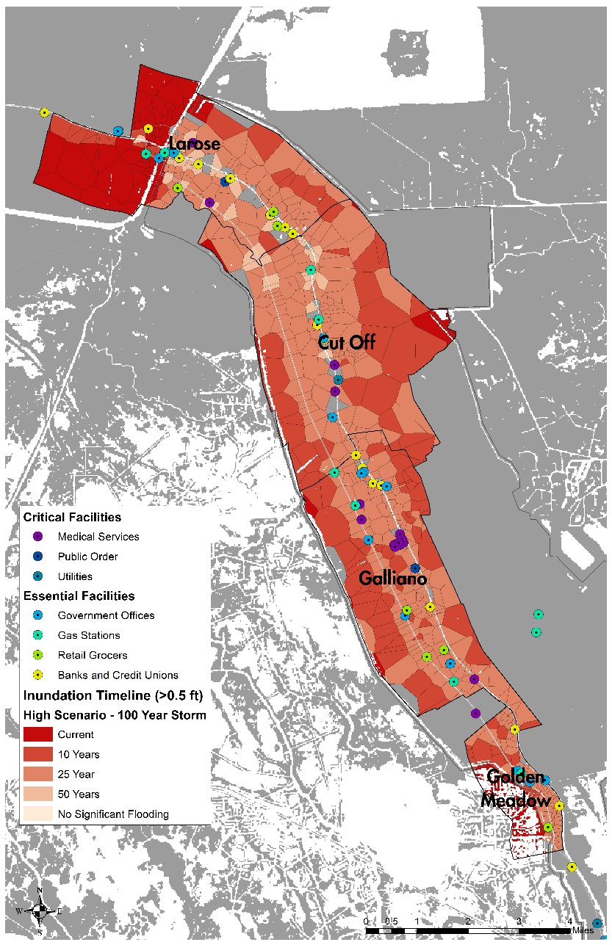
Modeling Community Inundation: Critical and Essential Facilities at Risk
Critical Facilities in Lower Lafourche Parish
Ambulance Services | 1
Hospitals | 1
Outpatient Care Centers | 17
Physician Offices | 8
Civil Defense | 1
Fire Stations | 7
Police Stations | 2
Electric Companies | 1
Radio and TV Broadcasting | 4
Essential Facilities in Lower Lafourche Parish
Banks and Credit Unions | 19
Gas Stations | 16
Government Offices | 34
Retail Grocers | 9

Slide 12
Modeling Community Inundation: Critical and Essential Facilities at Risk
Percent of Critical Facilities Inundated in Lower Lafourche Parish
High Scenario – 100 Year Storm
Facility Class | Total Facilities | Current Conditions | Year 10 | Year 25 | Year 50
Ambulance Services | 1 | 0.0 | 0.0 | 100.0 | 100.0
Hospitals | 1 | 0.0 | 0.0 | 100.0 | 100.0
Outpatient Care Centers | 17 | 0.0 | 0.0 | 94.1 | 100.0
Physician Offices | 8 | 0.0 | 0.0 | 87.5 | 100.0
Civil Defense | 1 | 100.0 | 100.0 | 100.0 | 100.0
Fire Stations | 7 | 14.3 | 14.3 | 100.0 | 100.0
Police Stations | 2 | 50.0 | 50.0 | 100.0 | 100.0
Electric Companies | 1 | 0.0 | 0.0 | 100.0 | 100.0
Radio and TV Broadcasting | 4 | 75.0 | 75.0 | 100.0 | 100.0
Percent of Essential Facilities Inundated in Lower Lafourche Parish
High Scenario – 100 Year Storm
Facility Class | Total Facilities | Current Conditions | Year 10 | Year 25 | Year 50
Banks and Credit Unions | 19 | 5.3 | 10.5 | 84.2 | 100.0
Gas Stations | 16 | 25.0 | 50.0 | 93.8 | 100.0
Government Offices | 34 | 17.6 | 17.6 | 94.1 | 100.0
Retail Grocers | 9 | 0.0 | 0.0 | 88.9 | 100.0

Slide 13
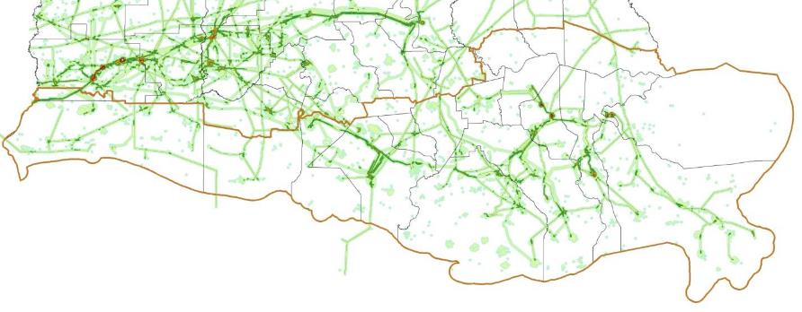
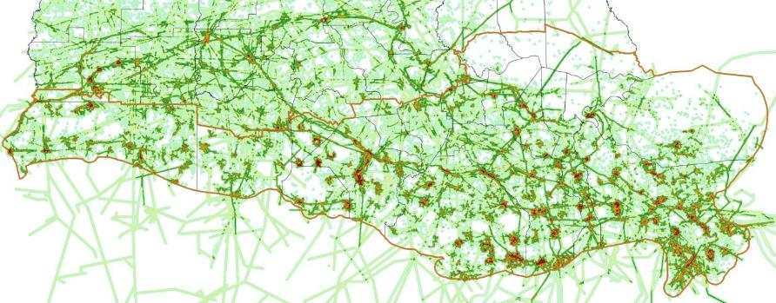
Modeling Community Inundation: Industrial Facilities at Risk
Combined Coastal Infrastructure Density 1950
Combined Coastal Infrastructure Density 2010
Notes:
Add Key observations to text notes
Note transition from onshore to offshore oil production
Note that infrastructure is not taken out, even though some of pipelines and facilities become decomissioned

Slide 14
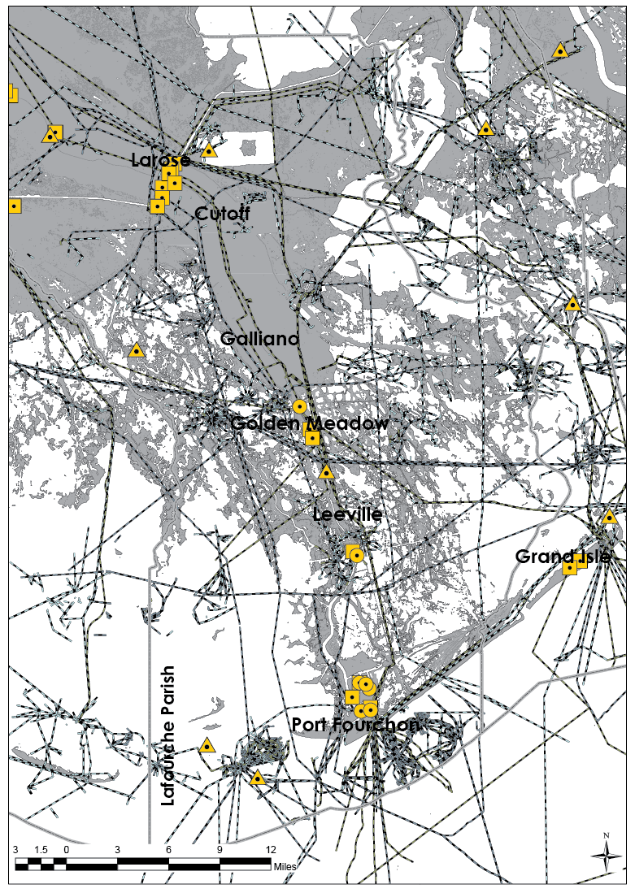
Modeling Community Inundation: Industrial Facilities at Risk
Data from 2010
Oil and Gas related infrastructure
Gas Processing Plants
Product Terminals
Shipyards
Oil- and Gas-related pipelines
Land loss

Slide 15
Modeling Community Inundation: Industrial Facilities at Risk
Future without action
20 year prediction
Moderate scenario
Gas Processing Plants
Product Terminals
Shipyards
Oil- and Gas-related pipelines
Land loss
Model: ICM – Coastal Master Plan

Slide 16
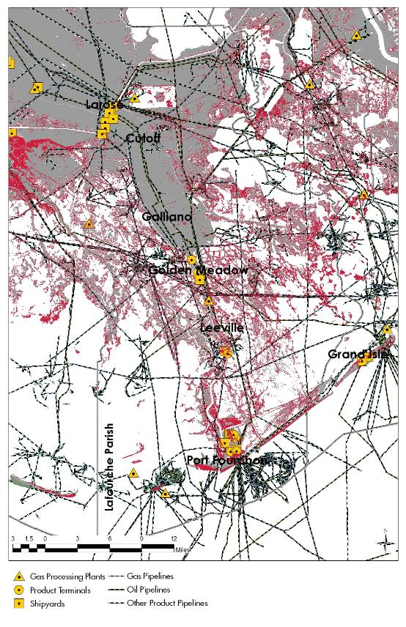
Modeling Community Inundation: Industrial Facilities at Risk
Future without action
50 year prediction
Moderate scenario
Gas Processing Plants
Product Terminals
Shipyards
Oil- and Gas-related pipelines
Land loss
Model: ICM – Coastal Master Plan

Slide 17
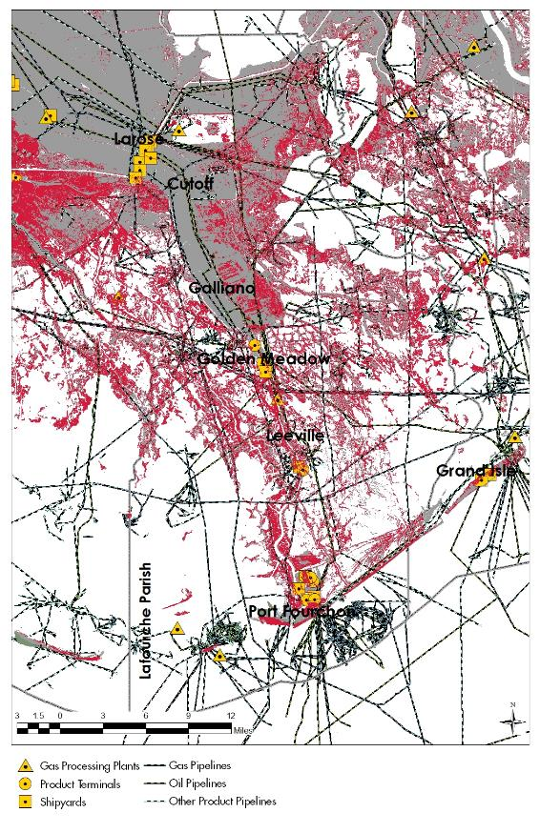
Modeling Community Inundation: Industrial Facilities at Risk
Future without action
50 year prediction
Less optimistic scenario
Gas Processing Plants
Product Terminals
Shipyards
Oil- and Gas-related pipelines
Land loss
Model: ICM – Coastal Master Plan

Slide 18
Data-driven adaptation Timelines
Identifying & Prioritizing At-Risk Facilities:

Slide 19
Modeling Community Inundation: Developing Adaptation Timelines

Slide 20
Modeling Community Inundation: Developing Adaptation Timelines
With no action, results in relocation in xx years (50 years, e.g.)

Slide 21
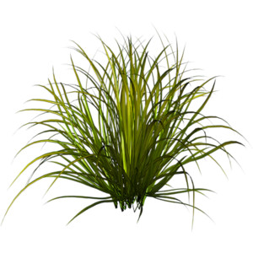
Modeling Community Inundation: Developing Adaptation Timelines
With no action, results in relocation in xx years (50 years, e.g.)
With action, results in resilience in in xx years (20 years, e.g.)

Slide 22
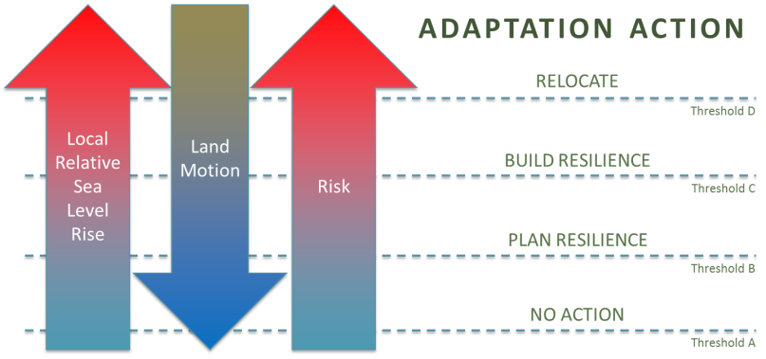
Modeling Community Inundation: Developing Adaptation Timelines
Objective way to quantify at-risk locations
Adaptation thresholds:
Standard risk-based (FEMA 1% Annual Chance, Velocity Zone, etc.)
Member-specified risk (more/less stringent)
Identifies clusters of at-risk infrastructure, aiding formation of project teams of asset holders with shared risk

Slide 23
Modeling Community Inundation: Developing Adaptation Timelines
Critical Facilities in Lower Lafourche Parish
Ambulance Services | 1
Hospitals | 1
Outpatient Care Centers | 17
Physician Offices | 8
Civil Defense | 1
Fire Stations | 7
Police Stations | 2
Electric Companies | 1
Radio and TV Broadcasting | 4
Essential Facilities in Lower Lafourche Parish
Banks and Credit Unions | 19
Gas Stations | 16
Government Offices | 34
Retail Grocers | 9

Slide 24
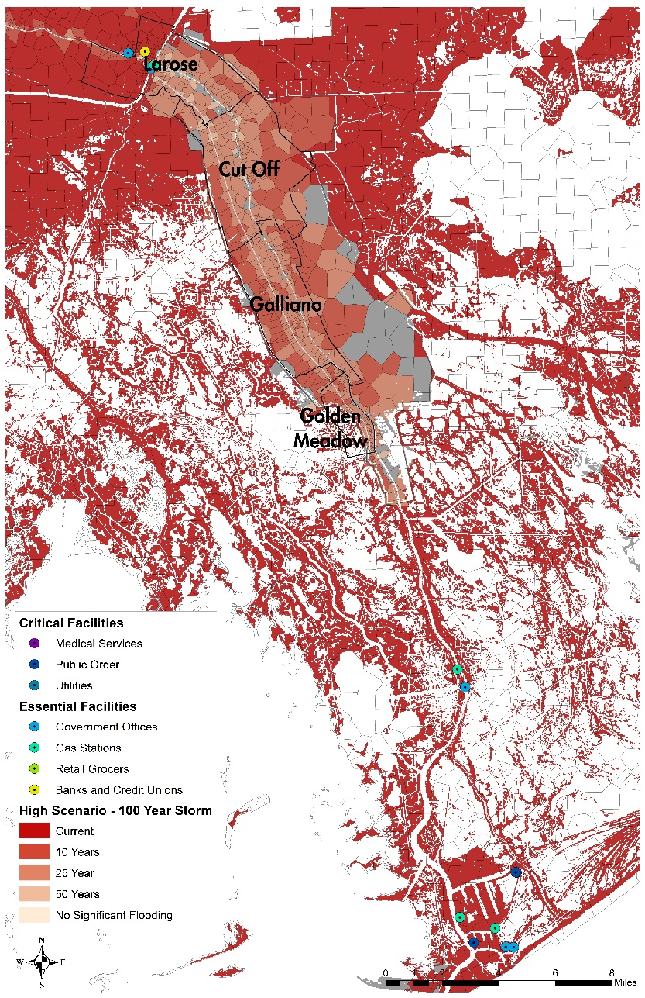
Modeling Community Inundation: Developing Adaptation Timelines

Slide 25
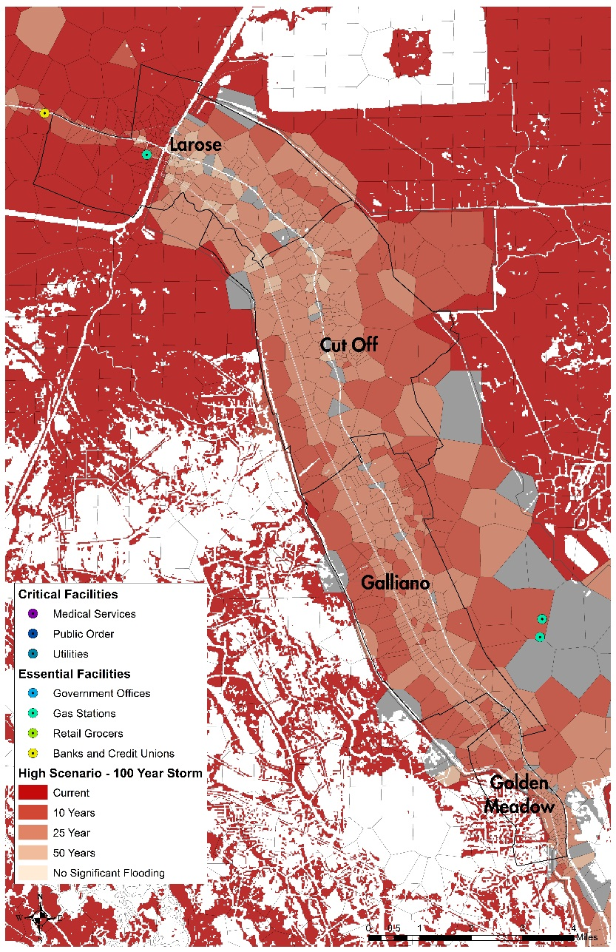
Modeling Community Inundation: Developing Adaptation Timelines

Slide 26
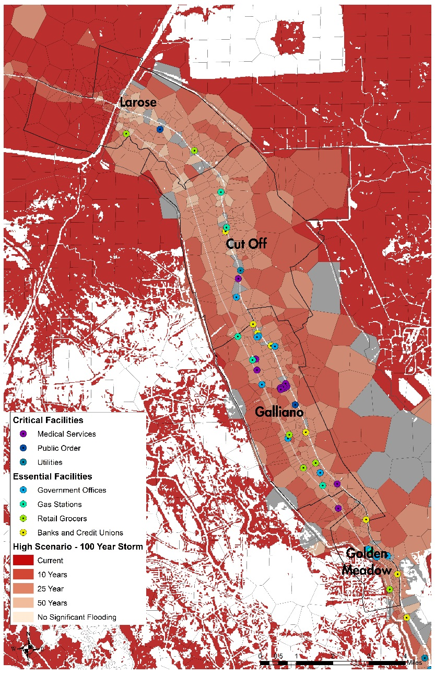
Modeling Community Inundation: Developing Adaptation Timelines

Slide 27
Modeling Community Inundation: Developing Adaptation Timelines

Slide 28
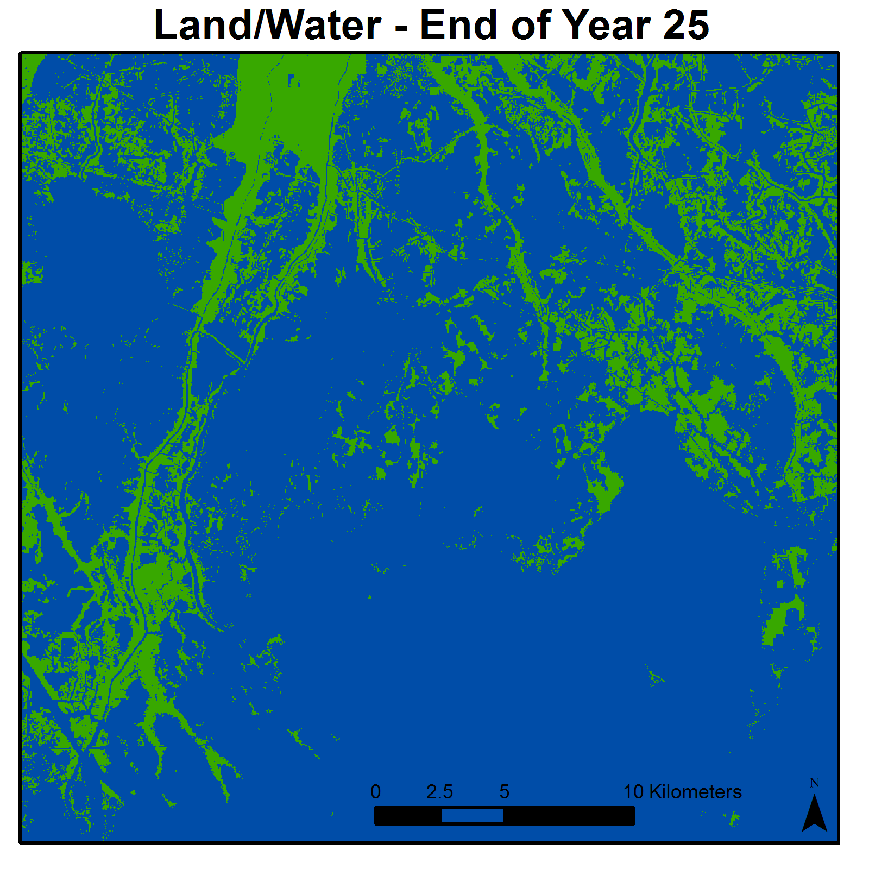
Natural and Human Adaptation to Climate Change: Understanding What’s At Risk
The pace of climate change presents both opportunities and challenges for coastal residents and planners.
Despite efforts to plan for climate change, individual action will likely be driven in large part by short-term pulse events.
Planning and managing for climate change in coastal ecosystems and communities is a matter of urgency. Inaction is not an option.

Slide 29
Scott Hemmerling
shemmerling@thewaterinstitute.org

