Slide 1
BTNEP Comprehensive Conservation and Management Plan
BTNEP MC Meeting
August 6, 2015

Slide 2
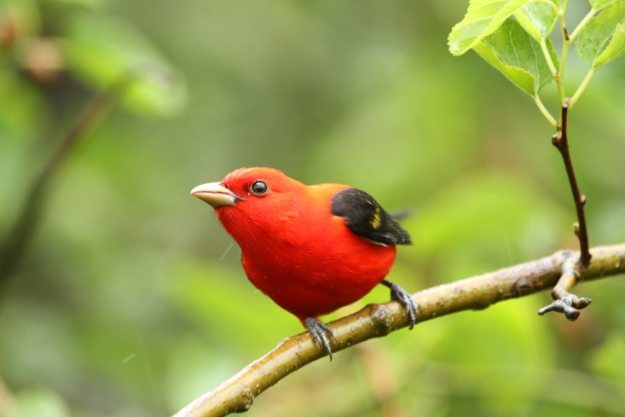
What is the BTNEP Comprehensive Conservation and Management Plan?
Why is it important?
How does it guide the work of the BTNEP?
How does it impact the work we do with our partners?

Slide 3
Comprehensive Conservation and Management Plan -CCMP
Required by Section 320 of the EPA Clean Water Act
Designed to protect and preserve the Barataria and Terrebonne basins
Voluntary Plan
Solid Scientific Evidence
Consensus Approval
Citizen Involvement
Provides for sustainable resource use
Recommends corrective actions

Slide 4
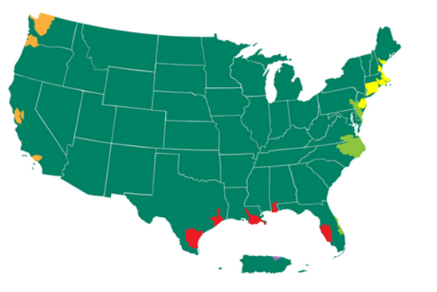
28 National Estuary Programs

Slide 5
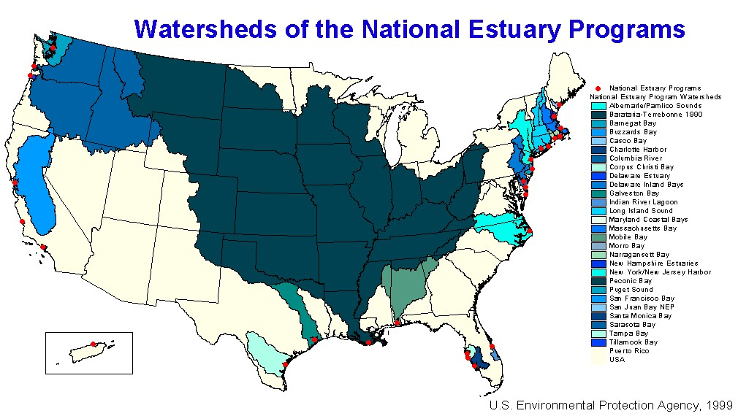
Watersheds of the National Estuary Programs

Slide 6
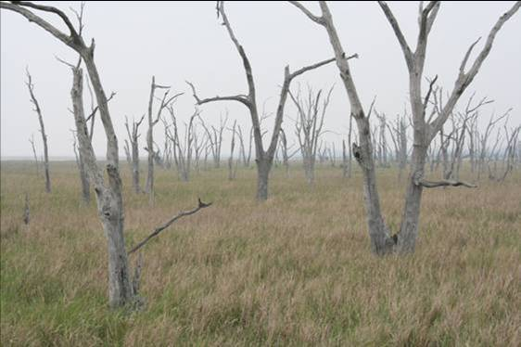
BTNEP 7 Priority Problems
Hydrologic Modification
Sediment Reduction
Habitat Loss
Eutrophication (too many nutrients)
Pathogens (disease producing organisms)
Toxic Substances
Changes in Living Resources

Slide 7
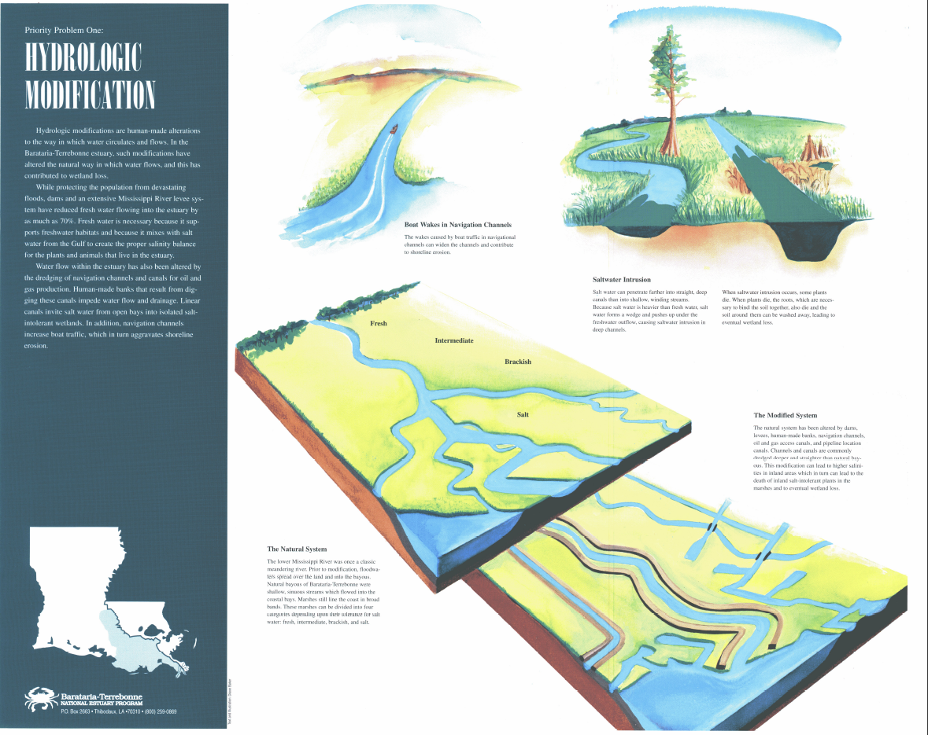

Slide 8
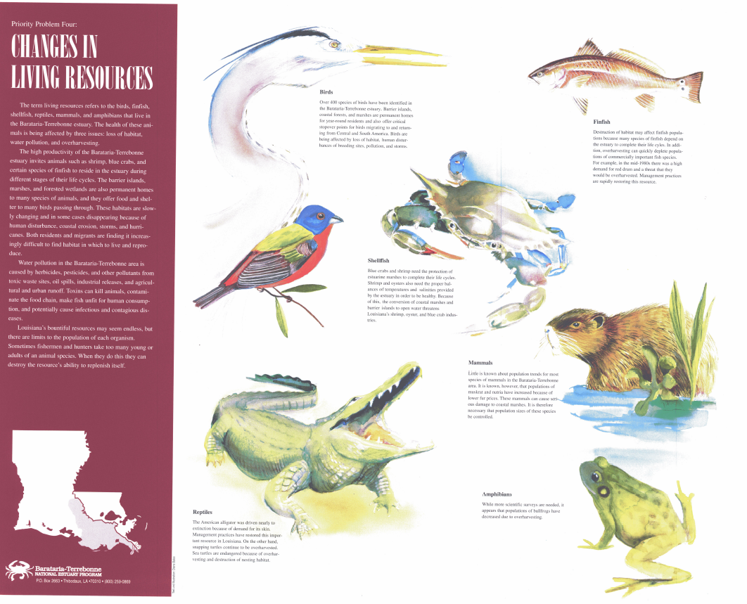

Slide 9
CCMP Executive Summary
The Executive Summary
CCMP Part 1 of 4
21 page document
summarizes the program objectives, priority problems, action plans, a summary of groups working to implement the plan through well thought out strategies.

Slide 10
CCMP – Estuary Compact
The Estuary Compact
CCMP Part 2 of 4
A promise by many groups to work together to address complex issues in the estuary
Identifies the Barataria-Terrebonne System as a national treasure with a unique environment, economic benefit to the nation, and recognizes the multi-cultural heritage of the area

Slide 11
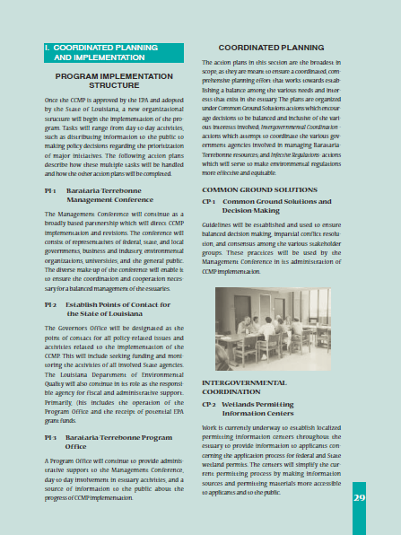
Approved Action Plans
51 Approved Actions
See page 27 through 35
Coordinated Planning and Implementation (PI and CP)
program implementation
structure and coordinated
planning
Ecological Management (EM)
includes habitat management,
water quality, living resources
and data sets
Sustained Recognition and Citizen Involvement (SR)
citizen involvement and
participation, public
information and education, K-
16 curriculum
Economic Growth (EG)
economic development,
technology transfer, and
cooperative incentives

Slide 12
Consensus
1. Majority of opinion
2. General agreement or concord; harmony.
http://dictionary.reference.com
1. Collective opinion
2. General accord
Webster’s II New Riverside Dictionary
1. Maximum point of agreement

Slide 13
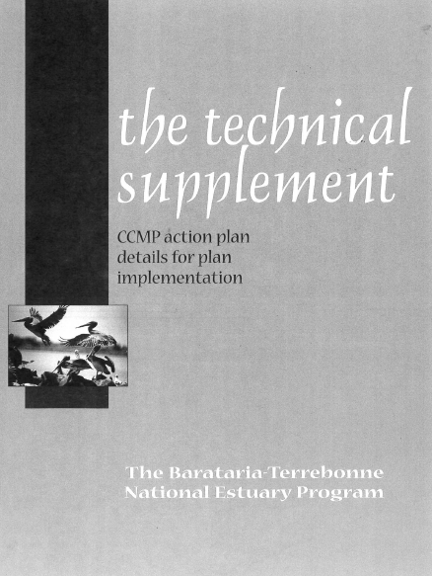
The Technical Supplement CCMP Part 3 of 4
The most important element of the CCMP that consists of detailed recommended actions to address the 51 action plans.
Includes:
Objectives
Description
Background/Major Issues
Benefits
IMPLEMENTATION SCHEDULE with the short-, medium- and long-term actions for this action
Lead and Support Implementers
Most lead implementers not BTNEP program office
BTNEP usually only co-lead
Cost and Economic Considerations
Funding Strategy
Evaluation Methods
MC and relationship to BTNEP Program office

Slide 14
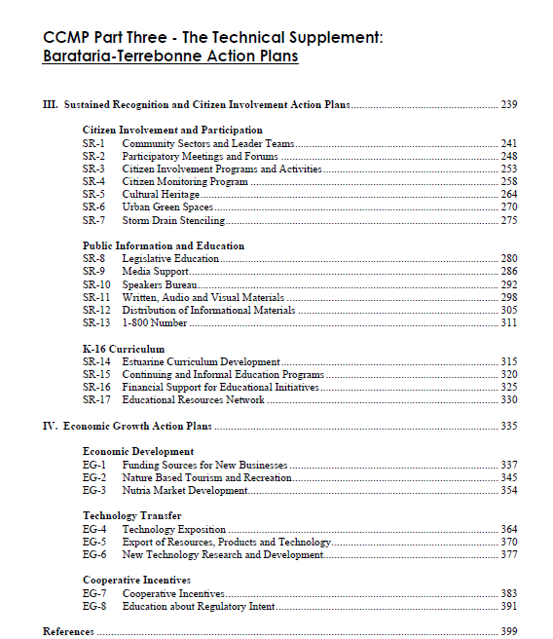
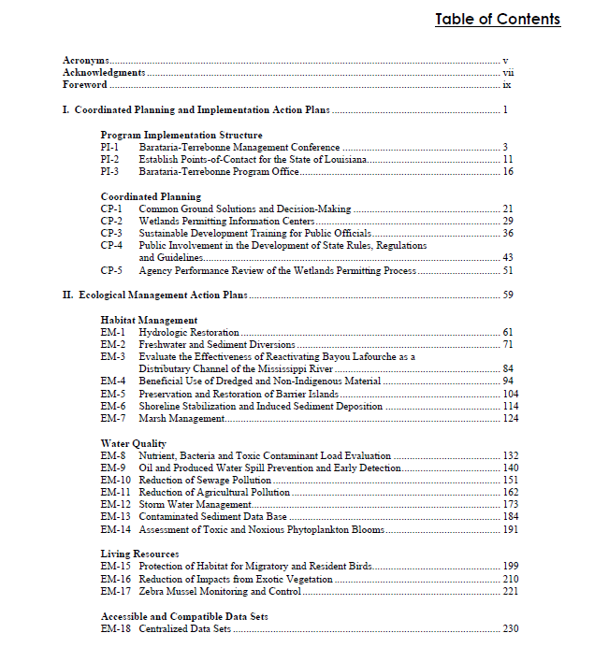

Slide 15
CCMP –Appendix
CCMP Part 4 of 4
A promise by many groups to work together to address complex issues in the estuary
Identifies the Barataria-Terrebonne System as a national treasure with a unique environment, economic benefit to the nation, and recognizes the multi-cultural heritage of the area

Slide 16
BTNEP Staff Members
Program Staff
Steve Mathies Director
Richard DeMay Scientific-Technical Coordinator
Lynn Schonberg Public Participation Coordinator
Stevie Smith Local Governments Coordinator
Dawn Bussey Secretary
Barbara Keeler, EPA Region VI Project Officer

Slide 17
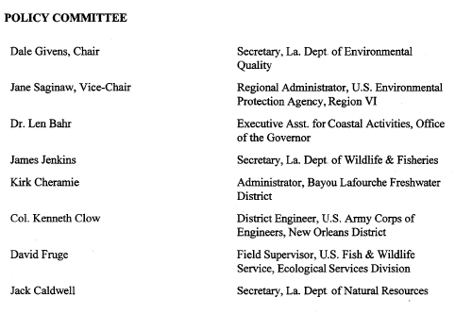

Slide 18
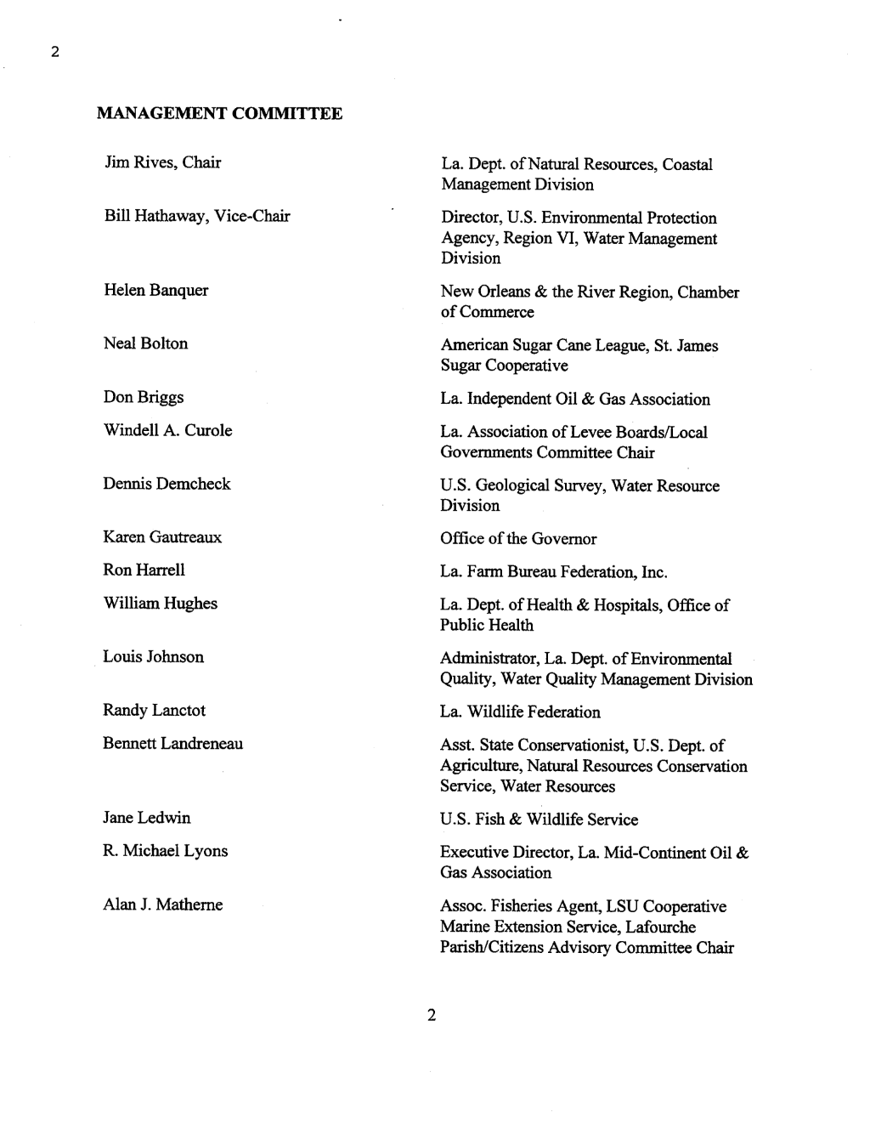
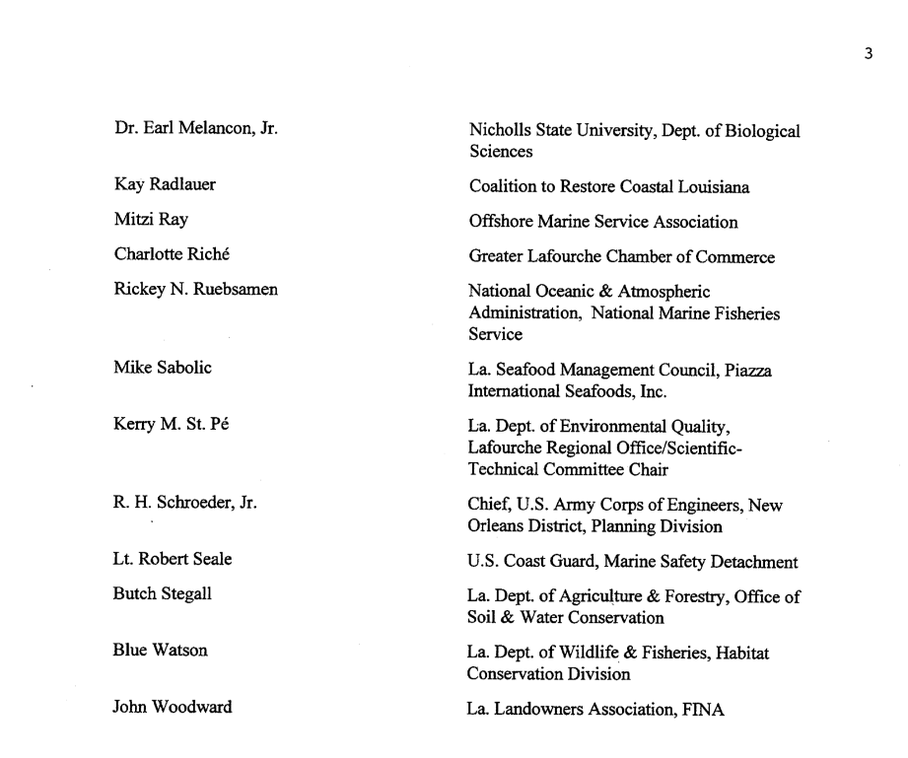
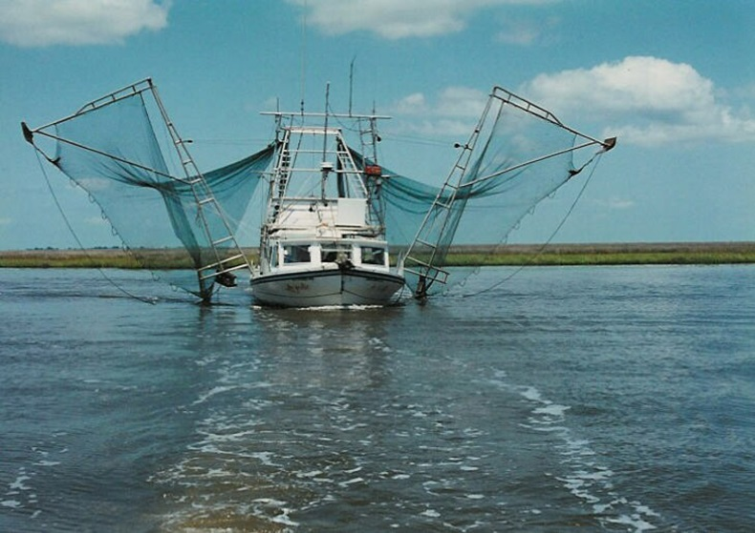

Slide 19
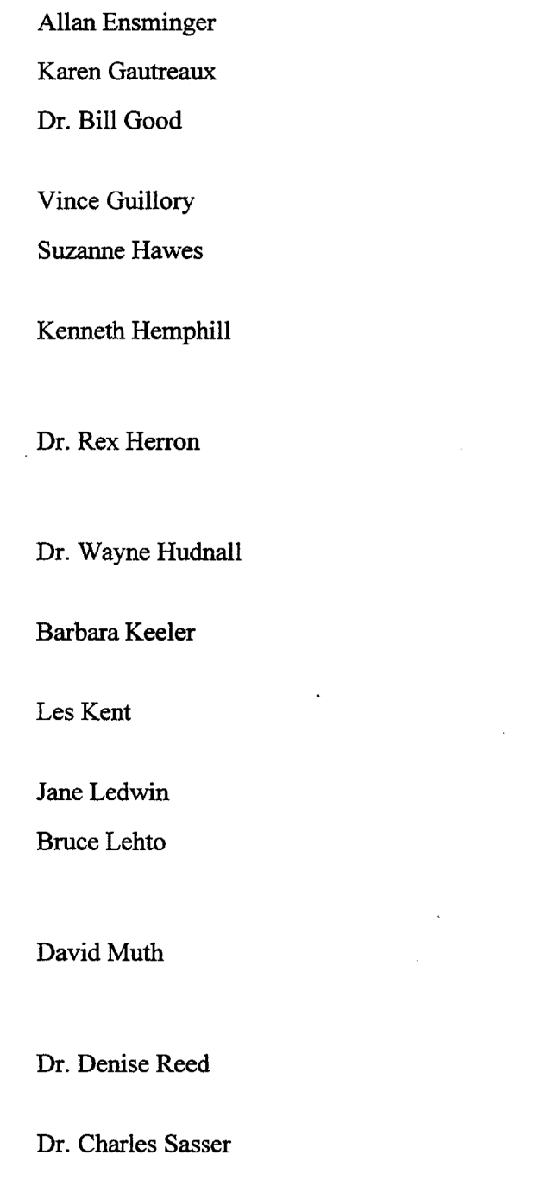
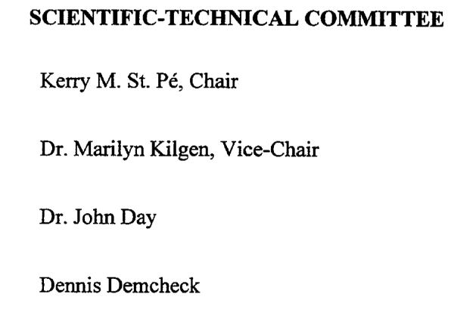
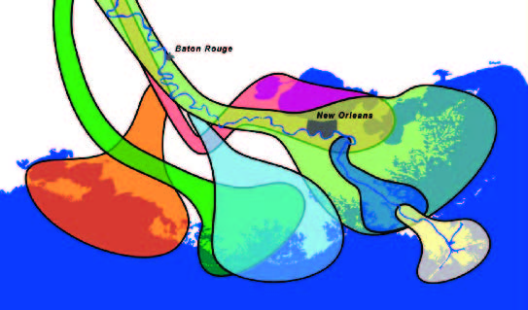

Slide 20
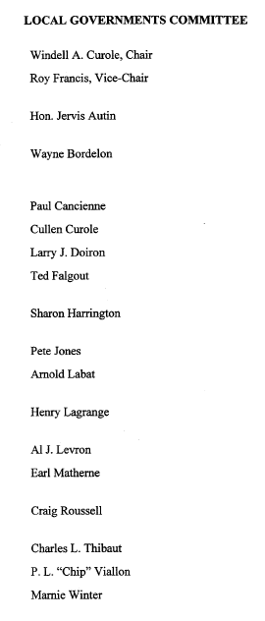

Slide 21
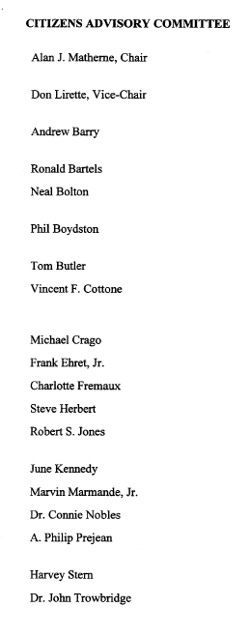
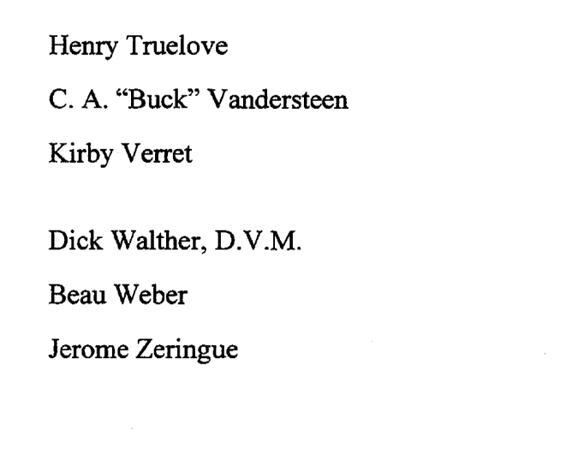

Slide 22
Evolution of BTNEP Organizational Structure
Changes over time

Slide 23
Current Structure
BTNEP Management Conference
BTNEP Program
Staff
BTNEP Action Plan Teams
BTEF

Slide 24
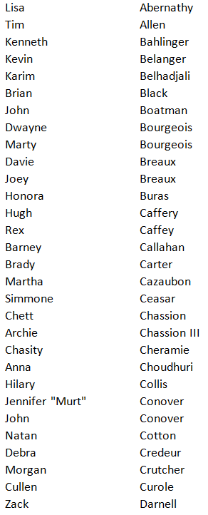
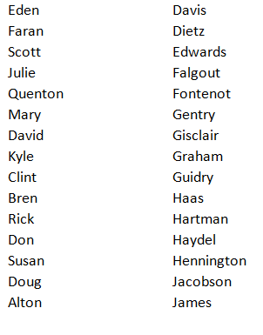
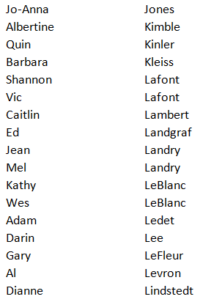
BTNEP MC Members

Slide 25
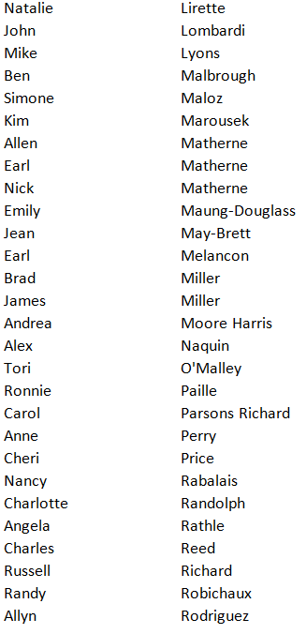
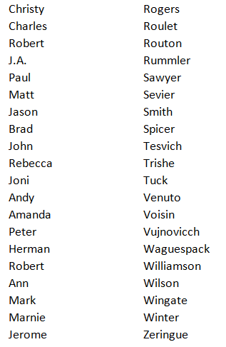

Slide 26
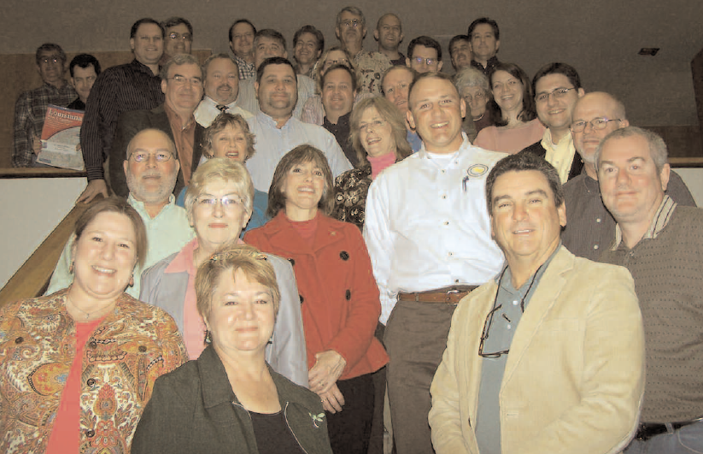
BTNEP MC Members

Slide 28
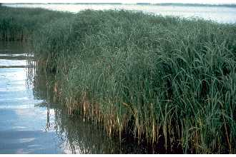
Revising the BTNEP CCMP
Requirements
EPA Checklist

Slide 29
NEW CCMP UPDATE
Describe priorities, goals and objectives in Action Plans
Clarify which Action Plans are enhanced or replacing previous Action Plans
Map of the estuary
Describe structure and membership
Discuss revisions to CCMP action items
Essential Components

Slide 30
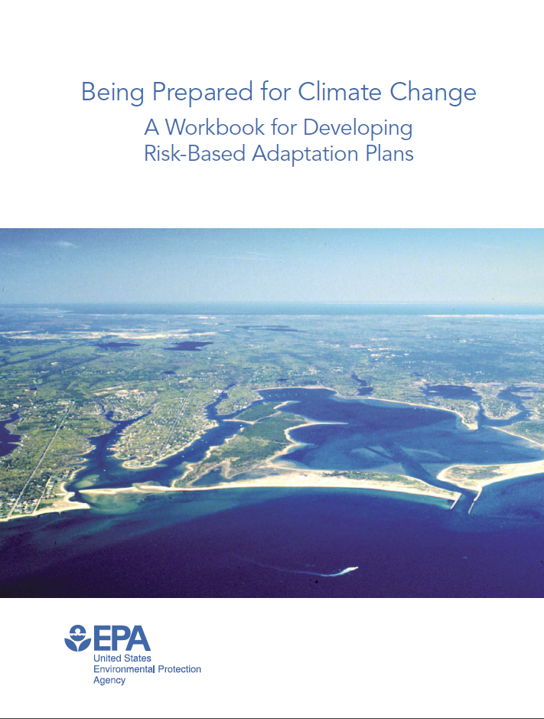
Climate Change
Each new CCMP must contain a section on Climate Ready Estuaries
EPA has created a workbook to use as a guideline
USGS and the State of Louisiana have a host of current research on the topic as it relates to Louisiana and the BT estuary

Slide 31
NEW CCMP APPENDIX
FINAL document will be completed on or before December 2017.
FINAL document must be approved by BTNEP MC
FINAL document will be collaboratively reviewed by EPA headquarters and the regional office.

Slide 32
How do you learn more about the CCMP?
Web Access
Search
“BTNEP CCMP”
in any search engine.
http://BTNEP.org/BTNEP/about/theplan.aspx

Slide 33
The CCMP Technical Supplement
Review
Revisions to Action Plans
Evaluate each of the 51 CCMP Action Plans
Team or committee members will make recommendations to BTNEP Management Conference

Slide 34
25th Anniversary of BTNEP

Slide 35
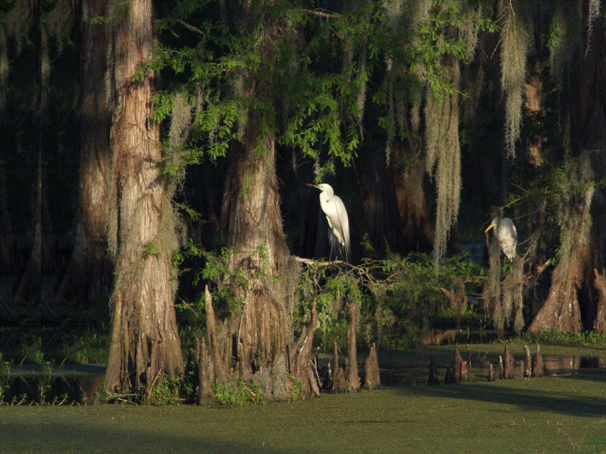
Goal of CCMP is to be sure we have a consensus agreement!
Notes:
What is next?
BTNEP Program Staff will carefully review Technical Supplement in upcoming months.
In November, will discuss how to move the plan forward
In November we will talk about how we will move forward
Could use APT to flesh out the AP

