Slide 1
Louisiana Oil Spill Response Education Community
Dianne Lindstedt
Louisiana Sea Grant
dlindst@lsu.edu
BTNEP Management Conference
May 7, 2015

Slide 2
Informal Educators Response
Developed a needs survey
Met to develop response strategy
Created a lesson/activity wish list
Chose topics and wrote lesson plans
Review, revision and edit process (Sea Grant)
Educators conducted workshops
Sea Grant partnered in Gulf wide video conferences (funded)
Notes:
Sea Grant developed a survey for teachers, informal educators and scientists/others
Educators met twice at State of the Coast in June 2011 for group response
Educators developed a lesson/activity list
Educators submitted lessons to Sea Grant for review, revision and editing
Conducted workshops post spill 2011/2012 LSTA, SAME, NMEA, YWP, WETSHOP
Sea Grant partnered in three Gulf wide video conferences (funded)

Slide 3
Who was involved in Louisiana?
Education Collaborative Effort for fall 2011
LA Sea Grant
LSU Dept. Education
LA Dept. Wildlife and Fisheries, Angela Capello
Aquarium of the Americas, Audubon Institute
LSU Ag Center (Youth Wetlands Program)
University Southeastern Louisiana
UNO
BTNEP
LUMCON
Environmental Education Commission
Teachers
Louisiana Department of Health
Notes:
(met twice at State of the Coast Conference)

Slide 4
Survey
Target: teachers, informal educators and science professionals
Polled educators, generated list of 85 topics and questions. Chose 22.
Three open ended questions
Responses: 190 teachers, 30 informal, 28 science),
Teachers, all grades, all subjects, 80% public schools
Respondents represented 72% of the parishes
Notes:
Response from 41 parishes
Highest participation EBR, St Tammany, Jefferson, Tangipahoa, Lafayette

Slide 5
Top “5” topics of interest/need
Question | Teachers (189) | Informal (30) | General (28)
Impacts on coastal habitats & wildlife | 1 | 2 | 1
Why wetlands are fragile | 2 | 6 | 3
Impacts on open water habitat & wildlife | 3 | 1 | 1
How spills are cleaned up | 4 | 5 | 4
How birds and animals are cared for after spill | 5 | 8 | 11
Impacts on seafood quality and safety | 6 | 3 | 4
What actions people can take | 6 | 7 | 7
Fate of oil in the environment | 8 | 3 | 4
Dispersants, their use and impact on wildlife | 10 | 5 | 12
Notes:
The results of the survey were shared at the GOMA meeting in January 2011

Slide 6
Important but Bottom of the List
Question | Teachers (189) | Informal (30) | General (28)
Basics of shallow and deep drilling | 22 | 19 | 12
Gulf water density, temperature and pressure | 21 | 21 | 15
Frequency of spills in Louisiana | 20 | 11 | 17
Technology to cap the well | 19 | 17 | 22
Oil spills are just one input into the sea | 18 | 17 | 19
How oil is produced and refined | 17 | 22 | 19
GOM seafloor topography | 14 | 11 | 19
Basics of oil and gas industry in Louisiana | 13 | 19 | 10

Slide 7
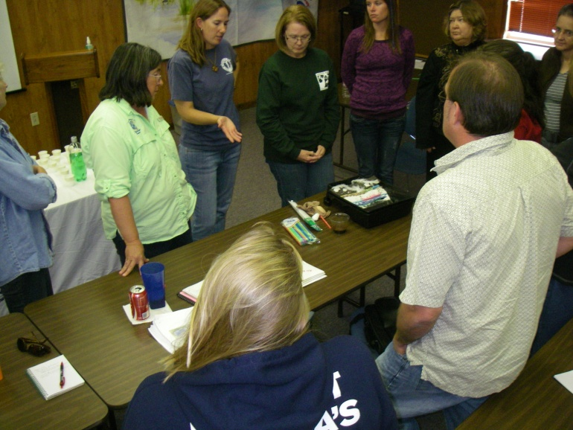
Topics and Concerns from Respondents
Misinformation from the press
Need of good information
Long term effects
Human health issues
Mental health
Economics
Food chain impacts
Wetland loss and recovery prospects
What can teachers /school children can do to help

Slide 8
Lesson Topics
Wetland Webs after an Oil Spill (ecology)
Sea Turtle Rescue Round Up, (biology/zoology)
Sea Turtle-O Bingo (ecology)
Oil Impacts to Wildlife, (math equations)
What are you Tasting ? (chemistry, food science, seafood tainting)
Animal Adaptations: Bird Feathers after Oil Spill, (biology)
Oil Spill in a Pan,(science, environment)
Oil Spill Jeopardy (chemistry, ecology, physical processes)
Notes:
Fate of Oil in the Sea (chemistry, physical science)
6-8
GOM Seafloor topography & currents, (geology, physical science)
Short Graphic (math skills)
Fate of Oil in the Sea (chemistry, physical science)
Resources at Risk ESI, (environmental science, management)
Gulf Circulation and Oil Spills, (physical science)
GOM Seafloor topography & currents, (geology, physical science)
ESI: Reading an environmental resources map, (Geography
Fisheries Economics and Oil Spills (Economics)
Oil Inputs into the Sea (chemistry, human impacts)
Wetland Impacts Graphic, (ecology)

Slide 9
Lesson Topics
Understanding Oil Spills: Article Oil Spill, (social studies, language arts)
Oil Spill Issue Analysis, (science, civics, management)
Oil Spill Reporting (social studies, writing)
Town Meeting “Think It, Speak it” (science, civics)
Activities
Density of oil & water (physical science)
Oil has Fingerprints (chemistry)
Notes:
Fate of Oil in the Sea (chemistry, physical science)
6-8
GOM Seafloor topography & currents, (geology, physical science)
Short Graphic (math skills)
Fate of Oil in the Sea (chemistry, physical science)
Resources at Risk ESI, (environmental science, management)
Gulf Circulation and Oil Spills, (physical science)
GOM Seafloor topography & currents, (geology, physical science)
ESI: Reading an environmental resources map, (Geography
Fisheries Economics and Oil Spills (Economics)
Oil Inputs into the Sea (chemistry, human impacts)
Wetland Impacts Graphic, (ecology)

Slide 10
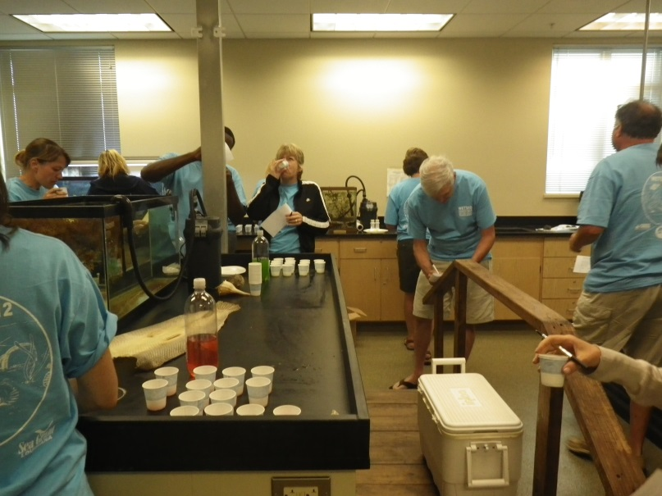
Workshops
Three oil spill sessions at LSTA November 2010
Professional Development at SAME November 2010
Oil Spill session and forum at NMEA June 2011
Environmental Education Symposium February 2011
WETSHOP 2011 to present
Youth Wetland Programming

Slide 11
Oil Spill Video Conferences
Teacher Video Conferences on April 2011 and January 2012 at ten Gulf locations.
Three sites in Alabama, Louisiana and Mississippi and one in Florida panhandle.
LSU, Aquarium and Bossier City Education Center
One presenter from each state
Classroom activities after the conference
LA Activities: What are you tasting? Sea Turtle Rescue, Oil and Water Mix, Oil Fingerprinting
NOAA funded
Notes:
LA activities Tasting, oil and water mix, oil fingerprinting, Sea Turtle Round up)

Slide 12
Topics for Teachers
Impact of Marine Mammals & Sea Turtles ( Dr. Frank Hernandez, AL)
Impacts on the Marine Environment (Barbara Albrecht, FL)
Seafood Safety* (Dr. Julie Anderson, LA)
Sargassum Communities in the Gulf (Dr. Mobi Solangi, MS)
Oil Pollution 101 (Dr. Julia Lytle, MS)
The Role and Effects of Dispersants* (Dr. Julie Anderson, LA)
Birdlife Response to the DWH Oil Spill (Dr. Mark Woodrey, AL)
Toxicity, Risk, Bioavailability and Biodegradation (Dr. Richard Snyder, FL)
Notes:
Activities: What are you Tasting?, Sea Turtle Rescue. Oil Fingerprinting,

Slide 13
Video Conference for Louisiana Community Forum
Sites: LSU, Aquarium of the Americas and SciPort
53 participants at all sites and 20 online
Topics
Overview of the DH Oil Spill (Dr. Ed Overton, LSU)
The Role and Effects of Dispersants (Dr. Julie Anderson, LSU)
Assessing Seafood Safety after the Spill (Lucina Lampila, LSU)
The Recovery and Release of 200 Sea Turtles
(Suzanne Smith, Audubon Aquarium)
Activities: What are you Tasting? Oil and Water Mix, Oil Fingerprinting
Notes:
November 11, 2011
Overview of the DH Oil Spill Dr. Ed Overton
The Role and Effects of Dispersants in an Oil Spill Dr. Julie Anderson, Sea Grant
Assessing Seafood Safety after the 2010 Gulf Oil Spill Dr. Lucina E. Lampila
Journey Home: The Recovery and Release of 200 Sea Turtles from the BP Oil Spill Suzanne Smith, LA Marine Mammal & Sea Turtle Rescue Program

Slide 14
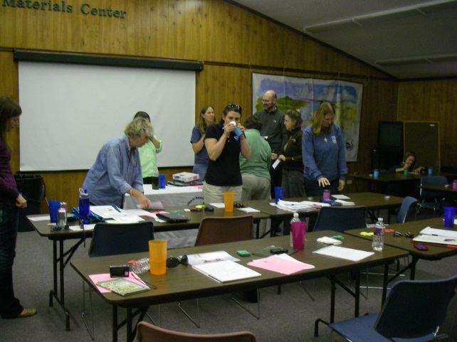
Results
512 teachers
17-34,000 students Gulfwide ~5,250-10,300 from Louisiana
73 other participants
Pre and post tests

Slide 15
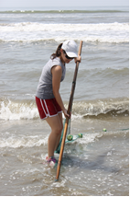
Lagniappe: Youth Summer Camps
To encourage integration of oil spill education in summer camps from NOAA grant
Lead Camp LUMCON
Minority Awareness in the Geosciences
Program UNO PIES
Aquakids Youth Volunteer Program Aquarium of the America’s

Slide 16
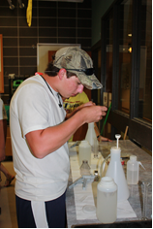
Student Reflection
“I feel like I had a big light bulb come on. It is amazing how everything is affected by everything else. Now I know more than anyone I fish with about the environment. Wait till I show off.”
Noah, LEAD Camp

Slide 17
Thank You
Dianne Lindstedt
dlindst@lsu.edu
Louisiana Sea Grant
May 15, 2015

Slide 19
Lessons/Activities
Wetland Webs after an Oil Spill (ecology)
Sea Turtle Rescue Round Up (biology/zoology)
What are you Tasting ? (chemistry, food science, seafood tainting)
Sea Turtle-O Bingo (ecology)
Animal Adaptations: Bird Feathers after Oil Spill (biology, adaptations)
Oil Spill in a Pan (science, environment)
Understanding Oil Spills: Article Oil Spill, (social studies, language arts)
Oil Spill Issue Analysis (science, civics, management)
Oil Spill Reporting (social studies, writing)
Oil Spill Jeopardy (chemistry, ecology, physical, clean up, impacts)
Oil Impacts to Wildlife (math equations)
Town Meeting “Think It, Speak it” (science, civics)
Density of oil & water; separating oil from water (physical science)
Oil has Fingerprints (chemistry)

Slide 20
Short Graphic (math skills)
Fate of Oil in the Sea (chemistry, physical science)
Resources at Risk ESI, (environmental science, management)
Gulf Circulation and Oil Spills, (physical science)
GOM Seafloor topography & currents, (geology, physical science)
ESI: Reading an environmental resources map, (Geography
Fisheries Economics and Oil Spills (Economics)
Oil Inputs into the Sea (chemistry, human impacts)
Wetland Impacts Graphic, (ecology)

Slide 21
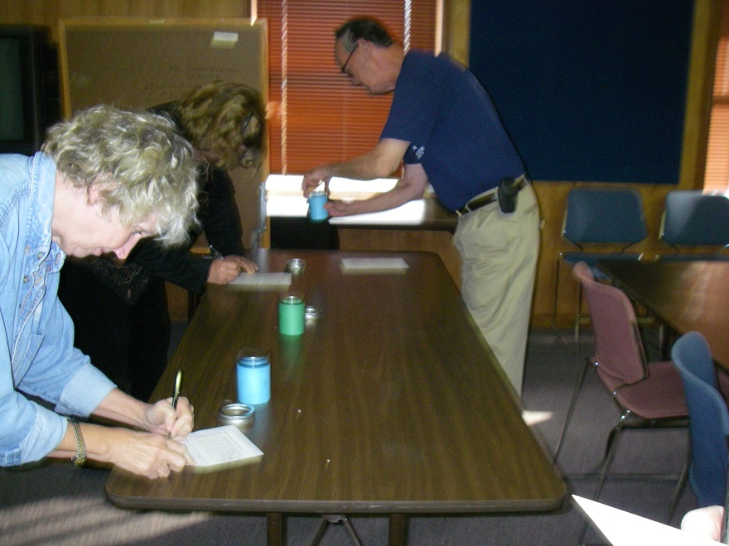
*Special Session at LSTA Fall Teacher workshops
Tricia LeBlanc and I presented oil spill lessons at
NMEA in Boston and answered questions at a general assembly
For the members of the conference and video conference presente dther 42 participates
LSTA, SAME, NMEA, WETSHOP
Need teacher numbers and educator numbers
Notes:
Tricia LeBlanc and I presented oil spill lessons at
NMEA in Boston and answered questions at a general assembly
For the members of the conference and video conference presente dther 42 participates

Slide 22
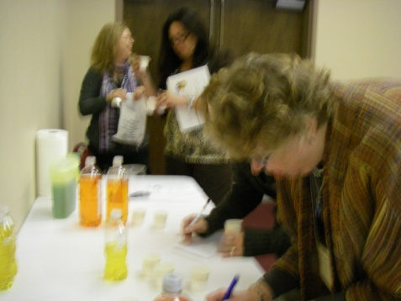
Workshops
Three oil spill sessions at LSTA November 2010
Professional Development at SAME November 2010
Oil Spill session and forum at NMEA June 2011
WETSHOP 2011 to present

Slide 23
Educators Response
Developed a needs survey for teachers, informal educators and scientists/others (Sea Grant Spring 2011)
Met twice at State of the Coast to agree on group response (Educators in June 2011)
Developed a lesson/activity list (Educators in June 2011)
Submitted lessons (Educators to Sea Grant for review, revision and editing
Conducted workshops post spill 2011/2012 LSTA, SAME, NMEA, YWP, WETSHOP
Sea Grant partnered in three Gulf wide video conferences (funded)

Slide 24
Educators Response
Survey for teachers, informal educators and scientists/others
Educators meet twice at State of the Coast in June 2011 for group response
Educators developed a lesson/activity list
Educators submitted lessons to Sea Grant for review, revision and editing
Conducted workshops post spill 2011/2012 LSTA, SAME, NMEA, YWP, WETSHOP
Sea Grant partnered in three Gulf wide video conferences (funded)
Notes:
Sea Grant developed a survey for teachers, informal educators and scientists/others
Educators met twice at State of the Coast in June 2011 for group response
Educators developed a lesson/activity list
Educators submitted lessons to Sea Grant for review, revision and editing
Conducted workshops post spill 2011/2012 LSTA, SAME, NMEA, YWP, WETSHOP
Sea Grant partnered in three Gulf wide video conferences (funded)

Slide 25
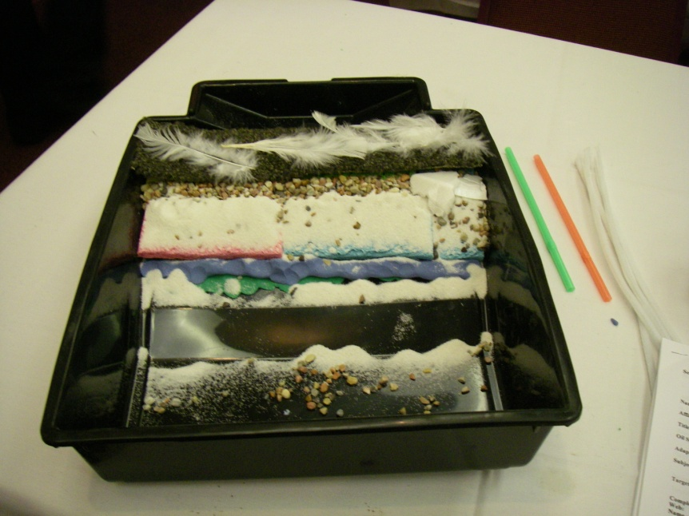
Workshops
LSTA, SAME, NMEA, YWP, WETSHOP
Notes:
LSTA SAME NMEA YWP WETSHOP

Slide 26
Lesson Topics
Wetland Webs after an Oil Spill (ecology)
Sea Turtle Rescue Round Up, (biology/zoology)
Sea Turtle-O Bingo (ecology)
Oil Impacts to Wildlife, (math equations)
What are you Tasting ? (chemistry, food science, seafood tainting)
Animal Adaptations: Bird Feathers after Oil Spill, (biology, adaptations)
Oil Spill in a Pan,(science, environment)
Understanding Oil Spills: Article Oil Spill, (social studies, language arts)
Oil Spill Issue Analysis, (science, civics, management)
Oil Spill Reporting (social studies, writing)
Oil Spill Jeopardy (chemistry, ecology, physical processes, clean up, impacts)
Town Meeting “Think It, Speak it” (science, civics)
Activities
Density of oil & water (physical science)
Oil has Fingerprints (chemistry)
Notes:
Fate of Oil in the Sea (chemistry, physical science)
6-8
GOM Seafloor topography & currents, (geology, physical science)
Short Graphic (math skills)
Fate of Oil in the Sea (chemistry, physical science)
Resources at Risk ESI, (environmental science, management)
Gulf Circulation and Oil Spills, (physical science)
GOM Seafloor topography & currents, (geology, physical science)
ESI: Reading an environmental resources map, (Geography
Fisheries Economics and Oil Spills (Economics)
Oil Inputs into the Sea (chemistry, human impacts)
Wetland Impacts Graphic, (ecology)

