Slide 2
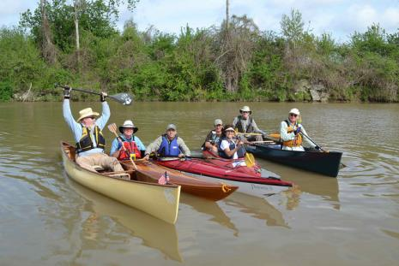
Statistics
4-Day Event
April 3-6
Donaldsonville to Lockport
156 paddlers registered
130 paddlers on water
Out of state participants
Notes:
We had 33 paddler that paddle all 4 days
Over 100 paddlers from Louisiana including local towns and cities as well as Alexander, Ruston, Quitman (15 mins south of Ruston), Baton Rouge and New Orleans.
25 out of state paddlers from Mississippi, Texas Alabama, Georgia, Maryland, Maine and Wisconsin

Slide 3
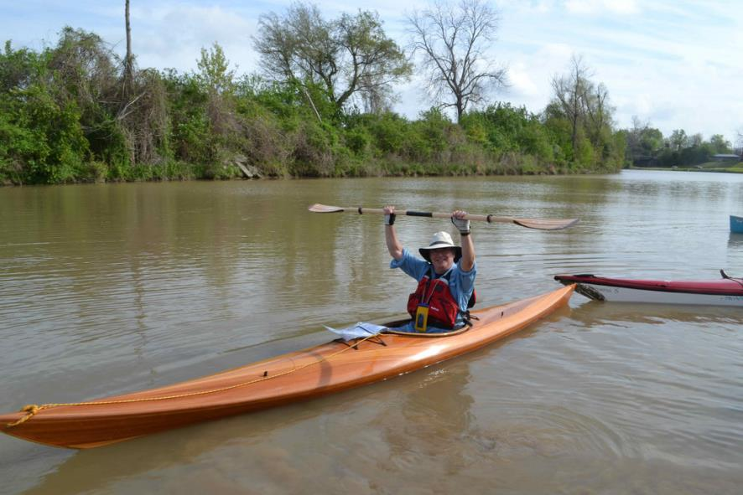
Harmony makes her appearance

Slide 4
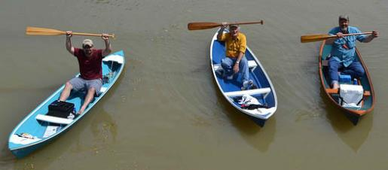
Thursday, April 3
Launch in Donaldsonville
Breakfast provided by Mosaic
Lunch at J.C. Leblanc’s Resident
Lunch provided by DOW Chemical
Camp out at Madewood Plantation
Dinner provided by Bayou Lafourche Freshwater District
Estuary Trivia
Notes:
71 paddlers out of the 75 registered
Mosaic provided breakfast bags with juice, fruit and granola bars.
Paddlers then stopped for lunch at the residence of J.C. Leblanc and was provided lunch by Dow Chemical which included hamburgers, hotdogs, chili, chips and bread pudding for dessert.
The paddlers faced a tough wind throughout the day. We had a little sprinkle every now and then, but the wind did give the paddlers a very hard time.
At Madewood Plantation where Paddlers set up camp, they were served shrimp and grits, chicken pasta, cold vegetable pasta, boudin balls, crawfish pies and Krispy Kreme bread pudding by the Bayou Lafourche Freshwater District.
Paddlers were then treated to an Estuary Trivia game hosted by Kerry St. Pé. The group was divided into four teams and were given a set of questions each to answer. The winning team received BTNEP mugs.

Slide 5
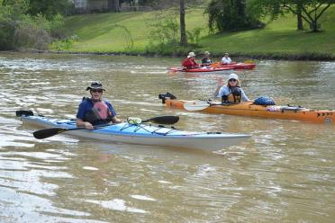
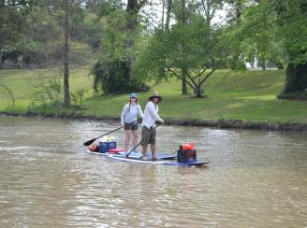
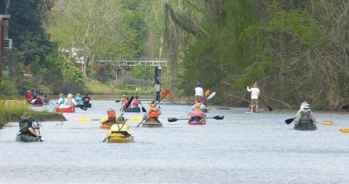
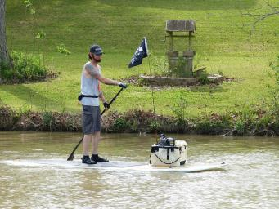
Thursday

Slide 6
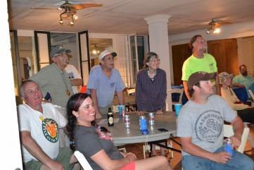
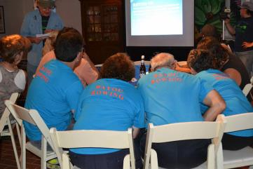
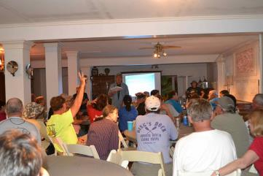
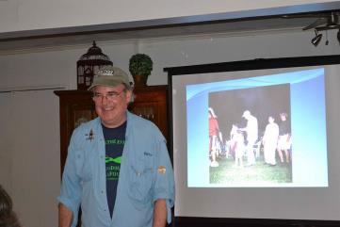
Thursday Night Estuary Trivia

Slide 7
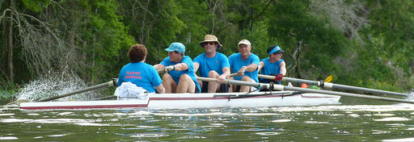
Friday, April 4
Launch at Madewood Plantation
Breakfast provided by Orbitz Worldwide
Lunch at Napoleonville Restaurants
Pick up at Jean Lafitte National Park
Camp out at Nicholls State University
Dinner provided by Bourgeois & Associates
Entertainment
Notes:
71 Paddlers out of the 84 registered
For lunch, paddlers stopped in Napoleonville and had a choice of three restaurants for lunch. Paddlers could enjoy lunch at Nubby Ducks, Cajun Café or Vinny’s Sandwich Shop.
The weather was predicted to have a lot of rain. The paddlers did hit some showers but for the most part the weather held off.
Paddlers completed their trip at Jean Lafitte National Park and then drove to Nicholls State University to set up camp for the night
Bourgeois and Associates provided dinner which included White beans, shrimp jambalaya, bread, and a variety of desserts
Paddlers were then entertained with the music from Pat Sylvest and Company.

Slide 8
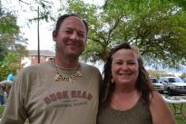
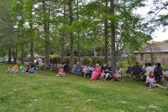
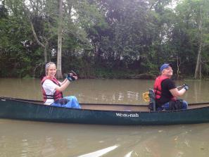
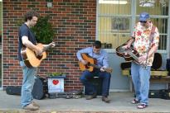
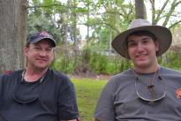
Friday

Slide 9
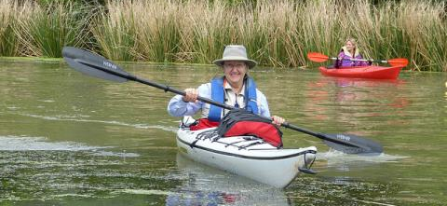
Saturday, April 5
Launch at Nicholls State University
Breakfast provided by BTNEP
Lunch provided by Virginia Plaisance’s Family
Pick up and camp at Dr. Mike & Brenda Dardar Robichaux Residence
Dinner provided by Robichaux Family
Entertainment
Notes:
90 paddlers out of the 118 registered
The weather was predicted to be bad again, but it held up with only a few showers during the trip. The weather got really bad when we were pulling paddlers our of the water at the Robichauxs. We did have paddlers that did not show up due to the weather that was predicted for all four days.
Mrs. Virginia Plaisance, along with her family and friends provided our paddlers with a variety of food and desserts for lunch.
The paddlers ended their day at the residence of Dr. Mike and Brenda Dardar Robichaux where they set up camp and were treated to an Houma Indian Cuisine and were able to visit with the United Houma Nation Indians. Due to the weather, the group was unable to do their demonstration.

Slide 10
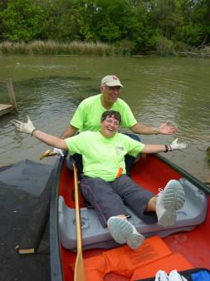
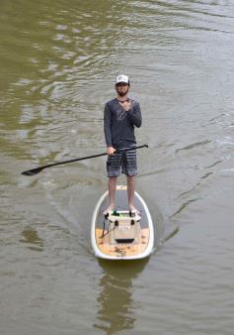
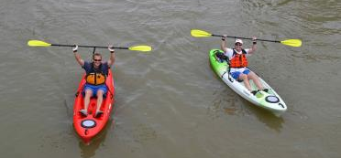
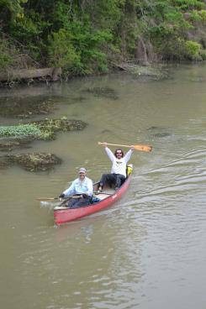
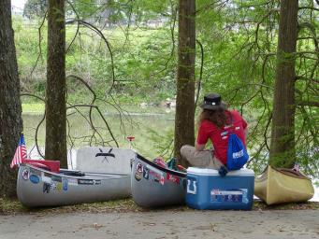
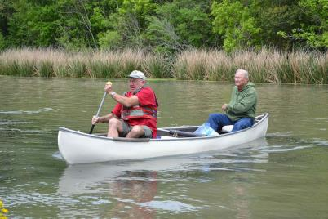
Saturday

Slide 11
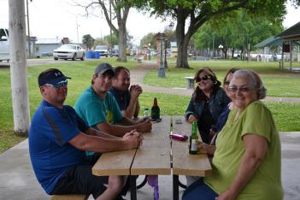
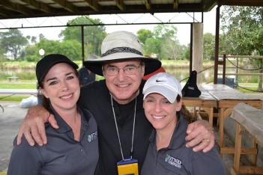
Sunday, April 6
Half day paddle
Launch at Robichaux Residence
Breakfast provided by Robichaux Family
Pick up at Lockport Bayouside Park
Lunch provided by BTNEP
Notes:
57 paddlers on the water out of the 98 registered
This was a half day for paddlers where they started at the Robichaux residence and ended at the Lockport Bayouside Park.
The paddlers enjoy breakfast that was provided by Mrs. Brenda Dardar Robichaux before launching.
We were scheduled to have lunch provided by the Town of Lockport and entertainment by Tysman Charpentier and Company, but due to the predicted weather we had to cancel.
Weather was again predicted to be really bad, so we decided to make a decision if we will paddle on the Sunday morning, which we did.
BTNEP decided to order sandwich and fruit trays for lunch for those paddlers that did show up.

Slide 12
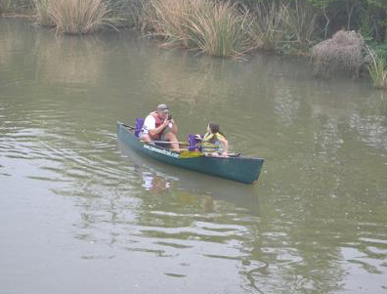
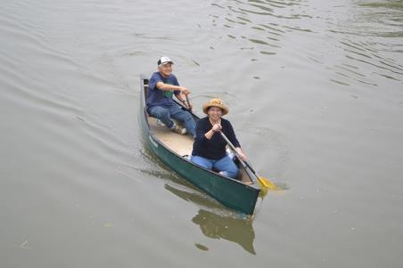
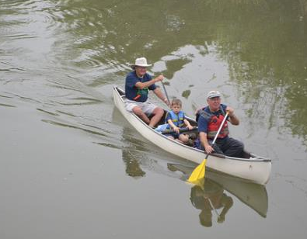
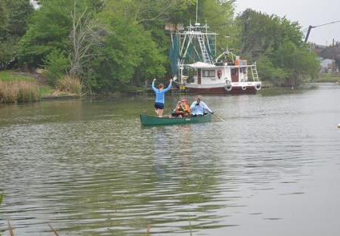
Sunday

Slide 13
What our paddlers had to say
“I hope to be able to return to the bayou for more BTNEP projects during my retirement. You folks do important work and the paddle trip educates people toward that need!” - Brian Schexnayder, Baltimore, MD
“Awesome trip. Thanks for all your hard work organizing and keeping us in line! It was wonderful.” – Colleen Earp, New Orleans, LA
“I had a great time on the Bayou Lafourche paddle this year! I think you all did an exceptional job. All your staff members were so helpful to us paddlers. Coming to the Bayou Lafourche over the years, I have learned a lot about Louisiana and its concerns of constant land loss. It is a bit like a family reunion!” – Winifred Shrum, Corpus Christie, Texas

Slide 14
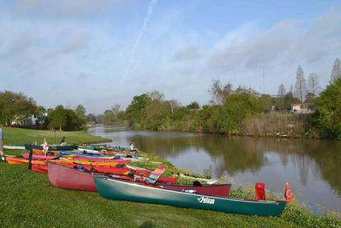
Sponsors
Bourgeois & Associates
Breaux Petroleum Products
Valentine Chemicals
Bobby Lynn’s Marina
Lafourche Ford Lincoln
Georgia Farms, Inc.
Synergy Bank
Community Bank
Jones Dermatology

Slide 15
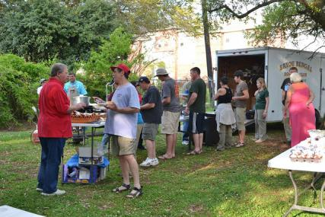
In-Kind Sponsors
Mr. JC Leblanc & Family
Mosiac
Orbitz Worldwide
DOW Chemical
Nicholls State University
Bourgeois & Associates
Town of Lockport
City of Donaldsonville
Jean Lafitte National Park & Preserve
Bayou Lafourche Freshwater District
Kleinpeter

Slide 16
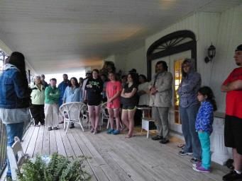
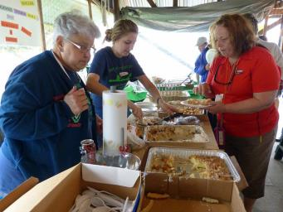
Hospitality
Madewood Plantation
Nubby Ducks
Emily’s Cajun Café
Vinnie’s Sandwich Shoppe
Ms. Virginia Plaisance & Family
Dr. Mike & Brenda Dardar Robichaux & Family

Slide 17
Things to think about for 2015
New location for Thursday lunch spot.
New location for Friday lunch spot.

Slide 18
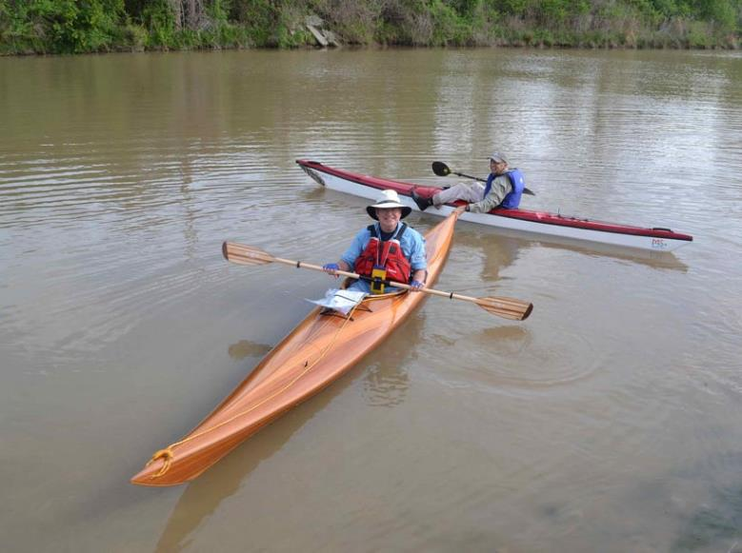
See you next year!

