Slide 1
Louisiana Coastal Area
Medium Diversion with Dedicated Dredging at Myrtle Grove
Barataria-Terrebonne
National Estuary Program
Management Conference Meeting
Study Update
11 Sept 2012

Slide 2
Study Authority
Title VII, Sec. 7006(c)(1) of the Water Resources Development Act of 2007 (WRDA) authorizes the Secretary to carry out the following projects substantially in accordance with the restoration plan:
Mississippi River-Gulf Outlet Environmental Restoration at a total cost of $105,300,000.
Small Diversion at Hope Canal at a total cost of $68,600,000.
Barataria Basin Barrier Shoreline Restoration at a total cost of $242,600,000.
Small Bayou Lafourche Reintroduction at a total cost of $133,500,000.
Medium Diversion at Myrtle Grove with Dedicated Dredging at a total cost of $278,300,000.
Before the Secretary may begin construction of any project under this subsection, the Secretary shall submit a report documenting any modifications to the project, including cost changes, to the Committee on Transportation and Infrastructure of the House of Representatives and the Committee on Environment and Public Works of the Senate

Slide 3
LCA Critical Needs
Prevent future land loss where predicted to occur
Restore fundamentally impaired or mimic deltaic processes through river reintroduction
Restore or preserve endangered critical geomorphic structures
Protect vital local, regional, and national socio-economic resources

Slide 4
Overview
The feasibility study has an overarching goal to “Use river resources (in a combination of diversion and dedicated dredging) to increase Area 1 wetlands quantity and quality”.
From this goal, study specific objectives were developed:
1. Establish geomorphic connection from the river to the estuary to introduce sediments to build and sustain Area 1 wetlands.
2. Deposit and retain riverine resources to maintain 33,880 marsh acres in Area 1 over the 50-year period of analysis.
Alternatives have been developed that seek to support the study goal and accomplish the study objectives.

Slide 5
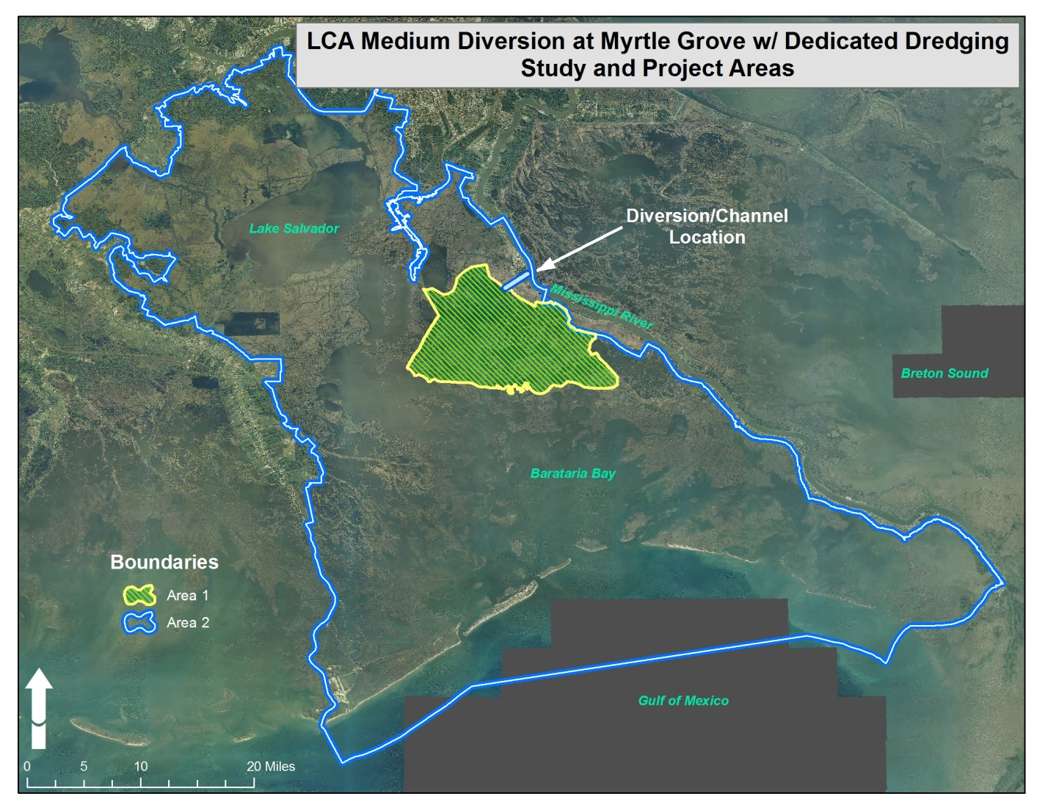
Preferred

Slide 6
Initial Array of Alternatives
Alternatives were developed in concert with project objectives and to address problems in the study area. They represent different combinations of diversion structure size, flow regime, and marsh creation scale. Each alternative was evaluated for benefits (marsh acres) and preliminary costs.
  Alternatives represent:
    Small to large diversion sizes
    Restrained to aggressive flow regimes
      Calendar based
      Sediment thresholds
    Scales of marsh creation over time
  60 alternatives met both objectives
  We are carrying through the 2004 Recommendation

Slide 7
Structure & Operation Alternatives
Structure Design Capacity (When River is at 1M cfs) | cfs | Continuous Flow through Structure | Dec – May Hydrograph | Dec – Mar Hydrograph | Top 33% Occurrence for Sediment | Top 20% Occurrence for Sediment | Top 10% Occurrence for Sediment | Top 1% Occurrence for Sediment | Top 37.5% Occurrence for Sediment
 | 5,000 | 1A | 2A | 3A | 4A | 5A | 6A | 7A | 8A
 | 15,000 | 1B | 2B | 3B | 4B | 5B | 6B | 7B | 8B
 | 30,000 | 1C | 2C | 3C | 4C | 5C | 6C | 7C | 8C
 | 45,000 | 1D | 2D | 3D | 4D | 5D | 6D | 7D | 8D
 | 60,000 | 1E | 2E | 3E | 4E | 5E | 6E | 7E | 8E
 | 75,000 | 1F | 2F | 3F | 4F | 5F | 6F | 7F | 8F
 | 100,000 | 1G | 2G | 3G | 4G | 5G | 6G | 7G | 8G
 | 125,000 | 1H | 2H | 3H | 4H | 5H | 6H | 7H | 8H

Slide 8
Dredging Scales
(to be paired with a diversion alternative)
Marsh Creation Strategy | Feature | Concept | Description | Total Acres
 | MC-7A | Priority Area Completion Approach – Small Scale | 6.5mcy per dredge cycle (~946 ac created in each of 5 cycles) | 4,730
 | MC-7B | Priority Area Completion Approach – Medium Scale | 6.5mcy per dredge cycle (~946 ac created in each of 8 cycles) | 7,568
 | MC-7C | Priority Area Completion Approach – Large Scale | 6.5mcy per dredge cycle (~946 ac created in each of 13 cycles) | 12,298
 | D7-1 | Infuse Diversion w/ Sediment Small Scale Dredging | 6.5mcy per dredge cycle (for 5 cycles) | TBD
 | D7-2 | Infuse Diversion w/ Sediment Medium Scale Dredging | 6.5mcy per dredge cycle (for 8 cycles) | TBD
 | D7-3 | Infuse Diversion w/ Sediment Large Scale Dredging | 6.5mcy per dredge cycle (for 13 cycles) | TBD

Slide 9
Sediment Thresholds
Based on a frequency analysis of the
1985-2009 Tarbert Landing Qs, the
Highest 1%, 10%, 20%, 33.33%, and
37.5% discharge threshold values were
determined. Annual daily discharge data
were compared to those threshold values
to compute the frequency of daily
discharges equal to or greater than the
threshold values.
= Total days > or = discharge threshold (in 25-yr record)
= Number of years discharge threshold did not occur
= TSS (mg/L) of discharge threshold
= Frequency of discharge threshold (1985-2009 Qs)

Slide 10
Preliminary Screening
Screening will applied to reduce the total number of alternatives for full evaluation. This will be based on several variables including:
  What are the benefits of each alternative?
  Does an alternative meet both objectives?
  Which alternatives are most cost effective?
  Which alternatives avoid constraints?
Screening is an iterative process and there may be additional criteria the PDT could develop to help further screen alternatives. The final array will hopefully consist of approximately five alternatives.

Slide 11
Diversion Alternatives
Structure Design Capacity (When River is at 1M cfs) | cfs | Continuous Flow through Structure | Dec – May Hydrograph | Dec – Mar Hydrograph | Top 33% Occurrence for Sediment | Top 20% Occurrence for Sediment | Top 10% Occurrence for Sediment | Top 1% Occurrence for Sediment | Top 37.5% Occurrence for Sediment
 | 5,000 | 1A | 2A | 3A | 4A | 5A | 6A | 7A | 8A
 | 15,000 | 1B | 2B | 3B | 4B | 5B | 6B | 7B | 8B
 | 30,000 | 1C | 2C | 3C | 4C | 5C | 6C | 7C | 8C
 | 45,000 | 1D | 2D | 3D | 4D | 5D | 6D | 7D | 8D
 | 60,000 | 1E | 2E | 3E | 4E | 5E | 6E | 7E | 8E
 | 75,000 | 1F | 2F | 3F | 4F | 5F | 6F | 7F | 8F
 | 100,000 | 1G | 2G | 3G | 4G | 5G | 6G | 7G | 8G
 | 125,000 | 1H | 2H | 3H | 4H | 5H | 6H | 7H | 8H

Slide 12
Dredging Scales
(to be paired with a diversion alternative)
Priority Area Strategy | Feature | Concept | Description | Total Acres
 | MC-7A | Priority Area Completion Approach – Small Scale | 6.5mcy per dredge cycle (~946 ac created in each of 5 cycles) | 4,730
 | MC-7B | Priority Area Completion Approach – Medium Scale | 6.5mcy per dredge cycle (~946 ac created in each of 8 cycles) | 7,568
 | MC-7C | Priority Area Completion Approach – Large Scale | 6.5mcy per dredge cycle (~946 ac created in each of 13 cycles) | 12,298
 | D7-1 | Infuse Diversion w/ Sediment Small Scale Dredging | 6.5mcy per dredge cycle (for 5 cycles) | TBD
 | D7-2 | Infuse Diversion w/ Sediment Medium Scale Dredging | 6.5mcy per dredge cycle (for 8 cycles) | TBD
 | D7-3 | Infuse Diversion w/ Sediment Large Scale Dredging | 6.5mcy per dredge cycle (for 13 cycles) | TBD

Slide 13
Draft Final Array of Alternatives
Alternatives | Identifier | Structure Size | Marsh Creation | Flow Regime
 | 1B (LCA 2004 Recommendation) | 15,000 cfs | 6,286 Acres | Year-Round (No Flow Below 150,000 cfs in River)
 | 8F-Small | 75,000 cfs | 4,730 Acres | Sediment Threshold > 136 mg/L (No Flow Below 600,000 cfs in River)
 | 8G-Small | 100,000 cfs | 4,730 Acres | Sediment Threshold > 136 mg/L (No Flow Below 600,000 cfs in River)
 | 8H-Small | 125,000 cfs | 4,730 Acres | Sediment Threshold > 136 mg/L (No Flow Below 600,000 cfs in River)
 | 8G-Medium | 100,000 cfs | 7,254 Acres | Sediment Threshold > 136 mg/L (No Flow Below 600,000 cfs in River)
 | 8H-Medium | 125,000 cfs | 7,254 Acres | Sediment Threshold > 136 mg/L (No Flow Below 600,000 cfs in River)
 | 8H-Large | 125,000 cfs | 12,118 Acres | Sediment Threshold > 136 mg/L (No Flow Below 600,000 cfs in River)

Slide 14
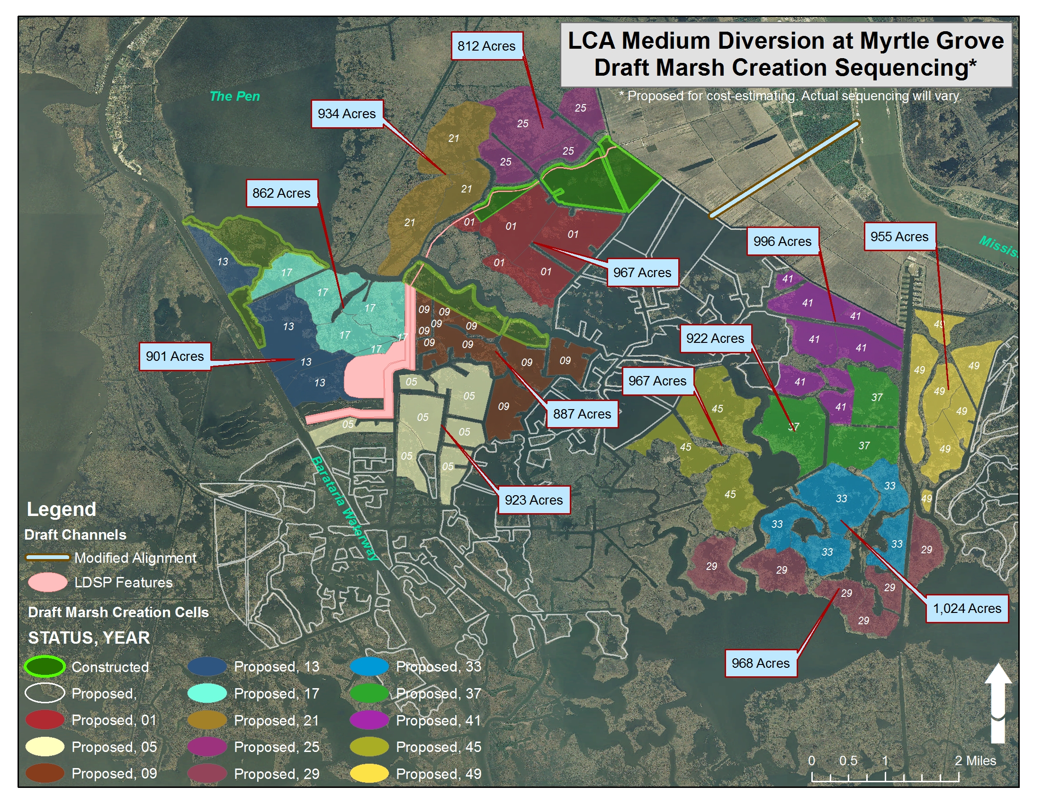

Slide 15
Next Steps
Several additional evaluation steps will be initiated to further analyze and describe alternatives. Upcoming activities include:
  Hydrodynamic modeling in the Barataria Basin to determine stage, salinity, and velocity effects for alternatives
  Wetland Value Assessments/Fisheries Modeling
  River Modeling
  Detailed Cost Estimates and Project Design
  State to initiate PED phase
A TSP is scheduled for May 2013 and a Chief’s Report in Oct 2014.

Slide 16
Questions?

