Slide 1
Davis Pond Freshwater Diversion – Status of MR&T Project and LCA Study
9/11/2012
Status Briefing for BTNEP Management Conference

Slide 2
Purpose of Briefing
Provide status briefing to BTNEP Management Conference on:
Davis Pond Freshwater Diversion Project (MR&T)
Modification of Davis Pond Diversion Study (LCA)

Slide 3
Davis Pond Freshwater Diversion Project (MR&T)
Authorized by the Flood Control Act of 1965 and modified by the Water Resources Development Acts of 1974, 1986, and 1996
Construction began in 1997 and “complete” in February 2002¹
¹ Notice of Construction Complete signed August 2012

Slide 4
Davis Pond Freshwater Diversion Project (MR&T)
Primary purpose – divert Mississippi River water to combat saltwater intrusion
Ancillary benefits:
  Help reduce the rate of land loss
  Improve fish and wildlife habitat

Slide 6
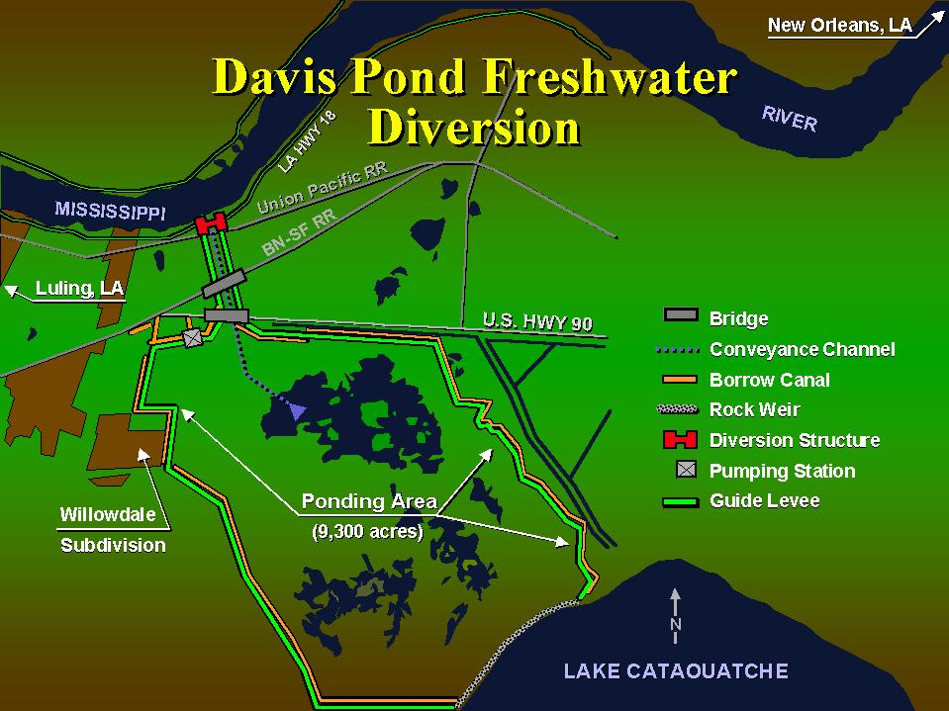
Notes:
It’s mechanics are realatively simpl,e, A small canal cut into the mississippi’s west bank lead’s to a set of four gates built into the side of the river levee. When the gates are raised, gravity pulls in river water and sends it down a 2-mile channel to a 9,300 acre “ponding area” of marsh and cypress tress. Guide levees on either side of the ponding area funnel the river water toward Lake Cataouatche, which drains into Lake Salvador and eventually barataria bay

Slide 7
LCA Modification of Davis Pond Diversion Study
Notes:
Title VII of the WRDA of 2007, P.L. 110-114, Section 7006(e)(1)(D) authorizes the Modification of Davis Pond Freshwater Diversion project in accordance with the modification plan in the Report of the Chief of Engineers dated January 31, 2005, contingent upon the submittal of a feasibility report to the Committee on Transportation and Infrastructure of the House of Representatives and the Committee on Environmental and Public Works of the Senate.
Section 7006 (e)(1)(D) States:
Additional Projects – In General-The Secretary is authorized to carry out the following projects referred to in the restoration plan if the Secretary determines such projects are feasible.
…………………………………………………………………………………………….
(D) Modification of David Pond Freshwater Diversion at the total cost of $64,200,000.
Section 7006 (e)(4) states that no appropriation shall be made to construct any project under this subsection if the report has not been approved by resolutions adopted by the Committee on Transportation and Infrastructure of the House of Representatives and the Committee on Environment and Public Works of the Senate.

Slide 8
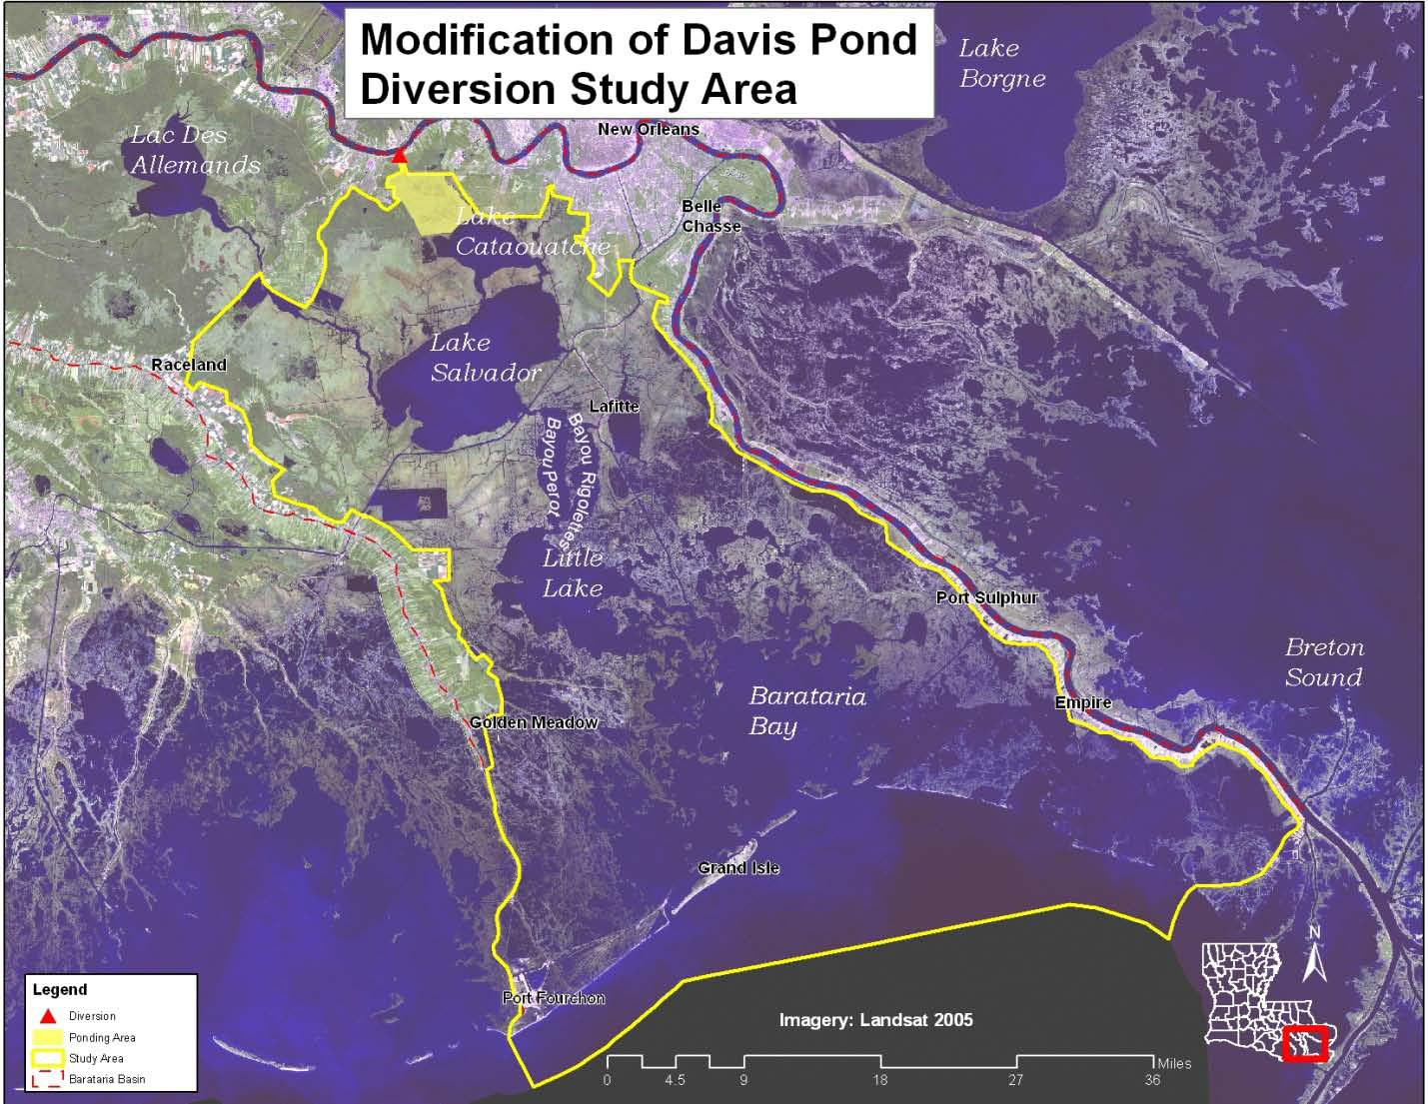
Study Area

Slide 9
Planning Goal & Objectives
Goal: Assess changes in the operation of the existing structure to increase wetland creation and restoration outputs.
Objectives:
Objective 1: Decrease the rate of land loss, and where possible, increase wetland acreage over the 50-year period of analysis.
Objective 2: Increase the geographic extent and distribution of Davis Pond freshwater, sediment, and nutrients throughout the study area over the 50-year period of analysis.
Objective 3: Create a salinity transition that supports a healthy and diverse estuarine system throughout the study area over the 50-year period of analysis.
Notes:
Goal:
Assess changes in the operation of the existing structure to increase wetland creation and restoration outputs to contribute towards achieving and sustaining a larger coastal ecosystem that can support and protect the environment, economy, and culture of southern Louisiana and thus contribute to the economy and well-being of the Nation.
Objectives:
To maximize the use of the diversion structure for the purpose of decreasing wetland loss rates and increasing habitat quality. Planning objectives include the following:
Objective 1: Decrease the rate of land loss, and where possible, increase wetland acreage over the 50-year period of analysis.
Objective 2: Increase the geographic extent and distribution of Davis Pond freshwater, sediment, and nutrients throughout the study area over the 50-year period of analysis.
Objective 3: Create a salinity transition that supports a healthy and diverse estuarine system throughout the study area over the 50-year period of analysis.

Slide 10
Plan Formulation/Evaluation
Developed/screened an initial array of 43 operational alternatives resulting in a final array of 8 alternatives
Final Array Analysis Tools:
  Hydrodynamic modeling (water surface elevation and salinity)
  ERDC-SAND2 Model (land building)
  WVA (net benefits – AAHUs)
  Cost Effectiveness/Incremental Cost Analysis
  Fisheries Tradeoff Analysis
Notes:
Developed an initial array of 43 alternatives
Screened based on criteria:
- Does the alternative fall within the scope of the project?
- Is the alternative duplicative of another alternative (same operational pattern triggered by different criteria)?
- Is the alternative complete (accounts for full annual operation)?
Final Array
8 alternatives ranging from “no-action” to operating at maximum capacity throughout year

Slide 11
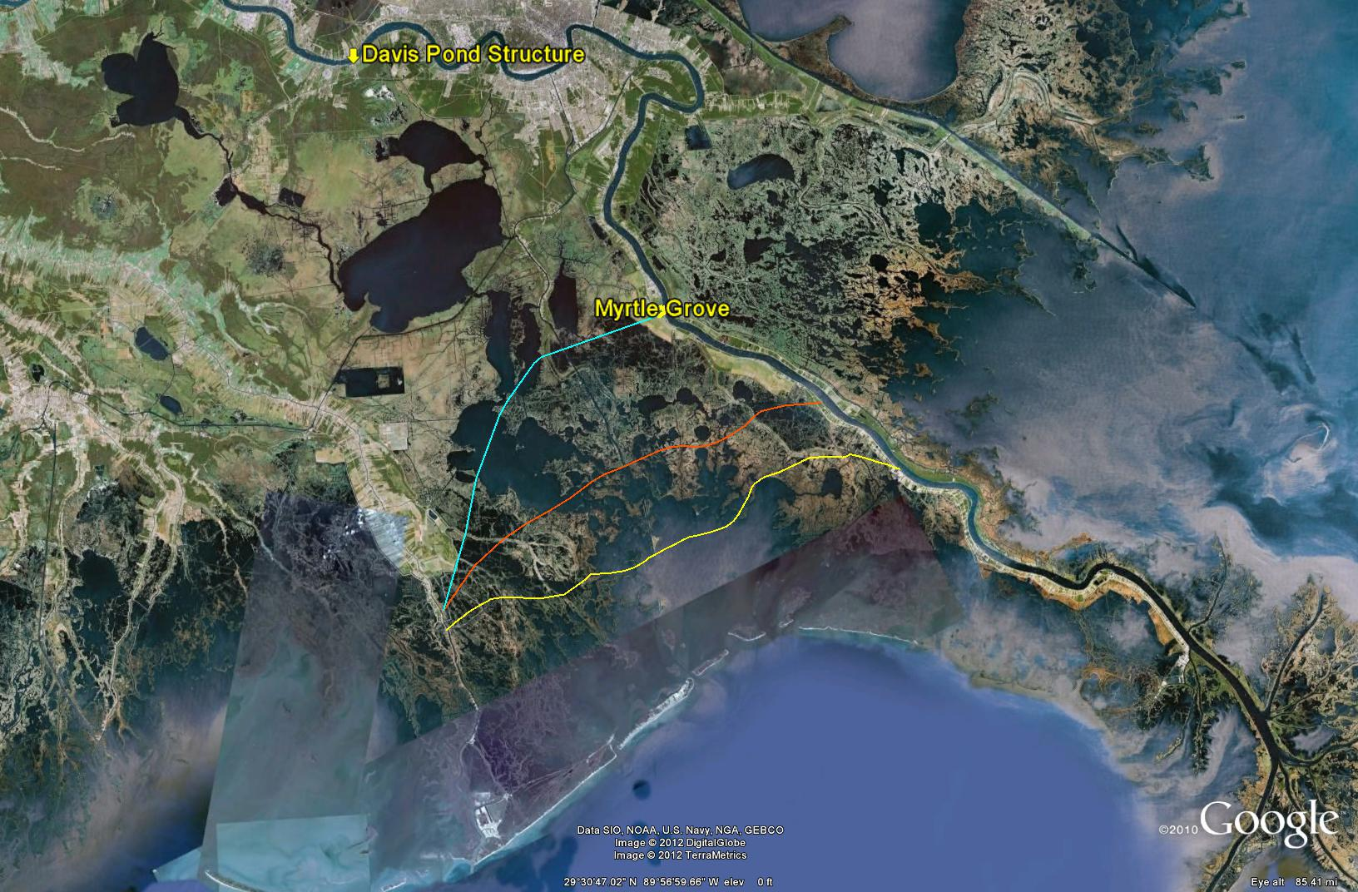
Pre-MR&T 5 ppt
Existing MR&T 5 ppt
Proposed LCA 5 ppt

Slide 12
Where are we in the process?
Step 1 – Identifying problems and opportunities
Step 2 – Inventorying and forecasting conditions
Step 3 – Formulating alternative plans
Step 4 – Evaluating alternative plans
Step 5 – Comparing alternative plans
Step 6 – Selecting a plan

Slide 13
2 Plans under Consideration for Recommendation
Alt 18 – River-stage Dependent
  Allow Mississippi River and marsh head differential to drive discharge
  Alt 42a - Maximize sediment load w/ time constraint (Jan-Apr)
    Window of opportunity Jan-April
    Target 162mg/L TSS to begin pulse
    Discharge at available capacity when TSS is at or above 162mg/L
    Remainder of time maintain new 5ppt

Slide 14
2 Plans under Consideration for Recommendation
Alternative 18
  Produces most benefits of other alternatives (measured in AAHUs)
  Does not spatially identify a salinity threshold (i.e., 5 ppt line) → more operational flexibility¹
  Supported by NGOs ²
  ¹ May 2012 USFWS Planning Aid Letter
  ² June 2012 letter from RorR, NWF, CRCL, EDF, Audubon LA
Alternative 42a
Provides 87% of Alt 18’s net reduction in wetland loss (50-year period of analysis)
Provides 68% of projected benefits of Alt 18 (50-year period of analysis)
Proposed 5-ppt line provides “predictability”
Long-term → modify operation to complement Myrtle Grove
Supported by fisheries agencies
Notes:
Near-term → Alternative 42a
Pre-Myrtle Grove – achieves same wetland acreage benefits as maximum operation
Provides “predictability” for fisheries
Provides 87% of max operation (Alt 18) net reduction in wetland loss over 50-year period of analysis
Provides 68% of projected AAHUs over 50-year period of analysis
Long-term (i.e., Myrtle Grove on-line) → Flexibility
Davis Pond salinity threshold not impede Myrtle Grove’s alternatives development/analysis
Future operation scheme for Davis Pond evaluated that complements recommended Myrtle Grove operation

Slide 15
Principles and Guidelines (P&G)
Screening Criteria
Completeness Does the plan include all the necessary parts and actions to produce the desired results?
Effectiveness Does the plan meet the objectives to some degree? How does it stack up against constraints?
Efficiency Does the plan minimize costs? Is it cost effective? Does it provide net benefits?
Acceptability Is the plan acceptable and compatible with laws and policies?
Source - IWR Report 97-R-15

Slide 16
Other Considerations
Environmental effects (adverse and beneficial)
  Fish and wildlife habitat
  EFH
  T&E
  Water quality
Social effects (adverse and beneficial)
  Commercial fishing
  Recreational fishing
  Cultural integrity w/in communities
  EJ concerns
Retain Davis Pond’s relevance post-Myrtle Grove
Avoid unintended consequences
  Environmental (water quality degradation - WQS, reduced biodiversity)
  Operational (introduce adequate flexibility in operation while maintaining acceptable balance in ecosystem)

Slide 17
Next Steps
Identify a consensus plan for recommendation
Signed Chief’s Report by Nov 2013

Slide 18
Questions?
For additional information
Danny Wiegand
(504) 862-1373
danny.l.wiegand@usace.army.mil

Slide 19
Attachments

Slide 20
Davis Pond Structure
535 feet long x 85 feet wide inflow channel
11,000 feet long x 120 feet wide outflow channel to the ponding area
4 iron gated 14 foot square box culverts
Total project area 10,084 acres including 9,300 acre ponding area
Structure is capable of 10,650 CFS

Slide 21
Final Array of Alternatives
FWOP Condition - No Action
Alt 39 - Maintain new 5ppt Isohaline
  Operate to maintain 5ppt isohaline
  Use current operational plan and monthly target ranges for salinity
  Alt 42a - Maximize sediment load w/ time constraint (Jan-Apr)
    Window of opportunity Jan-April
    Target 162mg/L TSS to begin pulse
    Discharge at available capacity when TSS is at or above 162mg/L
    Remainder of time maintain new 5ppt
Alt 42b - Same as 42a except remainder of year operate to maintain existing 5ppt line
  Alt 41 - Maximize sediment load and maximize footprint
    Target 162mg/L TSS to begin pulse
    Pulse until maximum footprint is reached - Continue to pulse if TSS is at or above 162mg/L
    Remainder of time, maintain new 5ppt but allowing discharge of available capacity if TSS is at or above 162mg/L
Alt 17 - Major Flow Event (1-3 years) – Emphasis on capturing maximum suspended solids from the river.
  Year One: Alternative 41
  Years Two – Three: Alternative 42a
Alt 40 - Major Flow Event (1-5 years) – Emphasis on capturing maximum suspended solids from the river.
  Year One: Alternative 41
  Years Two – Five: Alternative 42a
Alt 18 – River-stage Dependent
  Allow Mississippi River and marsh head differential to drive discharge

Slide 22
SAND Outputs

Slide 23
WVA Results (Year 50)
Alt | Habitat (AAHUs¹) |  |  |  |  |  | TY 50 Wetland Acreage Benefits (Net Acres)
 | Swamp | Fresh | Intermediate | Brackish | Saline | TOTAL (AAHU)
18 | 0 | 3,418 | 2,964 | 618 | 17 | 7,016 | 6,338
41 | 0 | 3,408 | 2,639 | 595 | 15 | 6,658 | 6,121
17 | 0 | 3,300 | 2,233 | 366 | 13 | 5,912 | 5,689
40 | 0 | 3,289 | 1,779 | 261 | 13 | 5,342 | 5,593
42a | 0 | 3,216 | 1,382 | 134 | 13 | 4,745 | 5,504
39 | 0 | 3,162 | 987 | 134 | 12 | 4,295 | 5,419
42b | 0 | 2,469 | 508 | 128 | 0 | 3,106 | 2,138
¹ AAHU (Average Annual Habitat Unit) – Increased Habitat Quality

Slide 24
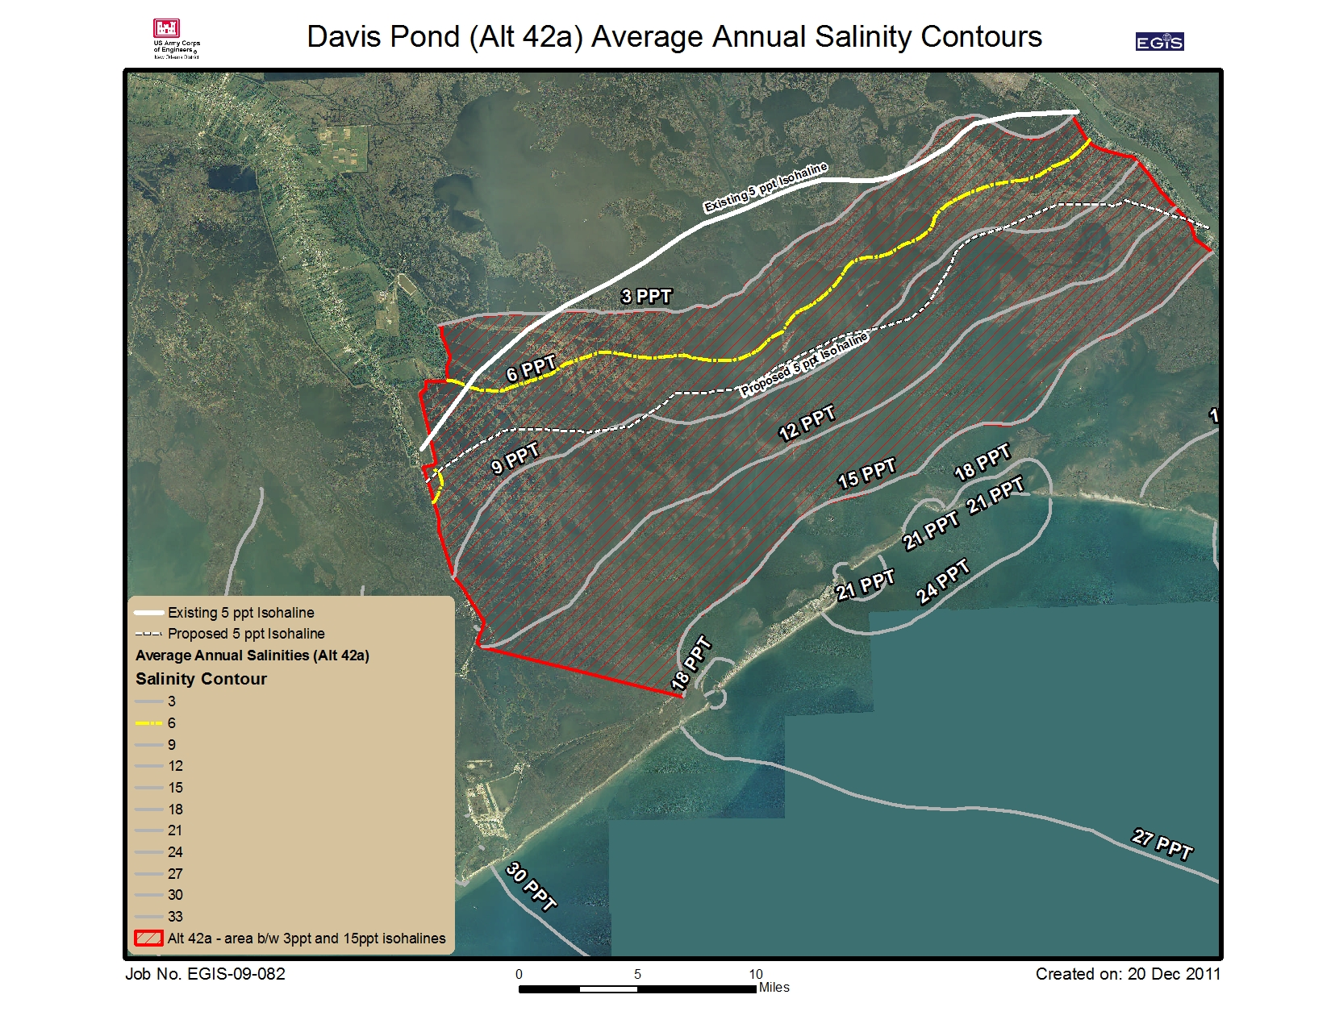
Red Hatched Area ≅ 250,000
Note: Acres are approximate
WVA AAHUs = 4,745

Slide 25
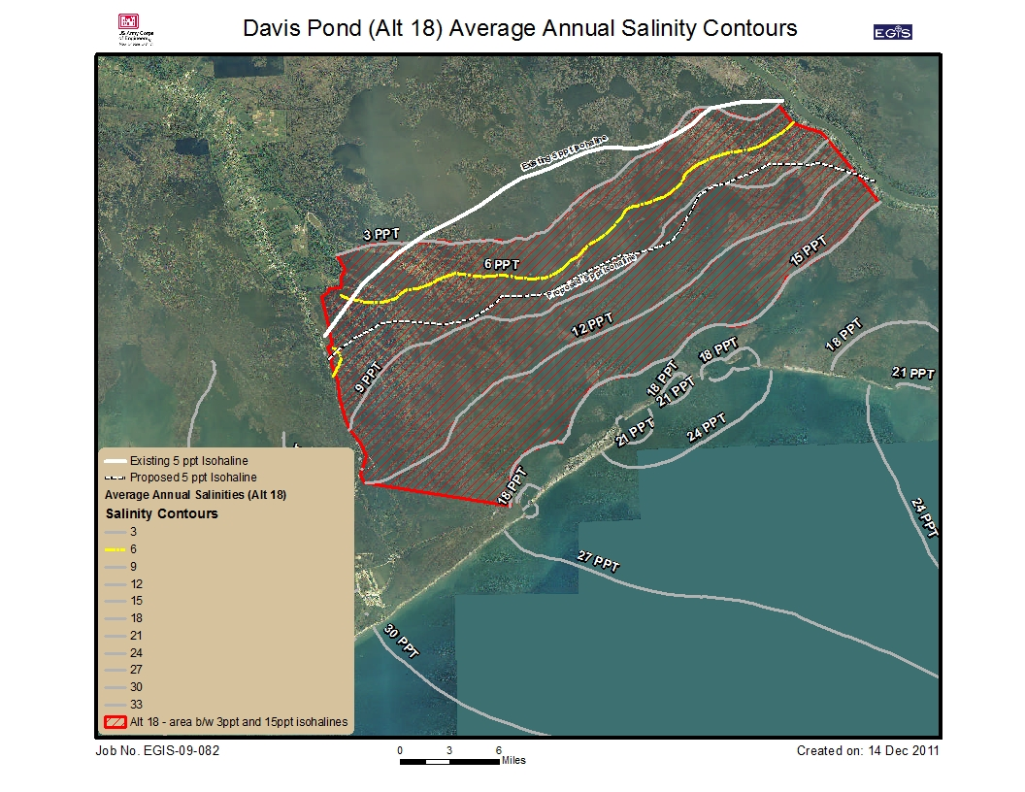
Red Hatched Area ≅ 257,000
Note: Acres are approximate
WVA AAHUs = 7,016

Slide 26
Proposed NER
Proposed NER Plan → Alternative 42a
  Meets goal and objectives
  Consistent with the Federal Objective (i.e., in accordance with national environmental statutes, applicable executive orders, and other Federal planning requirements)

Slide 27
Milestone Schedule
Activity | Start | Finish
Tentatively Selected Plan |  | 13 Apr 12
Agency Technical Review (ATR) | 4 June 12 | 13 Jul 12
Respond to ATR Comments | 16 Jun 12 | 27 Jun 12
Vertical Team Review | 30 Jun 12 | 13 Sep 12
Alternative Formulation Briefing (AFB) | 17 Sep 12 | 17 Sep 12
Public & Independent External Peer Review | 20 Oct 12 | 7 Jan 13
Mississippi River Commission Prep/Briefing | 19 Feb 13 | 6 Mar 13
Civil Works Review Board | 3 Jun 13 | 3 Jun 13
Final S&A/NEPA Review/Comment Response | 24 Jun 13 | 20 Aug 13
Sign Chief’s Report | 1 Nov 13 | 1 Nov 13

