Slide 1
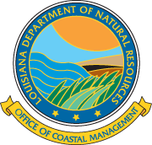
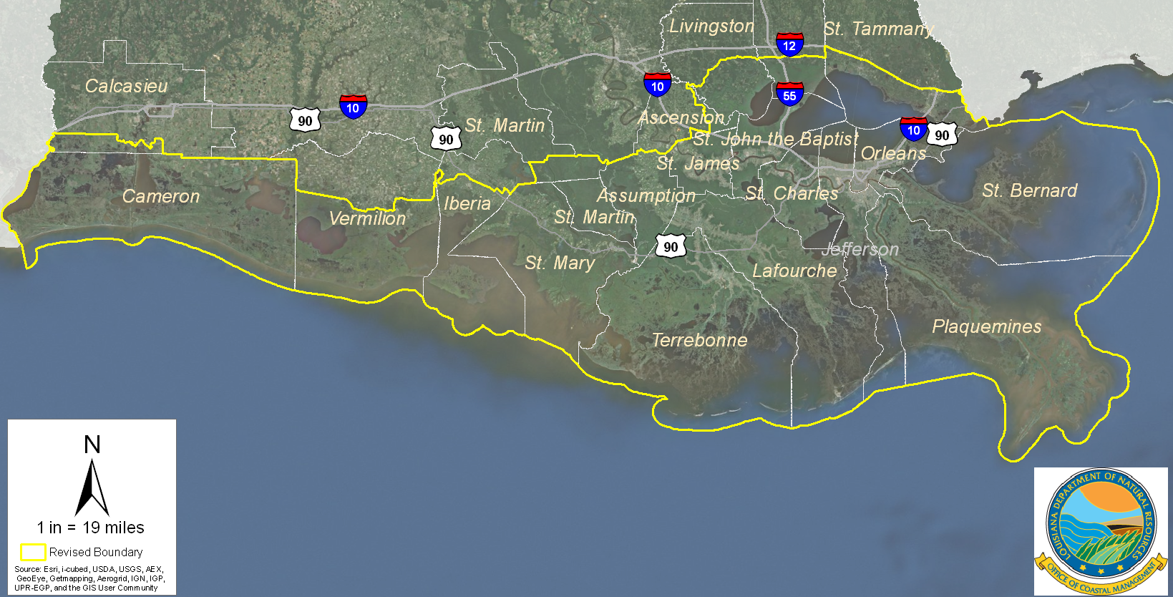
Changes to Louisiana’s Coastal Zone Boundary

Slide 2
Presentation Focus
Louisiana Coastal Zone Boundary Changes
Why was the coastal zone boundary changed?
What does Act 588 require?
What are the benefits of those changes?
What are the permitting requirements?
What is the DNR Office of Coastal Management (OCM) doing to implement those changes?

Slide 3
Why Was the Coastal Zone Boundary Changed?

Slide 4
History
Louisiana’s initial Coastal Zone Boundary was established in 1978
Amended in 1979 and 1980 to include additional areas
Senate Concurrent Resolution 60 of the 2009 Legislative Session directed CPRA to perform a science-based evaluation of the Coastal Zone inland boundary
Study was performed by DNR’s Office of Coastal Management from July 2009 through May 2011 with input of numerous stakeholders
Report was presented to CPRA in May 2011
CPRA passed a resolution in May 2011 accepting the report
Report was provided to Louisiana Legislature June 17, 2011
CRPA requested Legislature to consider statutory changes for implementation of the report’s recommendations at the earliest possible time
Per Act 956 of 2010 and CPRA May 2011 resolution, a portion of Ascension Parish was included in the La. Coastal Zone

Slide 5
Concerns with Previous Boundary
Coastline had changed significantly since the initial boundary was established
Inconsistent with boundaries of other coastal related programs in Louisiana (CWPPRA, State’s Coastal Master Plan, BTNEP, etc.)
Some coastal wetlands were not included

Slide 6
Science Study Summary
Science-based boundary incorporates environmental changes that have taken place since initial boundary was established in 1978
The study used information on storm surge, geology, elevation, soil type, vegetation, predicted subsidence/sea level rise, and boundaries of existing coastal programs to identify areas with a high level of coastal influence
New coastal zone boundary incorporates a net increase of 1887 square miles (12.6% increase)

Slide 7
What Does Act 588 Require?

Slide 8
Provisions of Act 588
Act became effective upon signature of the Governor (June 7, 2012)
Modifies inland boundary of Coastal Zone (12.6% increase in coastal area)
New boundary follows recommendations of the science-based evaluation report accepted by the CPRA and provided to Legislature in 2011

Slide 9
Provisions of Act 588 (cont’d)
Requires an electronic version of new boundary map to be available on the OCM website for viewing/download
Requires DNR Secretary to maintain map(s) depicting areas in coastal zone determined by the Secretary to be a fastland or above the 5-foot contour
Those maps shall be readily accessible to the public for their comparison to proposed project footprints, to help them make their own determination as to whether their activity is exempt (goal is to reduce the number of unnecessary permit applications).

Slide 10
Provisions of Act 588 (cont’d)
Act 588 did not establish or require any new regulations or exemptions.
The same coastal use permit regulations and exemptions that existed prior to Act 588 now apply to those areas that were added to the Louisiana coastal zone by Act 588.

Slide 11
New Coastal Zone Boundary

Slide 12
Summary of Boundary Changes
CZ area increased in Cameron, Calcasieu, Iberia, St. Martin, St. Mary, Terrebonne, Lafourche, and Assumption parishes
CZ area was reduced in Tangipahoa and Livingston parishes
CZ area remains the same in Vermilion, St. John, St. James, St. Charles, Jefferson, Plaquemines, Orleans, St. Bernard, St. Tammany, and Ascension parishes
No additional parishes incorporated

Slide 13
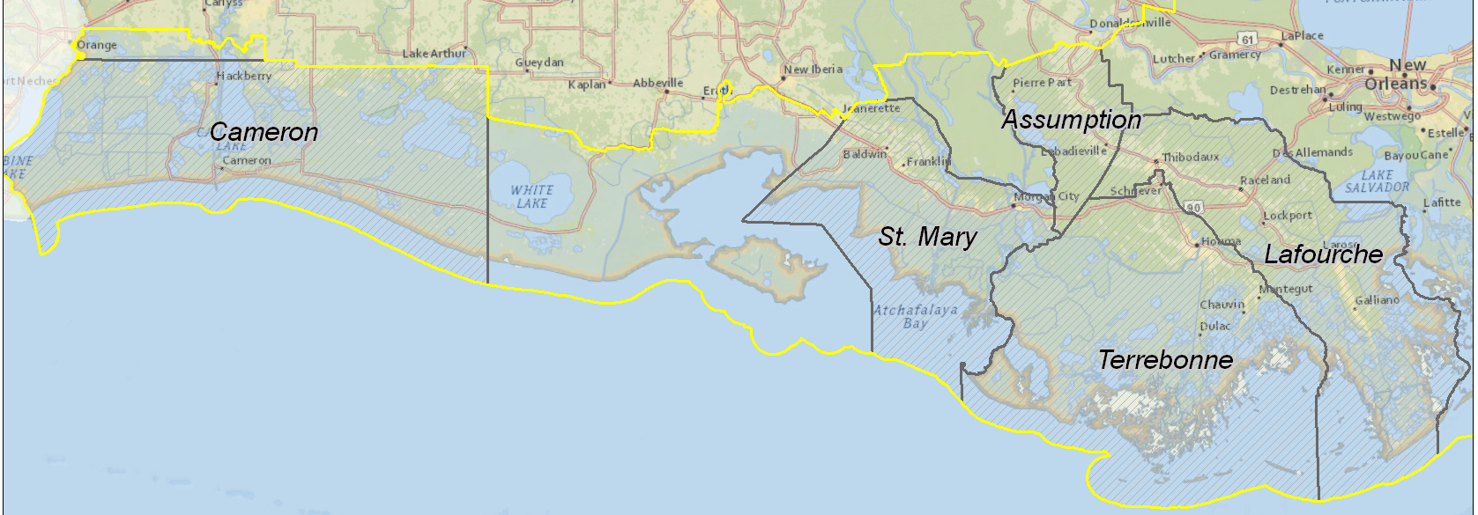
Five Parishes Were Partially Included Now Entirely Included
Terrebonne
Lafourche
St. Mary
Assumption
Cameron

Slide 14
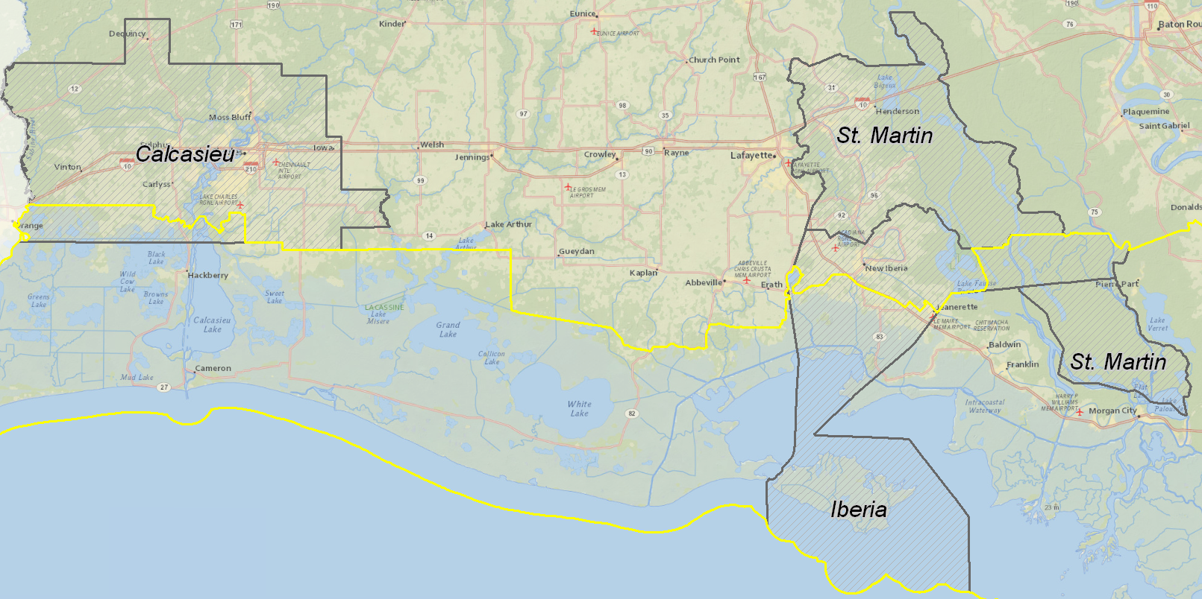
Three Parishes with Increased Coastal Area – Entire Parish Not Included
Calcasieu
Iberia
St. Martin

Slide 15
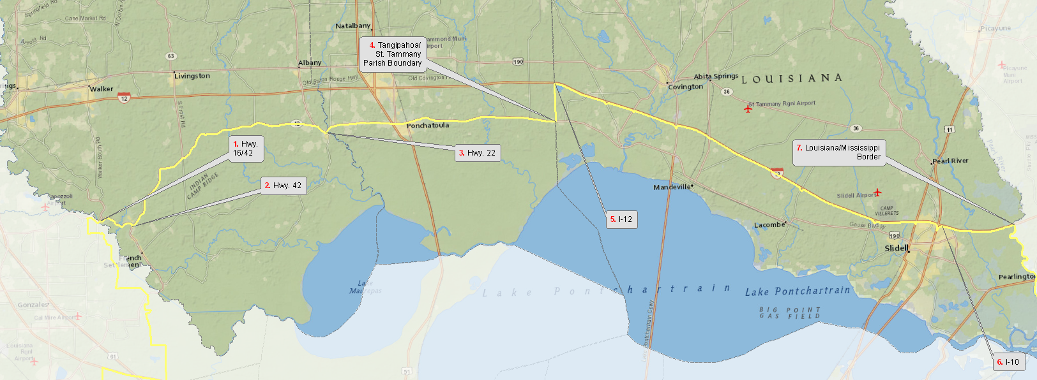
Parishes with Decreased Coastal Area
Livingston
Tangipahoa
No longer I-12
Moves down to Hwy 16, Hwy 42, and Hwy 22

Slide 16
What are the Benefits of Act 588?

Slide 17
Boundary Change Benefits: Coastal Zone Management
Ensures consistency with the State’s Coastal Master Plan
Provides State management of coastal resources in newly added areas (coastal management is one of cornerstones of State’s coastal protection and restoration efforts)
Reduces wetland impacts and coastal hazards
Requires Federal activities within the newly added areas to obtain a state consistency determination
Reduces processing time for many wetland permits in new CZ areas thru Corps’ use of programmatic general permits
Demonstrates, to the Nation, Louisiana’s strong commitment to coastal sustainability, thereby improving chances for federal funding

Slide 18
Permit Processing
PGP vs. Non PGP
LDNR-OCM
01/07/2011
AnaY

Slide 19
PGP Benefits
Over 60% of all permits issued by OCM in La. coastal zone are eligible for PGP approval
PGP greatly expedites Corps of Engineers approval for many projects in the La. coastal zone
O&G projects affecting up to 3.5 acres of wetlands are eligible (most O&G permits in CZ boundary are eligible)
PGP eligibility for other projects is up to 3 acres of impacts to non-tidal wetlands and up to 2 acres of impacts to tidal wetlands
OCM does all of the processing and evaluation of the applications
Allows Corps to approve PGP-eligible projects much faster
19

Slide 20
Coastal Use Permitting

Slide 21
Permitting Requirements in Areas Added to Coastal Zone
Existing coastal use permitting regulations also apply to those areas added to the coastal zone by Act 588, which is became effective June 7, 2012.
Any project in the area added to the coastal zone by Act 588, that had not obtained all necessary state authorizations prior to June 7, 2012, and is not exempt from permitting, will be within the regulatory jurisdiction of OCM and thus require review and permitting by the OCM.
OCM and Local Coastal Program offices are available to assist potential applicants in determining if their proposed project requires a permit, and to assist them with applications when necessary.

Slide 22
OCM’s Regulatory Role
Balance Development and Conservation
Balance Multiple Uses and Limited Coastal Resources
22

Slide 23
Activities Requiring Permits
Oil and Gas Activities – well sites, pipelines, production facilities, gas storage facilities (~60% of all applications)
Commercial Activities – big box stores, boat docks, marinas, subdivisions
Municipal Activities – utilities, roads, drainage, levees
Industrial Activities – refineries, steel mills, coal storage facilities, grain facilities
Other Activities – bulkheads, wharves, boat slips, trenasse clean-out

Slide 24
Exempt Activities
Fastlands (areas completely contained by levees and drained by pump)
Areas above the 5-foot contour
Existing agricultural, forestry and aquaculture activities
Normal maintenance and repair of existing structures
Private camps and residences
Activities which do not have a direct and significant impact on coastal waters

Slide 25
Joint Permit Application
25

Slide 26
Online Permitting
Allows for online completion, submission and modification of Joint Permit Application
Allows for electronic distribution, online commenting and real-time notification of comments
Allows for online payment of fees
Allows for online tracking of applications with real time status updates
26

Slide 27
OCM Objectives
AVOID
Can adverse impacts to coastal resources be avoided by relocating or redesigning project?
MINIMIZE
Can adverse impacts to coastal resources be minimized by utilizing less damaging construction techniques?
27

Slide 28
Mitigation
Compensatory mitigation is legislatively required replacement, substitution, enhancement or protection of ecological values to offset anticipated losses of ecological values caused by a permitted activity
28

Slide 29
Pre-application Meetings
OCM encourages pre-application meetings to discuss projects early in the planning stages. Agencies can offer input on information requirements and alternatives before the applicant spends potentially large amounts of time and money.
Application processing time can be dramatically reduced by incorporating agency suggestions offered during pre-application meetings.
To schedule a pre-application meeting, please call at 225-342-7591 or send an email to OCMinfo@la.gov
29

Slide 30
What Has Been Done to Implement Act 588?

Slide 31
Implementing Act 588
Hosted meetings to inform parish officials and stakeholders on boundary changes and related permitting. Meetings held in Thibodaux, Houma, Patterson and Lake Charles (June & July)
Made OCM permit/mitigation supervisors, senior staff, and field staff available to assist those who may not be familiar with the permitting process
Established a help desk at CPRA’s Thibodaux office to provide assistance to potential applicants in local area
OCM worked with Corps of Engineers to ensure that areas added to the coastal zone are covered by the Programmatic General Permit and joint application process for coastal areas
OCM helped Local Coastal Programs to update their program documents (Lafourche, Terrebonne, Calcasieu, Cameron)

Slide 32
Implementing Act 588
Maps of new Coastal Zone boundaries are now available on DNR-OCM website for viewing/downloading
Hardcopy maps of new Coastal Zone are projected to be available in a few months

Slide 33
Implementing Act 588
OCM is providing GIS datasets showing areas currently determined to be fastlands and areas above 5-foot contour, to help the public determine where activities are likely exempt from coastal use permit requirements.
That information is available via DNR’s web site www.SONRIS.com under the GIS link (new).
OCM personnel continue to review GIS datasets and conduct field inspections to determine which areas in coastal zone meet the definition of a fastland. Datasets will be updated as more fastland determinations are made.
To compensate for possible elevation errors, OCM is only depicting those areas shown to be at least above 7 feet, to provide a conservative margin of error.

Slide 34
Web Links
Department of Natural Resources
http://dnr.louisiana.gov/
Coastal Zone Boundary
http://dnr.louisiana.gov/index.cfm?md=newsroom&tmp=detail&aid=942
SONRIS
http://sonris.com/
Office of Coastal Management Coastal Use Permit Search
http://sonris-www.dnr.state.la.us/sonris/cmdPermit.jsp?sid=PROD
Office of Coastal Management Joint Application
http://sonris.com/redirect.asp?linkid=1
SONRIS Interactive Maps
http://sonris-www.dnr.state.la.us/gis/agsweb/IE/JSViewer/index.html?TemplateID=181

Slide 35
Contact Information
Office of Coastal Management
Hours Monday – Friday 8:00 am-4:30 pm
(800) 267-4019
(225) 342-7591
Fax: (225) 342-9439
Mail Address: P.O. Box 44487, Baton Rouge, La 70804-4487
Physical Address: 617 North Third St., Baton Rouge, LA 70802
For Coastal Zone Boundary Questions
CZB@LA.GOV
For Permit and all other Questions
OCMINFO@LA.GOV

Slide 36
THE BIG PICTURE: Long Term Outcome Vision
Sustainable Coastal Communities
Sustainable Commerce and Industry
Sustainable Fisheries Production
Sustainable Coastal Ecology
Sustainable Employment Opportunities
Sustainable Coastal Louisiana Culture

Slide 37
Questions?

